Slide 1
A Framework of Applying Process Mining for Fraud Scheme Detection
Tiffany Chiu, Yunsen Wang and Miklos Vasarhelyi
Rutgers 18th Fraud Seminar, December 7th

Slide 2
Introduction
This paper aims at providing a framework on how process mining can be applied to identify fraud schemes and assessing the riskiness of business processes.
Specifically, the proposed framework captures how the patterns in process mining can be used to detect potentially fraudulent transactions.
This paper contributes to the existing literature by associating notable variants/activities with potential fraud schemes and then assigning risk levels, which could be used as an automatic tool to test the fraud risk of every transaction.

Slide 3
Literature Review
The idea of mining business processes was first proposed by Agrawal et al. (1998) where they developed an approach to identify business processes occurred in the system by evaluating existing logs.
Cook and Wolf (1998) proposed the term - process discovery, and introduced a technique that develops process models by capturing current business processes.
A large body of academic research analyzed business processes using event logs and proposed either new types of process mining techniques or a case study to evaluate or improve these techniques.
Bozkaya et al. (2009) proposed a process diagnostics method using process mining to help organizations understand three perspectives, namely: “how the process model actually looks like,” “how well does the system perform,” and “who is involved in the process and how.”
Rozinat and van der Aalst (2008) proposed a novel conformance checking approach to examine the differences between the observed business process and the designed process model.
Notes:
According to Fahland and van der Aalst (2015), process discovery and conformance checking are the two major analyses of process mining. Process discovery aims at constructing process models that describe event log behaviors while conformance checking compares the designed process models with real-life logs (Fahland and van der Aalst 2015). For example, Gunther and van der Aalst (2007) proposed a process discovery technique called fuzzy mining. They used the concept of roadmap to show how process model can be designed based on significance and correlation. The proposed techinque could add value to capturing “spaghetti-like” real-life business processes. Rozinat and van der Aalst (2008) proposed a novel conformance checking approach to examine the differences between the observed business process and the designed process model.

Slide 4
Literature Review
Financial Statements Fraud and Fraud Type
Accounting research on financial statement fraud and Accounting and Auditing Enforcement Releases (AAERs) includes testing hypotheses grounded in the literature of earnings management (Summers and Sweeney, 1998; Beneish, 1999; Sharma, 2004) and corporate governance (e.g., Beasley, 1996).
Numerous measures for earnings management are created to indicate the risk of financial misstatement and fraud, such as earnings persistence (e.g., Richardson et al., 2005), abnormal accruals and accruals models (e.g., Jones, 1991; Dechow et al., 1995; Dechow and Dichev, 2002; Kothari et al., 2005), and earnings smoothness (e.g., McInnis, 2010).
To evaluate the predictive power of the extent accrual-based earnings management measures to detect financial statement fraud, Jones et al. (2008) conducted an empirical analysis comparing ten measures (e.g., discretionary accruals, accrual quality) derived from popular accrual models and found that only the accrual estimation errors (Dechow and Dichev, 2002) and their modifications have the ability to predict fraud and non-fraudulent restatements of earnings.
Notes:
For example, the alpha process mining algorithm can automatically extract a Petri net that concisely models behavior in the event log; in this case, the auditors can have an unbiased view of what has actually happened in the company.
The reason is that event logs may represent that all events have been continuously monitored by auditors for anomalies and subject to tests of analytical procedures.
Yang and Hwang → detecting health insurance fraud
The processing of health insurance claims involves three parties: service providers, insurance subscribers, and insurance carriers.

Slide 5
Fraud Types and Fraud Category
Total Fraud Sample: 470 fraud firm-year observations (1994-2016)
Fraud Types and Fraud Category
Fraud Category | Frequency | Percentage
Revenue recognition issues | 174 | 37.02%
Foreign, related party, affiliated, or subsidiary issues | 150 | 31.91%
Liabilities, payables, reserves and accrual estimate failures | 114 | 24.26%
Accounts/loans receivable, investments & cash issues | 107 | 22.77%
Inventory, vendor and/or cost of sales issues | 107 | 22.77%
Notes:
1994-2016
- Accrual manipulation: depreciation / LIFO FIFO
- Revenue recognition
1) Side agreements (modify sales terms or contracts) → wants to recognize revenue before sales complete
2) Channel stuffing send a lot more inventory to its customer than demanded (usually happens in the end of accounting period)

Slide 6
Standard Order-to-Cash and Procure-to-Pay Business Processes

Slide 7
Applying Process Mining for Corporate Fraud Detection
To detect corporate fraud using process mining, it is necessary to understand the standard business process for accounting cycles.
“Order-to-cash” cycle: Order Created -> Goods Issue -> Invoice Created -> Invoice Posted -> Payment Received -> Invoice Cleared
“Procure-to-pay” cycle: Create Purchase Order -> Sign -> Release -> Goods Receipt -> Invoice Receipt -> Payment.
Based on the corporate fraud schemes and the activities and variants in the event logs of an ERP system, this study identifies suspicious patterns or activities for each fraud scheme and assigns the risk levels.

Slide 8
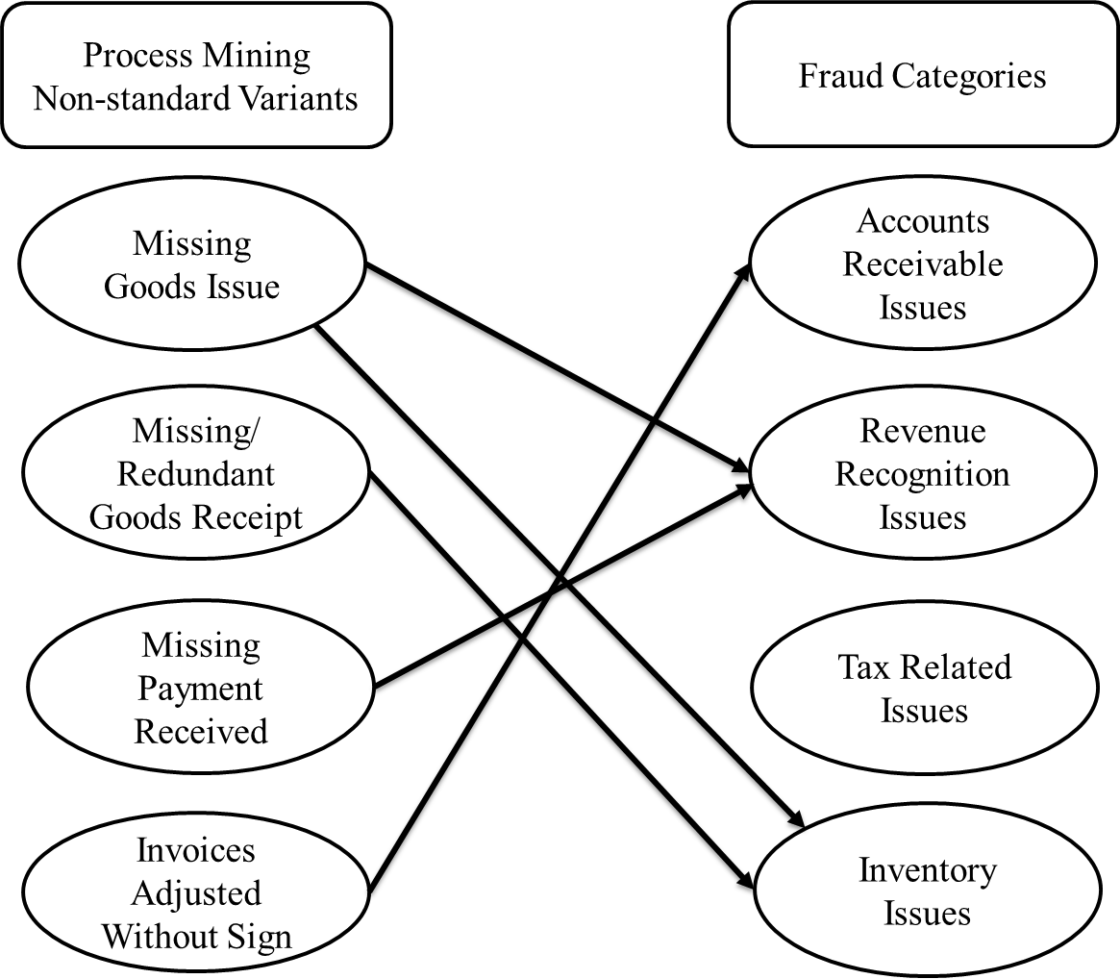
Mapping Notable Variants into Financial Statement Fraud Categories
Refresh Receivables
Bill-and-Hold
Off-site or Fictitious Inventory
Notes:
The items on the left are notable variants in process mining (e.g., Missing Goods Issue, Missing/Redundant Goods Receipt, Missing Payment Received and Invoices Adjusted without Sign) and items on the right are fraud categories (e.g., Accounts Receivable Issue, Revenue Recognition Issue, Tax Related Issues and Inventory Issue).
For example, if one finds an incomplete sales order that does not have “goods issue” or “payment received” activities, there is a risk that this order/transaction could turn out to be fictitious or involve in a “bill-and-hold” fraud scheme, which will ultimately result in revenue recognition issue. Therefore, the “Missing Goods Issue” and “Missing Payment Received” bubbles are linked to the “Revenue Recognition Issue” bubble on the right.
If the “Invoice Adjusted” activities frequently occur in sales orders without appropriate approval process, it could represent high risks that accounts receivable are manipulated or a “refresh receivables” fraud is perpetrated, which will ultimately result in accounts receivable issue. Therefore, the “Invoices Adjusted Without Sign” bubble is linked to the “Accounts Receivable Issue” bubble on the right.
If a purchase order does not have “goods receipt” or has too many redundant “goods receipt” activities in the procure-to-pay cycle, then the risk of having inventory related fraud is high. Therefore, the “Missing/Redundant Goods Receipt” bubble is linked to the “Inventory Issue” bubble on the right.
“Refreshed” Receivables - In order to mask rising account receivable balances (including known or suspected uncollectible balances) while avoiding increasing the bad debt provision, a company may “refresh” the aging of receivables and improperly represent A/R balances as being current in nature instead of showing the true age of the receivables.

Slide 9
Accounting Fraud Schemes and Suspicious Process Patterns
Accounting Cycle | Fraud Scheme | Non-standard Variant/Activity | Suspicion Pattern Example | Risk Level
Order-to-Cash | Altering Documentation | Order Adjusted: Goods Issue Date Invoice Adjusted | Frequent occurrence of order adjusted and/or invoice adjusted activities without approval process during the fiscal year-end period. | High
Order-to-Cash | Bill and Hold | Goods Issue Payment Received | Missing goods issue and/or payment received. | High
Order-to-Cash | Channel Stuffing | Order Adjusted: Order Return Invoice Adjusted: Invoice Credit Note | Frequent occurrence of order return or invoice credit note immediately after fiscal year end without an approval process. | High
Order-to-Cash | Failure to Record Sales Allowances | Payment Received | Missing payment received or incomplete payment | High
Order-to-Cash | Inflating the Value of Inventory | Order Adjusted: Net Price | Order adjusted without an approval process Putting in improper price comparing to the market value | High
Order-to-Cash | Promotional Allowance Manipulation | Invoice Adjusted: Cash Discount | Many Invoice Adjusted: Cash Discount activities are entered. | Medium
Order-to-Cash | Up-Front Fees | Payment Received Goods Issue Order Adjusted: Change Goods Issue Date | Payment received occurs before goods issue or invoice created. | Low
Procure-to-Pay | Off-site or Fictitious Inventory | Goods Receipt | Abnormal goods receipt records: missing goods receipt and/or have duplicate or more than one goods receipt in one purchase order | High
Others | Fraudulent Audit Confirmation | All Activities | Matching trading partners corresponding event logs | High/ Medium/ Low
Others | Refresh Receivables | Invoice Adjusted | Invoices adjusted occurs for many transactions without an approval process | High
Others | Bribery and Corruption | All Activities | Using resource information in event logs to identify a potential violation of segregation of duty controls | Medium
Notes:
A bill and hold transaction occurs when a company recognizes revenue before delivery takes place. Normally a revenue is not recognizable until goods are delivered or services are rendered.
Up front fees: unearned revenue (The upfront fee is generally a portion of the total fee that the buyer must pay. )
Sales allowance: return not require goods back (no payment)
Audit confirmation (confirm our log with other’s log)
Refresh receivables (refresh the date)
Sales allowance refers to reduction in the selling price when a customer agrees to accept a defective unit instead of returning it to the seller. It is normally recorded under the account "Sales Returns and Allowances". Contents: Definition of sales allowance. (contra revenue account)
Sales Returns and Allowances xx.xx
Accounts Receivable (or cash) xx.xx
- Promotional allowance manipulation → cash discount for items not allowed

Slide 10
An Example of Detecting Fraud Scheme Using Process Mining
Non-standard Variant for Channel Stuffing
When auditors perform analytical procedures on a client using process mining, they notice that a large number of process instances have activities “Order Adjusted: Order Return” and “Invoice Adjusted: Invoice Credit Note” during January. Then, the auditors perform substantive tests on these sales orders using the event log. If they find a large portion of the returned goods are associated with the sales orders created and processed by the same manager at the end of December, there could be a high risk that this manager has been involved in a “channel stuffing” fraud scheme.
Notes:
A bill and hold transaction occurs when a company recognizes revenue before delivery takes place. Normally a revenue is not recognizable until goods are delivered or services are rendered.
Up front fees: unearned revenue (The upfront fee is generally a portion of the total fee that the buyer must pay. )
Sales allowance: return not require goods back (no payment)
Audit confirmation (confirm our log with other’s log)
Refresh receivables (refresh the date)
Sales allowance refers to reduction in the selling price when a customer agrees to accept a defective unit instead of returning it to the seller. It is normally recorded under the account "Sales Returns and Allowances". Contents: Definition of sales allowance. (contra revenue account)
Sales Returns and Allowances xx.xx
Accounts Receivable (or cash) xx.xx
- Promotional allowance manipulation → cash discount for items not allowed

Slide 11
Conclusion
Process mining can be a powerful fraud detection tool when auditors include the potential fraudulent patterns in their fraud detection process.
Contribution: (1) this paper proposes a framework that links notable variants/activities in process mining with corresponding fraud schemes. (2) The proposed framework incorporates risk assessment mechanism that indicates the risk level of each fraud scheme and related notable activity.
Limitation: this study only includes notable variants/activities in two accounting cycles and several most commonly occurred fraud schemes.
Future research could extend the current framework by incorporating more fraud schemes and other accounting cycles when discussing how process mining can be used in fraud detection.

Slide 12
Thank you!

