Slide 1







Automated Invoice Analysis for Auditing and Accounting: A QR-Code-Driven Approach
Guilherme S. C. A. Fernandes
Rui Francisco P. M. L. da Cruz
70th WCARS – World Continuous Auditing and Reporting Symposium
21/05/2026
Notes:
Hello everyone.
My name is Guilherme Fernandes, and today I will present my research titled “Automated Invoice Analysis for Auditing and Accounting: A QR-Code-Driven Approach”, which I am currently developing as part of my master’s thesis at ISCTE Business School.
This work focuses on how mandatory fiscal QR codes can support automated invoice processing, structured accounting analysis, and audit-oriented workflows through a locally processed architecture.

Slide 2

AGENDA
01 |  | Context: The Invoice Processing Challenge | 05 |  | Methodology & Dataset
02 |  | The Core Problem & Objectives | 06 |  | Preliminary Results & Evaluation
03 |  | Literature Gap | 07 |  | Contributions & Limitations
04 |  | The Key Insight: Fiscal QR Code | 08 |  | Conclusion & Future Directions
Notes:
This is the structure of my presentation.
I will begin by introducing the invoice-processing challenge and the core problem addressed by this research.
Then, I will discuss the literature gap and explain the key insight behind the project - the use of Portuguese fiscal QR codes.
After that, I will present the methodology, dataset, and system architecture, followed by preliminary results and evaluation criteria.
Finally, I will conclude with the main contributions, limitations, and future research directions.

Slide 3

Context: The Invoice Processing Challenge
01

Slide 4


CONTEXT: THE INVOICE PROCESSING CHALLENGE
SCALE & COMPLEXITY
PERSISTENT OPERATIONAL PROBLEMS
  Rapid digitalisation has dramatically expanded accounting documentation volumes
  Invoices remain the primary evidentiary document in financial audits
  Heterogeneous formats: PDFs, scanned images, digital files
  Manual and semi-automated processing remains the norm
  High processing time and significant operational costs
  Human error degrades data reliability
  Limited traceability weakens audit evidence quality
2
Notes:
The increasing digitalisation of business processes has significantly expanded the amount of accounting documentation handled by organisations, especially invoices.
Invoices remain one of the main evidentiary documents used in accounting and auditing activities. However, despite advances in automation technologies, invoice processing is still frequently manual or only partially automated.
Organisations often receive invoices in heterogeneous formats such as PDFs, scanned images, or digital files, which creates operational complexity.
As a result, companies face several persistent problems:
high processing effort, operational costs, human error, and limited traceability of audit evidence.
These issues are particularly relevant in auditing contexts, where data reliability and document traceability are critical.

Slide 5
The Core Problem & Objectives
02

Slide 6
THE CORE PROBLEM & OBJECTIVES
FORMAT HETEROGENEITY
OBJECTIVES
Invoices arrive as PDFs, scanned images, and handwritten documents, each demanding distinct extraction techniques and validation pipelines.
Develop a local prototype for automated invoice analysis.
Extract structured accounting data from Portuguese fiscal QR codes.
Store invoice information in a local SQLite database.
Support audit-related analysis through SQL queries and optional AI assistance.
Evaluate feasibility, reliability, and practical applicability.
VALIDATION & INTEGRATION GAPS
Extracted data must be validated, reconciled, and integrated into accounting systems - a step often missing from current approaches, creating compliance risks.
MANUAL PROCESSING RISKS
Repetitive, labour-intensive tasks amplify susceptibility to human error, inflate costs, and undermine the reliability of audit evidence (Huang & Vasarhelyi, 2019).
Notes:
One of the main technical challenges is invoice heterogeneity.
Invoices arrive in multiple formats and structures, often requiring different extraction methods and validation workflows.
At the same time, manual processing introduces repetitive and labour-intensive tasks that increase the probability of human error and reduce the reliability of accounting information.
Another important issue is that many existing approaches focus only on extraction itself, without properly integrating validation, reconciliation, and structured storage into the accounting workflow.
For this reason, the main objective of this research is to develop a local prototype capable of automatically extracting structured invoice data from Portuguese fiscal QR codes and storing it in a local SQLite database.
The system also supports SQL-based audit analysis and optional AI-assisted analytical commentary.
Finally, the work aims to evaluate the feasibility, reliability, and practical applicability of this approach in audit-related contexts.

Slide 7
Literature Gap
03

Slide 8
LITERATURE GAP
WHAT THE LITERATURE SHOWS
Existing automation research in auditing demonstrates strong performance metrics, yet significant structural gaps remain:
~98%
~76%
EXTRACTION ACCURACY
PROCESS AUTOMATION
Reported in leading OCR/ML approaches
Achieved across semi-automated pipelines
CRITICAL GAPS IDENTIFIED
  Few studies focus specifically on invoice-centric automation for audit purposes
  Heavy reliance on complex OCR models and cloud-based ML services
  Absence of clear, reproducible end-to-end pipelines
  Elevated costs and data privacy concerns deter SME adoption (Perdana et al., 2023)
  Limited real-world applicability demonstrations
Notes:
Existing research in audit automation demonstrates promising results, particularly in OCR, machine learning, and robotic process automation approaches.
Some studies report very high extraction accuracy and significant levels of process automation.
However, several important gaps remain.
First, relatively few studies focus specifically on invoice-centric automation for auditing purposes.
Second, many solutions rely heavily on computationally intensive OCR pipelines, cloud-based machine learning services, and complex infrastructures.
This raises practical concerns related to cost, privacy, scalability, and SME adoption.
Additionally, the literature still lacks simple, reproducible, end-to-end pipelines with strong real-world applicability.
This gap motivated the development of the approach presented in this work.

Slide 9
The Key Insight: Fiscal QR Code
04

Slide 10
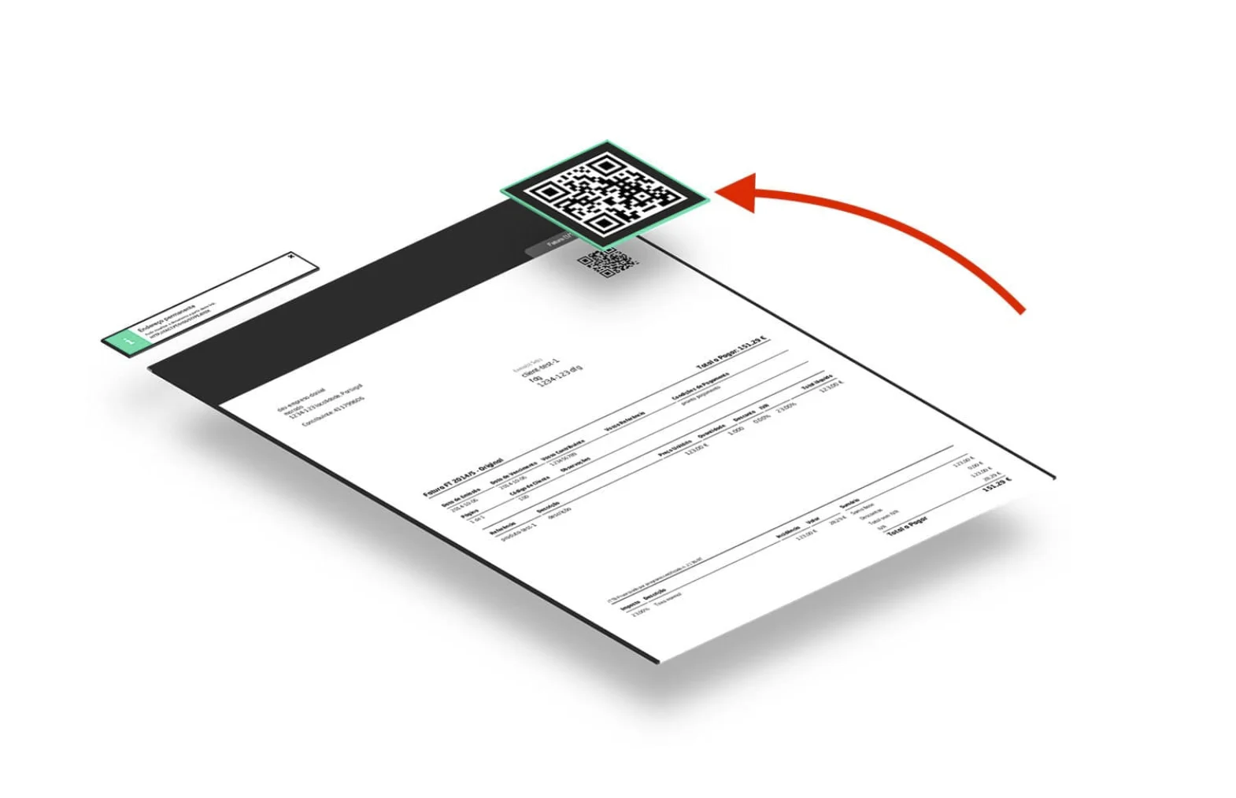
THE KEY INSIGHT: FISCAL QR CODES
In the Portuguese context, all invoices must legally include a mandatory fiscal QR code - a structured, machine-readable data source that eliminates the need for complex OCR pipelines entirely.
🔖 Tax Identification Number (TIN)
Taxpayer identification numbers for buyer and seller
💶 TOTAL & VAT(Value Added Tax)
Gross total and itemised VAT amounts
🧾 INVOICE NO.
Unique document identifier for traceability
📅 DATE
Transaction date for temporal audit trails
📝 TYPE & NUMBER OF THE DOCUMENT
Type of the document identifier and the number.
By decoding the QR code directly, the prototype achieves structured, reliable data extraction without computationally intensive models - ideal for privacy-sensitive, local deployments.
Notes:
The key insight behind this research is relatively simple.
In Portugal, invoices are legally required to include a mandatory fiscal QR code.
This QR code already contains highly structured accounting information in a machine-readable format.
Instead of relying entirely on OCR or advanced visual extraction models, the proposed approach directly decodes the QR code to retrieve key invoice fields.
These include:
taxpayer identification numbers, VAT amounts, invoice totals, invoice identifiers, dates, and document types.
This creates several advantages.
The extraction process becomes simpler, more structured, more reliable, and significantly less computationally intensive.
It is also particularly suitable for privacy-sensitive environments because the core extraction pipeline can operate fully locally.

Slide 11
Methodology & Dataset
05

Slide 12

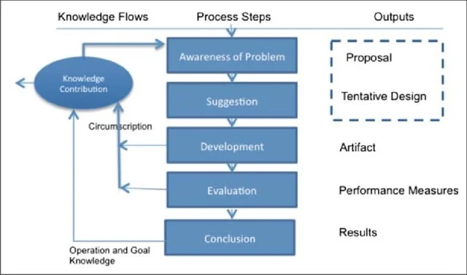
METHODOLOGY: DESIGN SCIENCE RESEARCH
RESEARCH METHODOLOGY
This study adopts the Design Science Research (DSR) methodology, which is oriented towards the creation and evaluation of IT artefacts - in this case, a functional prototype - within a real-world organisational context.
THREE RESEARCH PHASES
1
PROBLEM IDENTIFICATION
Review of literature; analysis of current invoice processing limitations
2
PROTOTYPE DEVELOPMENT
System architecture design, QR extraction scripting, database integration
3
EVALUATION
Testing with real invoice data; performance and usability assessment
Notes:
This research follows the Design Science Research methodology.
The objective is not only to analyse a problem theoretically, but also to design and evaluate a functional technological artefact.
The work was divided into three main phases.
First, problem identification and literature review.
Second, prototype development, including QR extraction scripts, automation workflows, and database integration.
Third, evaluation using real invoice data in order to assess usability, feasibility, and extraction reliability.
This methodology is particularly appropriate because the research is strongly practice-oriented and focuses on solving a concrete operational problem.

Slide 13
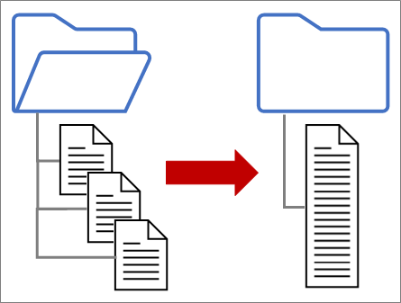
DATASET
DB - SQLite
PUBLIC DATASET
PRIVATE COMPANY DATA
  Public invoice dataset from Cruz (2021) - Fine-Tuning a Transformers-Based Model to Extract Relevant Fields from Invoices
  Real invoices provided by a Portuguese family business
All data processed locally, anonymised, and securely handled
Notes:
The prototype was developed using two main data sources.
The first source was a public invoice dataset created by Cruz in previous research related to invoice field extraction.
The second source consisted of real invoices provided by a Portuguese family business.
All invoice data was processed locally, anonymised, and securely handled throughout the experimentation process.
This combination of public and real-world data helped increase the practical relevance of the prototype.

Slide 14

SYSTEM ARCHITECTURE: END-TO-END PIPELINE
INVOICE FOLDER
POWER AUTOMATE
PYTHON QR
SQLITE DB
SQL QUERIES
The core extraction and storage pipeline is fully local, ensuring structured invoice processing and secure data handling. AI-assisted analysis can optionally be performed through external APIs for higher-level analytical support while maintaining compliance with data protection standards
Notes:
This slide presents the architecture of the proposed pipeline.
The process begins with a local invoice folder, where invoices are introduced into the system.
Power Automate detects new files and triggers the automation workflow.
Python scripts then decode the fiscal QR code and extract the structured invoice fields.
The extracted information is stored in a local SQLite database, enabling structured storage and traceability.
SQL queries and dashboard visualisation support audit-oriented analysis and accounting exploration.
Additionally, optional AI-assisted analysis can be performed through external APIs for higher-level analytical commentary.
Importantly, the core extraction and storage pipeline remains fully local.

Slide 15
Preliminary Results & Evaluation
06

Slide 16
PRELIMINARY RESULTS & EVALUATION
REDUCED PROCESSING TIME
The automated pipeline is designed to reduce invoice processing effort compared to manual and semi-automated workflows
RELIABLE QR-BASED EXTRACTION
Structured QR-code data supports reliable extraction of key invoice fields while reducing OCR-related misreads.
IMPROVED DATA ORGANISATION
Centralised SQLite storage enables structured querying, reconciliation, audit-trail generation, and improved query-based audit analysis
AI-ASSISTED AUDIT SUPPORT
AI-assisted analysis via ChatGPT API can generate contextual accounting commentary, supporting exploratory accounting and audit-related analysis.
Notes:
At this stage, the work is still under ongoing evaluation, so these should be interpreted as preliminary observations and evaluation criteria rather than final validated metrics.
Initial observations suggest that the automated pipeline may reduce invoice-processing effort compared with manual workflows.
The use of structured QR-code data also supports reliable field extraction while reducing common OCR-related misreads.
The SQLite-based structure improves organisation, traceability, and query-based audit analysis.
In addition, optional AI-assisted commentary may support exploratory accounting analysis and audit-related interpretation.
Future evaluation will focus on quantitative validation of extraction reliability, processing efficiency, and analytical usefulness.

Slide 17
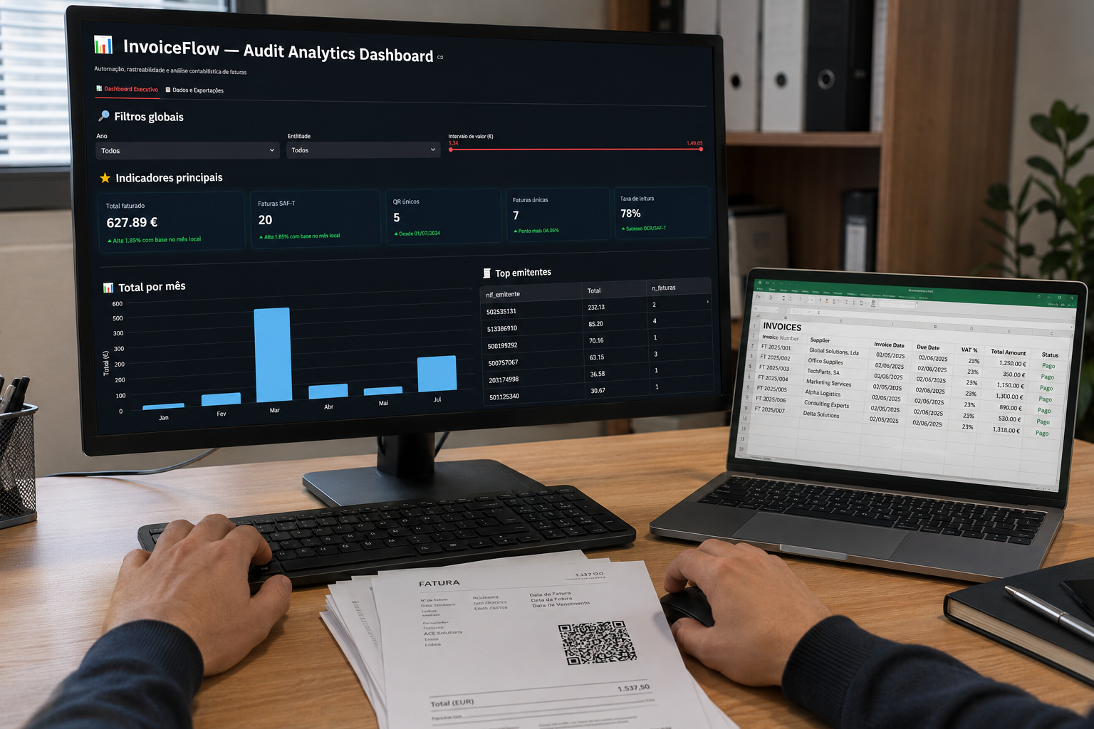
9
Notes:
Dashboard

Slide 18
Contributions & Limitations
07

Slide 19
CONTRIBUTIONS & LIMITATIONS
KEY CONTRIBUTIONS
ACKNOWLEDGED LIMITATIONS
INVOICE AUTOMATION FRAMEWORK
A practical, reproducible pipeline integrating QR extraction, SQL storage, and AI analysis for audit contexts
QR CODE AND API DEPENDENCY
The approach relies on mandatory fiscal QR codes, which are not universally adopted across all countries or jurisdictions. It also includes an optional dependency on external AI APIs for advanced analytical queries
PRIVACY-ORIENTED HYBRID ARCHITECTURE
Core invoice extraction, processing, and database storage are performed locally, reducing exposure of sensitive financial information while allowing optional AI-assisted analytical support
PROTOTYPE STAGE
The system was developed and tested as a research prototype; production deployment requires additional security hardening and scalability testing
INNOVATIVE QR CODE USE
Repurposes mandatory fiscal infrastructure as a structured extraction source - a novel contribution to audit automation literature
GEOGRAPHIC SCOPE
Validated primarily within the Portuguese fiscal context; generalisation to other QR-code regimes requires further empirical validation
EUROPEAN SCALABILITY POTENTIAL
The approach has scalability potential as several European countries are moving towards structured e-invoicing, fiscal verification systems and invoice QR-code mechanisms, including Portugal, Spain and Poland
Notes:
This work contributes to invoice automation literature in several ways.
First, it proposes a practical and reproducible audit-oriented automation framework integrating QR extraction, SQL storage, and AI-assisted analysis.
Second, it introduces a privacy-oriented hybrid architecture, where core processing remains local while optional AI support can be externally integrated.
Third, the work repurposes mandatory fiscal infrastructure - specifically fiscal QR codes - as a structured extraction source for auditing and accounting workflows.
Finally, the approach may have broader European applicability as several countries continue adopting structured e-invoicing and fiscal verification systems.
At the same time, some limitations must be acknowledged.
The system was primarily validated within the Portuguese fiscal context, so generalisation to other jurisdictions requires additional empirical validation.
Additionally, the prototype remains at a research stage and still requires further scalability and security testing.
In Portugal, the QR code also connects invoice data with the e-Fatura ecosystem, reinforcing its potential for validation and tax traceability.

Slide 20
Conclusion & Future Directions
08

Slide 21
CONCLUSION & FUTURE DIRECTIONS
KEY TAKEAWAYS
FUTURE RESEARCH DIRECTIONS
This study demonstrates that mandatory fiscal QR codes represent a promising foundation for automated invoice analysis in auditing. By combining local Python-based extraction, structured SQL storage, and AI-assisted analysis, the prototype demonstrates the potential for efficiency gains, reliable extraction performance, and strong data protection - all without reliance on complex cloud infrastructure.
01
MULTI-COUNTRY EXPANSION
Extend to EU member states adopting e-invoicing mandates under the ViDA directive
02
ERP INTEGRATION
The approach is practical, replicable, and directly relevant to the continuous auditing agenda.
Connect the pipeline to enterprise resource planning systems for seamless accounting workflows
03
Automation improves efficiency · QR Codes are the key · The system is scalable
ADVANCED AI EVOLUTION
Incorporate fine-tuned LLMs for anomaly detection, fraud flagging, and deeper audit commentary
"A locally processed, QR-driven approach shows that simplicity and rigour are not mutually exclusive in audit automation."
Quantitative evaluation of efficiency gains and extraction performance
Notes:
To conclude, this research demonstrates that mandatory fiscal QR codes may represent a promising foundation for automated invoice analysis in auditing and accounting.
By combining local QR-based extraction, structured SQL storage, and optional AI-assisted analysis, the prototype demonstrates the potential for efficiency gains, reliable extraction performance, and strong data protection.
The approach is practical, scalable, and aligned with the continuous auditing agenda.
Future research directions include expansion to additional European countries, ERP integration, and the incorporation of more advanced AI models for anomaly detection and fraud-related analysis.
Finally, quantitative evaluation of efficiency gains and extraction performance remains an important next step for this research.

Slide 22
Let’s change the world of audit together!
Notes:
Thank you very much for your attention.
I will be very happy to answer any questions or receive suggestions and feedback that may help improve this research

Slide 23

Thank you!
Contacts: gscaf@iscte-iul.pt or guilhermealmeidafernandes@gmail.com
LinkedIn: https://www.linkedin.com/in/guilherme-fernandes--/
Notes:
You may also contact me through email or LinkedIn if you would like to discuss the project further.
Thank you.

Slide 24
References
  Cruz, R. (2021). Fine tuning a transformers based model to extract relevant fields from invoices [Dissertação de mestrado, NOVA IMS]. RUN - Repositório Universidade Nova.
  Huang, F., & Vasarhelyi, M. A. (2019). Applying robotic process automation (RPA) in auditing: A framework. International Journal of Accounting Information Systems, 35, 100433.
  Perdana, A., Lee, W. E., & Kim, C. M. (2023). Prototyping and implementing robotic process automation in accounting firms: Benefits, challenges and opportunities to audit automation. International Journal of Accounting Information Systems, 51, 100641.
  Remlein, M., Nowak, D., Romanchuk, K., et al. (2024). The benefits of implementing robotic process automation in accounting. ZTR, 48(3), 133-153.
  Saout, T., Lardeux, F., & Saubion, F. (2024). An overview of data extraction from invoices. IEEE Access, 12, 19872-19886. Automated Invoice Analysis for Auditing and Accounting: A QR-Code-Driven Approach 3

Slide 25


