Slide 1
70th World Continuous Auditing and Reporting Symposium (WCARS)
Vime: A NEW EXPERIMENTAL STATISTIC FOR VISUALIZING BUSINESS MULTILOCATION IN SPAIN
Eva esteban bragado
STATISTICS DEPARTMENT
MAY 21, 2026

Slide 2
Introduction and context
VIME: tool for Visualizing Business Multilocation in Spain
Use cases:
  3.1 Impact of the DANA in Valencia
  3.2 Interregional connections
Conclusions

Slide 3

Introduction and context
Origin of the project (1)
DATA COLLECTED AND MANAGED BY CENTRAL BALANCE SHEET DATA OFFICE (CBSO) AT BANCO DE ESPAÑA (BdE)
Accounting financial statements
Of non-financial companies
For over one million firms per year
Data available since 1983
But massive since 1991, thanks to:
    The legal obligation of companies since 1990 to report the annual accounts to the Commercial Register (CORPME)
    The agreement signed by BdE with CORPME to share this data
    The use of XBRL (eXtensible Business Reporting Language)
A single location for each company: based on headquarters address
MASSIVE DATA FROM:

Slide 4




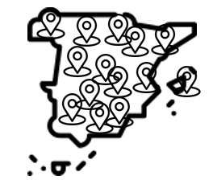




Introduction and context
Origin of the project (2)
INITIAL SITUATION
PROBLEMS
NECCESITY / SOLUTION
Accounting information available but…
Difficulty in accurately measuring:
Physical risks and their impact
“Estimated” distribution of accounting information by regions
Necessity of alternative datasources on the geographical location of production centers to fine-tune the process
… based on the firm headquarters address
Accounting information available at the CBSO
+ Information on multilocated firms provided by INE
= ViME (Visualizer of Business Multilocation)
The National Statistics Institute provides confidential access to information about multilocated firms*
(*) Multilocated firm: a company with its production centers located in more than one postal code

Slide 5
2. vime: tool for visualizing business Multilocalization in spain
OBJECTIVE
Objective: Show how the distribution of Spanish firms changes based on their headquarters or production centers using samples from the INE and Central Balance Sheet Data Office (CBSO)
Headquarters*
Nº of firms vs production centers
Multilocation**
Distribution of the four variables based on the % of employment that the company has in each postal code according to INE data
Total assets
Employees
Turnover
Gross Operating Profit (REB)
(*) postal code of the company´s headquarter
(**) postal code associated with the multilocated company with 1 or more production centers in it

Slide 6


2. vime: tool for visualizing business Multilocalization in spain
The phenomenon of business multilocalization in Spain
The experimental VIME statistic, jointly developed and disseminated by the National Statistics Institute (INE) and the Bank of Spain, illustrates the extent of the phenomenon of business multilocation in Spain.
have their establishments or production centers in a single location (headquarters)
86%
Of the total of non-financial corporations existing in Spain:
have their establishments or production centers in more than one location → MULTILOCATED FIRMS (≈ 180,000 firms)
14%
This phenomenon is more common in large companies than SMEs

Slide 7
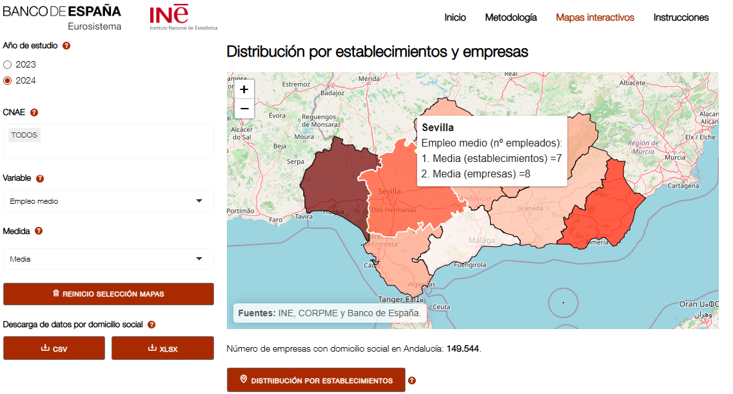
2. vime: tool for visualizing business Multilocation in spain
MAIN CHARACTERISTICS (1)
The visualization tool allows navigation through interactive maps by selecting the autonomous community, province, and municipality, with details by postal code, with information as of December each year.
Three sections:
Methodology
Interactive maps
Instructions
Two years available
Sector of activity according to NACE classification (14 sections)
Distribution of the selected variable based on the company´s headquarters
5 variables: nº of firms/production centers, total assets, employees, turnover and Gross Operating Profit (REB)
3 measures: aggregated value, mean and median
Reset view
Download data
Distribution by production centers
https://app.bde.es/ree_mle/

Slide 8
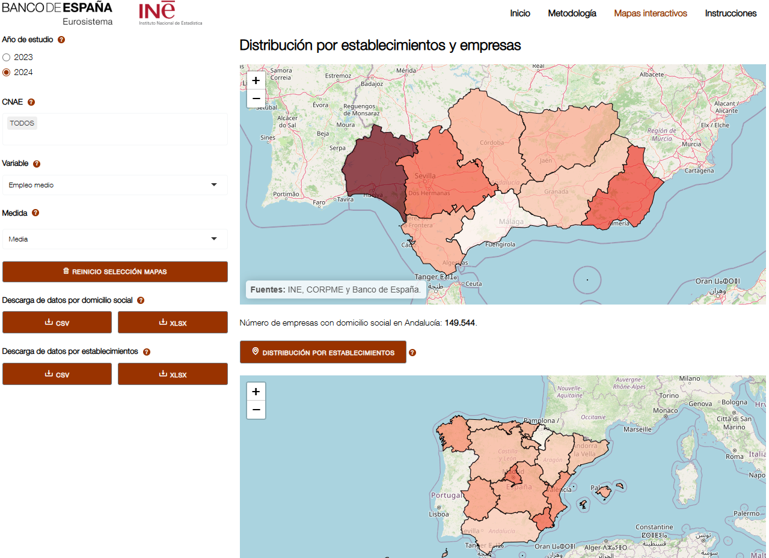

2. vime: tool for visualizing business Multilocation in spain
MAIN CHARACTERISTICS (2)
https://app.bde.es/ree_mle/
Distribution of the selected variable based on the company´s headquarters
Possibility of drill-down in maps to view details by autonomous communities, provinces, and municipalities.
Distribution by production centers
AGGREGATED DATA
Only aggregated data is provided, not data from individual companies
Distribution of the selected variable based on the multilocation of companies
ANONIMIZED
Data is anonymized
CONFIDENTIAL
Nodes with less than 3 firms are censored

Slide 9

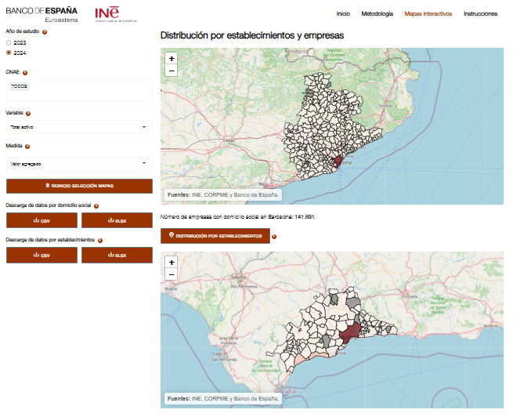

2. vime: tool for visualizing business Multilocalization in spain
Example 1 of the how the tool works
How are the total assets of companies with headquarters in Barcelona distributed in the province of Malaga?
1
Steps:
First, we select on the map above (by registered office) Autonomous Community: Catalonia Province: Barcelona Municipality: Barcelona.
Then, by clicking on the 'DISTRIBUTION BY ESTABLISHMENTS' button below the map, a second map (by establishments) will open below, showing the distribution across Spain of the assets by establishments of companies with a registered office in Barcelona.
Subsequently, on the map displayed below (by establishments), we will select Autonomous Community: Andalusia Province: Málaga, and we will be able to observe the distribution of assets by establishments in all the municipalities of the province of Málaga of companies with a registered office in the municipality of Barcelona.
1
2
2
3
3

Slide 10
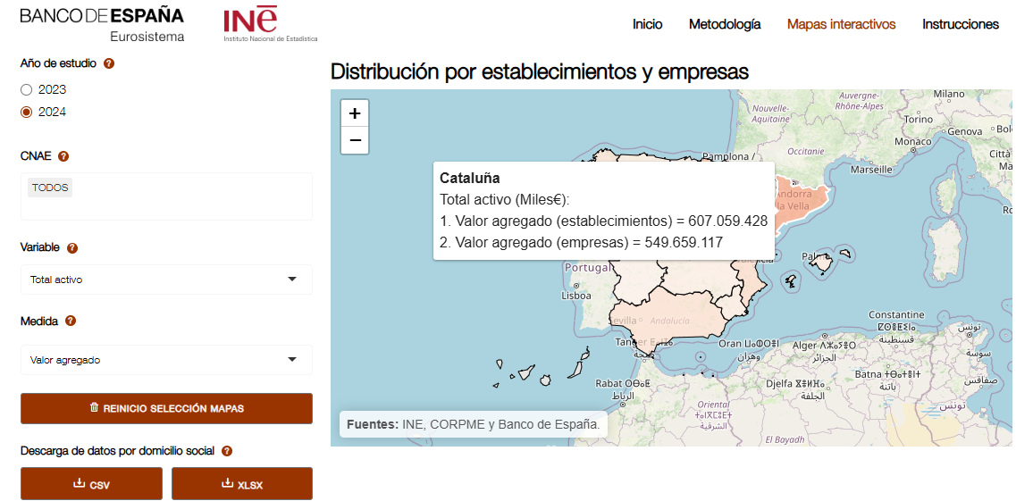
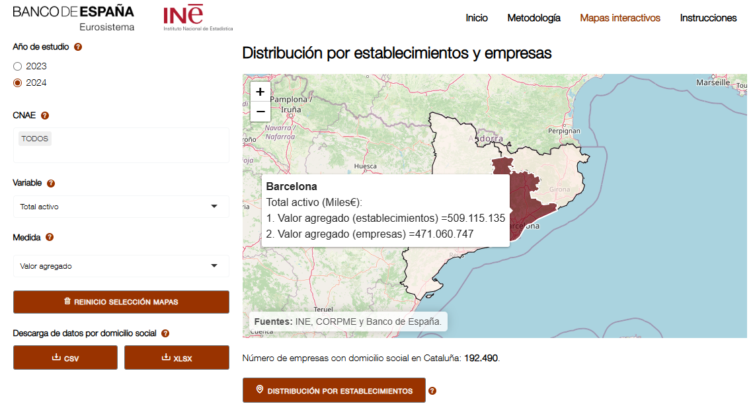
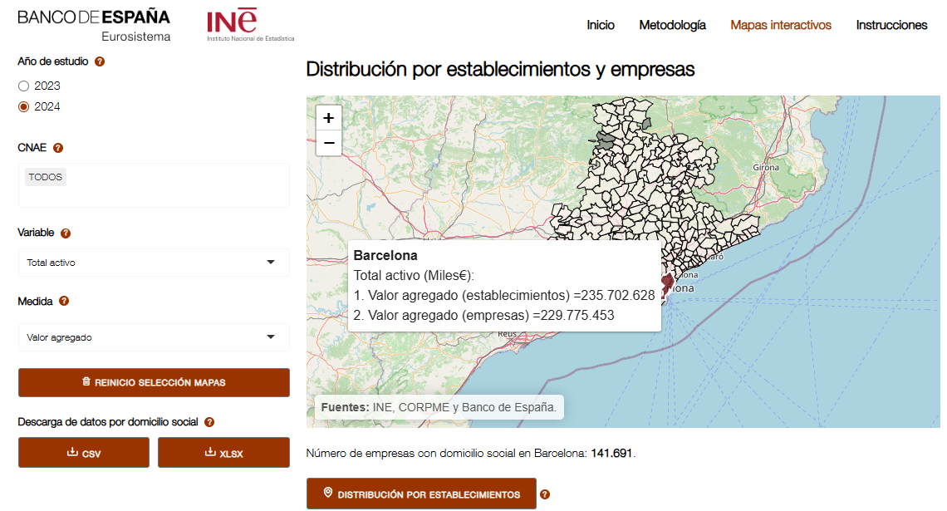
2. vime: tool for visualizing business Multilocalization in spain
Example 2 of the how the tool works
And what if we wanted to see the total assets located in the municipality of Barcelona of all Spanish companies?
1
Steps:
First, we select on the map above (by registered office) Catalonia.
Then, we select the province of Barcelona.
Subsequently, we will select the municipality of Barcelona to view the total assets of companies from all over Spain located in the municipality of Barcelona
2
1
2
3
3

Slide 11
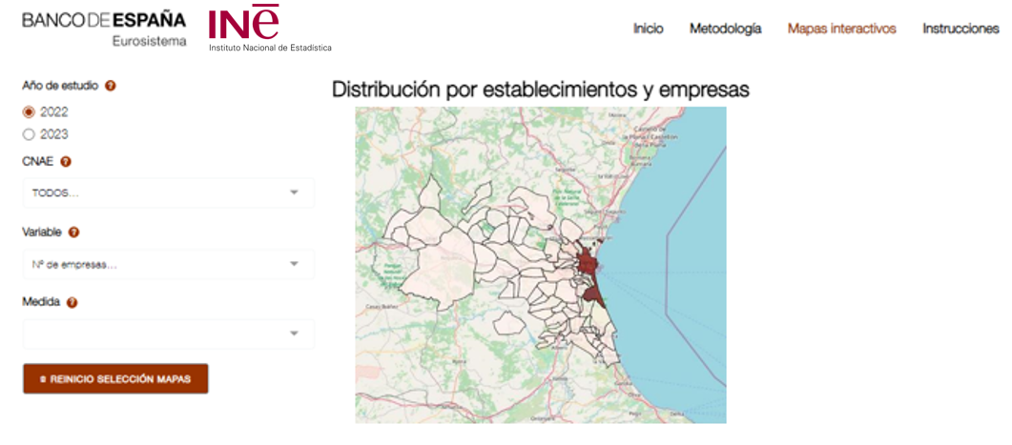


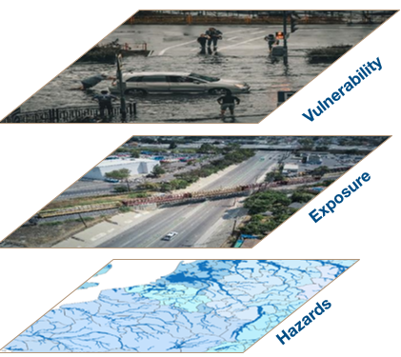

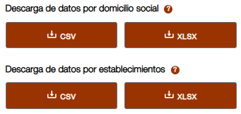
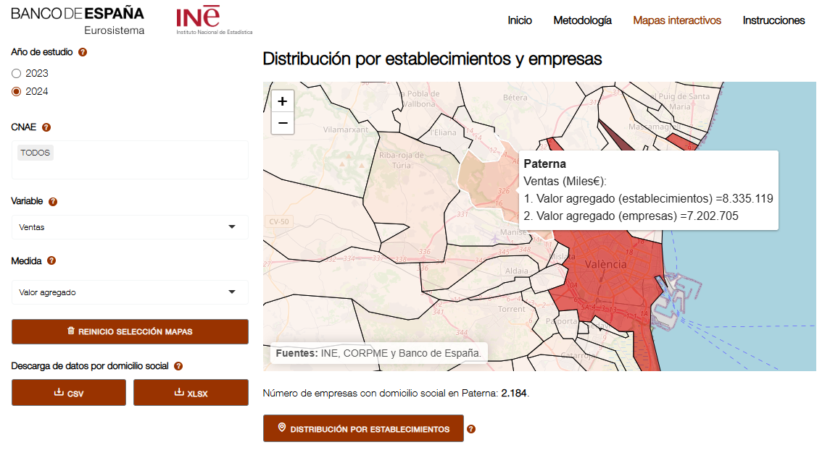
3. USE CASES
Impacts of the dana in valencia
ViME tool allows for a more precise understanding of real impacts…
In October 2024, a DANA* strongly impacted various municipalities in the province of Valencia, causing millions in losses, hundreds of deaths and severe damage to businesses and homes located in those areas.
If we only had accounting information based on the headquarters, we would have an approximate value of assets, employment, sales, or the number of affected companies. However, thanks to the combination with multilocation information, the real impacts of this phenomenon could be estimated more precisely.
For two specific affected municipalities, the difference was +20% more impact in terms of sales, employment, and assets when analyzing the information by multilocation versus registered office.
(*) DANA (Isolated Depression at High Levels) is a meteorological phenomenon that causes intense storms and torrential rains.

Slide 12
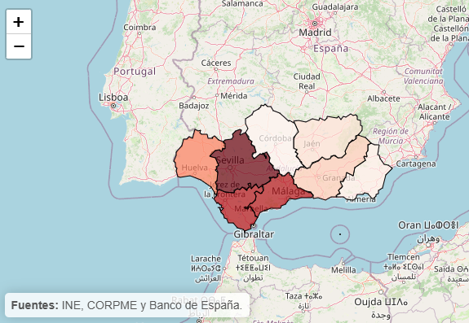
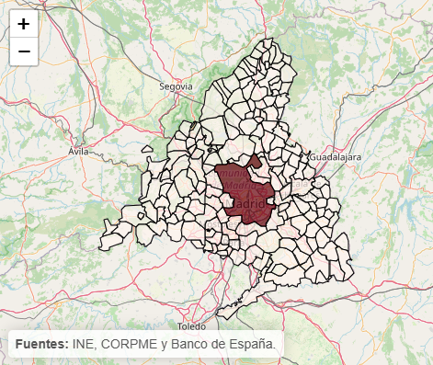
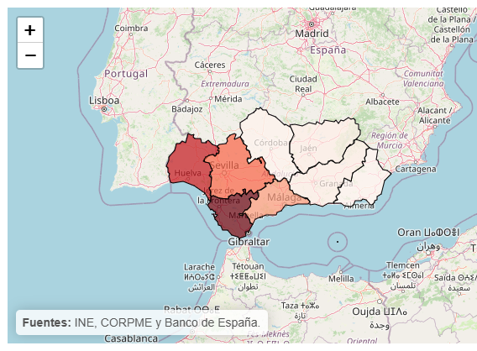


3. USE CASES
interregional connections
… but it also helps to detect interterritorial connections and behaviours
For example, the group of non-financial companies based in the municipality of Madrid has more than 5,900 production centers in Andalusia, with assets close to 50.000 million euros and sales around 37.000 million euros.
Distribution of total assets of companies with headquarters located in the municipality of Madrid in the autonomous community of Andalusia.
Distribution of sales of companies with headquarters located in the municipality of Madrid in the autonomous community of Andalusia.

Slide 13



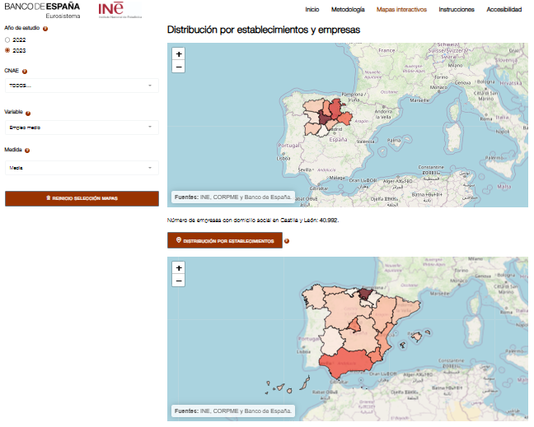


4. conclusions
MAIN HIGHLIGHTS
Collaboration between institutions and the interoperability and combination of data allows the generation of new high-value-added statistics like VIME.
Collaboration between public institutions (data sharing)
Data interoperability
Experimental statistic of high value added for various objectives, studies and analysis

