Slide 1
Compliance & Analytics-A View from the C-Suite 2016 FERF research: Data Analytics and Financial Compliance: How Technology is Changing Audit and Business Systems Rutgers University November 2016
Michael P. Cangemi CPAretired, CISAretired, CGMAretired
Former CFO, CEO & Director; Audit Com Chair
Senior Fellow Rutgers University CA&R Lab
Senior Advisor and Investor Tech companies

Slide 2
GRC to CEO career progression
Ernst & Young – CPA ( 1970-80)
Phelps Dodge – (1980 -88) CAE;VP;CIO
IS Control Journal (87-07)
Speaker/author - Managing the Audit
BDO – (1989-92)IT Audit & IA Services
Senior Fellow Rutgers U -CA&R Lab
Etienne Aigner, Inc. (92 -04)CFO – CEO
Financial Exec Intl (07-8) CEO
FEI Committee on Finance & Tech
Management, IT, Financial Governance 2 Cangemi Company, LLC

Slide 3
My Focus on CM and Analytics
Senior Advisor and Investor – Analytics focused Tech Companies
Active with FEI CFIT committee; ISACA; Rutgers CAR LAB AB
Research, articles, Keynote’s
My themes – expansion of analytics, CA and CM in business
Good timing since 2005 – now we are in the “Golden Age of Analytics!”

Slide 4
I learned: CA-CM is a Process
CM is a process & foundation technology
Process - it can be manual; or automated
CM does not have to be continuous
It is often a tool – like EXCEL; once used you will expand the usage
It is rapidly evolving IE: WATSON: IOT; Visualization

Slide 5
C-Suite’s Point of View - GRC
Overarching Issue of Corporate Governance, (reason for IC & audit)
Capital Formation & Cost of Capital
Need to safeguard assets, revenue, profit
Business managers like- Free Enterprise
Have to find and growth Profits & ROI
Don’t like - Overhead IE: any drag on ROI i.e.: Government Regulation
Management, IT, Financial Governance 5 Cangemi Company, LLC
Notes:
I would like to discuss Management’s point of view about Governance–
The over arching issue of corporate governance is capital formation and the cost of capital.
Managers of businesses believe strongly in our free enterprise system and government regulation is not sought after until a need arises that cannot be addressed by the private sector.
The role of the Board of directors has evolved along with the development of the capital markets. In the 19th century Boards were composed of the investors who took a very active role in governance to protect there capital. They set strategy, supervised execution and checked on their assets, including the bank balance to verify the business was controlled and made sure they made a profit.

Slide 6
Audit vs Management Conundrum
Many surveys of company management say they want more from internal audit.
IIA survey data, “8 out of 10 CAEs (Chief Audit Executives) worldwide believe assurance of internal controls is one of the top ways to add value.”
And only 5 out of 10 CAEs say business improvement demonstrates internal audit is adding value

Slide 7
The Three Lines of Defense Model
Notes:
In the Three Lines of Defense model, operational management is considered the first line of defense; compliance and risk management are the second line; and internal audit is the third line. The first and second lines of defense use continuous monitoring as a technology-supported process with data analytics to identify exceptions to policies, control failures, fraud, and breakdowns in business processes or to improve information integrity and transaction quality. The third line of defense (internal audit) uses continuous auditing as a technology-supported process to help provide independent objective assurance over the effectiveness of governance, risk management, and internal control.

Slide 8
Audit-Management Conundrum
Internal & External audit are in a good position to not only use tech but also to recommend and be involved with the expanded use of continuous monitoring and analytics by finance and operations
Alternative – continued subornation of assurance to first and second lines of defense

Slide 9
FERF Research Project - 2016
Financial Compliance: How Technology is Changing Audit and Business Systems
reflects the CFO/Controller concerns:
GRC costs growth and need for coordination of work performed by IA, compliance departments and external audit

Slide 10
FEI Audit Fee Surveys
Median increase in audit fees for all SEC filers 2014 and 2015:
3.4% & 3.2%
If ineffective IC for them the median increase was 6.4% & 5.1%)
Top reason for increases: reviews of manual controls from PCAOB Inspections (40%) and other PCAOB issues (46%)
Total compliance or audit costs pre sox 2002 compared to 2015 – up 100% +

Slide 11
Can Audits be More Effective?
Recent FEI CFIT and CGRC Discussions:
The cost of compliance is growing and financial executives question the effectiveness of internal control audits
PCAOB inspections are challenging for PAs
Audit Firms are exploring/expanding use of “cutting-edge technologies” (WSJ 3-8-16)
Auditing standards were written before today’s technologies were invented

Slide 12
PA Interest in Analytics & PCAOB

Slide 13
Data Analytics and Financial Compliance: How Technology is Changing Audit and Business Systems
Research objective:
Are auditors are making effective use of technologies available – including the status of their use of automated monitoring and analytics
Identify leaders in use of automated monitoring and analytics
Note: This builds on 2011 FERF research report “ The Benefits of Continuous Monitoring”

Slide 14
FERF Research -Research Interviews
Internal Auditors
External Auditors
AICPA - Amy
Call with PCAOB
Analytics Vendors with focus on GRC
Note: Missing Finance and Operations ie: second line of Defense however mentioned by IA and PA (Research Opportunity)

Slide 15
Internal Auditors’ Use of Analytics
Research Highlights:
Audit quality is the primary goal
Detection of duplicate payments is easy and valuable (same finding since 2011 FERF)
Analytics can be used to identify risks
Some internal auditors want to partner with the business; others are concerned with independence
There are staffing challenges

Slide 16
Shaw Industries - Berkshire Hathaway
$ 4 Billion carpet manufacturing
CAE reports to VP-Finance
Automated approach – started with Oversight Systems in P2P, added T&E,P card and most recent FCPA
Solved problems with data formats and learning scripts – Page 8 last paragraph
ACL for other ad hoc analytics

Slide 17
Shaw Industries Berkshire Hathaway
Partnered with Business
Analytics process becomes part of the company’s system of IC and
Is seen as delivering value to the business and
A very efficient cost effective approach
Only 4 audit staff

Slide 18
Campbell Soup
Interest by company supply chain group in looking at complex disparate data
IA worked with them to use Smart Exporter and connect directly to SAP database and analyze large data sets in IDEA
Used analytics in disbursement – found cash recoveries and frauds

Slide 19
Dow Chemical and Starwoods Hotels
Dow Chemical- Improving audit quality and confidence in conclusions by doing full populations
Starwood Hotels- transactional analytics to identify anomalous transactions in full populations and to identify possible fraud; look for locations with unusual financial matrices; and created for the business a balance sheet analytics tool

Slide 20
IA & External Audit Opportunity -- CM
Further tangential opportunity for IA & EA to recommend even more CM to improve IC systems to Management ,1st line of defense, and compliance departments, 2nd line of defense (Cangemi EDPACS 2010 ) Tools: i.e.: CaseWare, ACL, Oversight, Microsoft etc.
Then build independent CA application on top – strengthening the 3rd line of defense.
Notes:
The use of continuous auditing (CA) is one of the most important trends in technology for internal auditing. However, continuous auditing is only used extensively by 14% of survey respondents, making it one of the least used technology techniques in the survey. Continuous auditing offers internal auditors an excellent opportunity to add value to their organizations. In particular, internal auditors should look for opportunities to migrate their automated or continuous auditing routines to management so that management, as the first line of defense, assumes more responsibility for conducting their own continuous monitoring activities. In that way, internal audit helps management improve processes and also enhances the overall control environment of their organizations.

Slide 21
External Auditors’ Use of Analytics
Research Highlights:
Audit quality is the primary goal
Delivering business insights is a secondary goal
Efficiency is a third goal
Audit firms need to differentiate themselves
and here again ---
There is a talent shortage

Slide 22
Audit Quality
“We want to deliver a higher-quality audit, and that has been central to our audit transformation program.”
“We think that there is a better way to do it, by using data and analytics more effectively.”
Roshan Ramlukan
Ernst & Young

Slide 23
Business Insights
“You have a greater ability to learn things about your client and their business and how they do their business in a more efficient way.”
Craig Sharples
PwC

Slide 24
Differentiation
“The use of data and analytics are merely enablers to transforming the audit.”
“Technology and innovation are being used by the profession as a key differentiator in delivering audit services.”
Roshan Ramlukan
Ernst & Young

Slide 25
The Talent Shortage
“As we evolve into this data-enabled world, the occupation that we call the data scientist today didn’t exist five years ago.”
“There is a talent shortage out there, and everybody’s trying to hire them and develop them.”
Craig Sharples
PwC

Slide 26
PA Firms issues with expanding use of analytics
AICPA
There are Issues with data access
AICPA Audit Data Standard Project
Issues with auditing standards – currently need to follow up on all identified exceptions
Many firm partners fear PCAOB review – do it the old fashion way!!
PCAOB
Briefing call not an interview
They are meeting with firms and monitoring

Slide 27
Analytics Vendors
Many software solutions are available with analytics: some generalized and some with a specific focus: Visualization, BI, Data Mining
FERF interviewed three with GRC focus:
Oversight Systems: Insights on Demand
ACL
CaseWare Analytics

Slide 28
Analytics Vendors
Research Highlights:
Data Analytics solutions provide a means to replace sampling
Close the loop- find a problem, make a change, prevent the next incident
Analytics are part of a process, look at the outputs, measure them, appraise them and make corrections and systemic improvements

Slide 29
Analytics Vendors
“We apply analytics to business process as a closed loop control… for many analytical problems you are dealing with gray”
Patrick Taylor- Oversight Systems
“The most impressive thing we are doing with Analytics is closing the loop” referring to AML software that completes required AML reports
Andrew Simpson - CaseWare

Slide 30
Analytics Vendors
Customer drivers:
Regulatory compliance – some require review of ever transaction
Monitoring should be done by the business, as well as, internal audit (and compliance departments)
Analytics customers look for hard-dollar recoveries or savings
80% of SOX compliance can be automated with analytics
Dan Zitting ACL

Slide 31
Staffing Challenge
Our interviews revealed a number of issues related to staffing for automated audits.
Internal & PA audit need people who:
Know how to audit,
Understand work processes, and
Have expertise in technology or an interest in learning to use new software solutions.

Slide 32
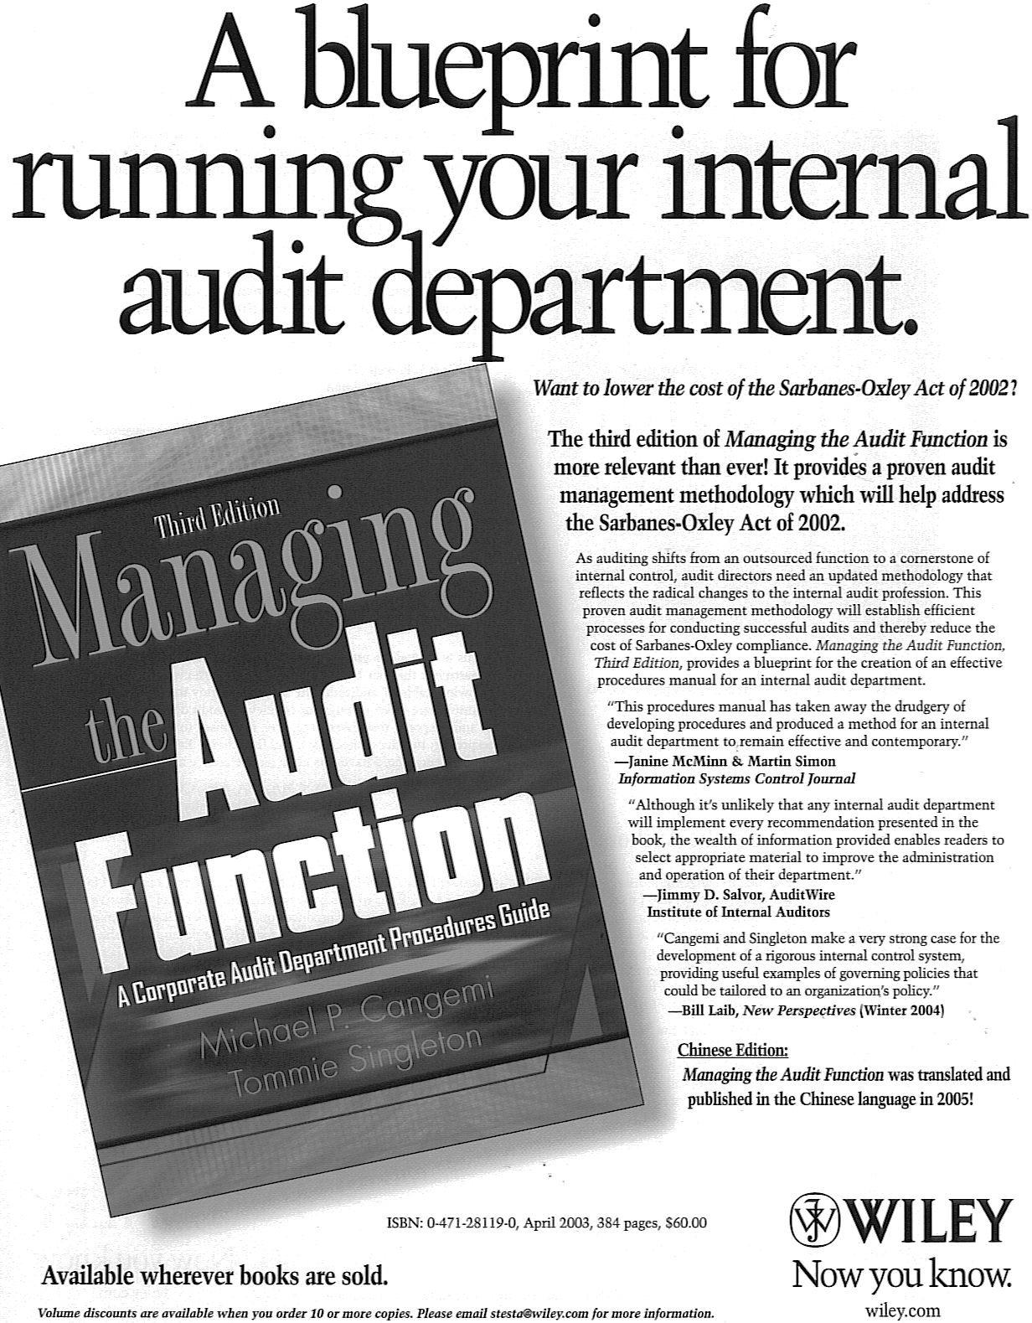

Slide 33
Challenges to expanding the use of Tech by IA
IA foundation skills are in accounting and auditing – need more tech focus
Capital to invest – you need to fight for it
Other priorities – time restrictions.
Need for creativity skills and vision.
Need to take risks - IT implementations do not always work out
Need to add value to the business

Slide 34
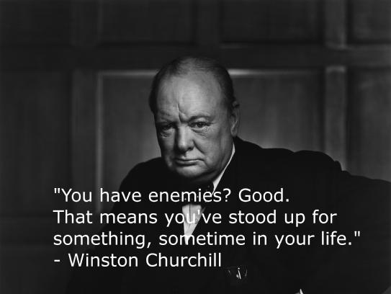
Leadership -- Risk taking

Slide 35
The Future of Analytics
Research Highlights:
Audits of the future will look very different
For PA firms audit standards and PCAOB must evolve
Machine learning and artificial intelligence will eliminate manual work
Robotic Process Automation will be used for routine audit work
Benchmarking with industry data – Shaw Ind & Oversight

Slide 36
The old audit model will evolve
Technology and real time data will force a change
Confirmation.com
SEC Robo-COP
Real time multi company audit
Rutgers Univ –Coney presentation
Video & Contextual Analytics – Solink
Real time verification - Blockchain

Slide 37
Digital Money and Auditing
Bitcoin operates on the Blockchain ledgers
Blocks are ledgers
Chains- unique secure hash algorithms
Globally Distributed Network -secured
Peer to Peer transactions with real time verification – 2015 still not tested
2016 main stream of business tests
JP Morgan, NASDAQ, State of Delaware

Slide 38
Recent Article & Keynote’s
Summary of what I learned & suggest:
Tech Trends and Analytics Keynotes:
May 2015 AICPA,
Nov 2015 UK ACE Conf, London;
May 2016 IDEA User Conference
Views on Internal Audit, Internal Controls, and Internal Audit’s Use of Technology" by Michael Cangemi published in EDPACS January 2016

Slide 39
Barriers to automation

Slide 40
Questions – Thank you for listening !!
Management, IT, Financial Governance 40 Cangemi Company, LLC

Slide 41
Cangemi Company LLC
Senior Advisor & Board Member
Consulting –Financial, Technology, Strategic, Governance, Internal Audit
Media –Keynotes, speaking; seminars
Book -Managing the Audit Function; available at Amazon, Wiley
mpcangemi@msn.com
www.canco.us
Management, IT, Financial Governance 41 Cangemi Company, LLC

