Slide 1
Continuous Auditing & Reporting Laboratory (CARLab) Research Overview
As of February 2024

Slide 2
CarLab Analytic Research
Tracking Technologies: An Examination of Hospital Privacy Compliance and IT System Control Effectiveness | Whether Firms’ Risk Disclosures are Still Informative? Using a Novel Tool to Measure Textual Data | Can External Auditors Utilize ChatGPT to Assure ESG Reports? - Starting from Environmental Section Test | CONTINUOUS MONITORING SYSTEM WITH INTERACTIVE VISUALIZATION: CASE STUDY ON GOVERNMENT PAYROLL DATABASE | The Relationship Between the Proportion of Outliers and the Average Attenuation Rate of Outlier Scores: An Approach of Algorithm Selection in Unsupervised Outlier Detection without Ground Truth
The benefits of big data: the case of wind data to detect greenwashing | The Watchdog Effect of Granular Transparency Regulation: Evidence from Firms’ Responses to the Greenhouse Gas Reporting Program | Sentimental Analysis as a measure for determining the Informativeness of Cybersecurity Disclosures | Enhancing Payroll Fraud Detection for Governments: Continuous Auditing with Deep Learning based Outlier Detection | RPG gamification in accounting education
Partner-client Social Ties and Audit Quality. | Qualitative accounting education research using ChatGPT. | Analyzing Analyst Question Patterns in Earnings Calls: Leveraging NLP Models for Sentiment and Forward-Looking Analysis | ESG violation and insider trading | The Usefulness of Large Language Models in External Audits
Governance and Donations: Evidence from Small Nonprofit Organizations | AI Co-pilot auditing Plus More | Do employees know what would happen? Signals for the firm performance derived from the bottom tone | Municipality Government Reporting Automation | Bad Debt In Emergency Department
ESG - Deloitte | Manual Journal Entry Risk Identification_Using Natural Language Processing and Deep Learning | ESG Report Data Extraction: A Generalized Text-Mining Framework. | Predicting revenues using customer reviews | The Analysis and Prediction of Fiscal Distress in Local ...
The Increased Role of Advanced Technology and Automation in Audit A Delphi Study | Collaborate Verbal, Voice, and Visual Evidence in Detecting Managerial Uncertainty and Financial Outcomes | AIS Literature Review Generation | Continuous Auditing in the Age of AI: An Exploration of OpenAI's GPT Model Applications | Auditing Medical Assessments: Risk Assessment with Machi...
Connecting the Dots: Auditing in the Age of Foundation M... | Employee Insights, Financial Integrity: Rethinking Int... | ESG violation and insider trading

Slide 3
The CarLab
Continuous Audit and Reporting Laboratory
  Graduate School of Management
  Rutgers University

Slide 4

CarLab 2017

Slide 5
CRMA
CDA
CCM
KPMG
Sigma Bank
HP
Itaú-Unibanco
Verizon
GL
KPIs/KRIs
Process Mining
PPP Insurance
PPP
Credit Card Insurance
A/P
IDT
P&G
Itaú- UniBanco
AT&T
D&B
Inventory Dashboard
Duplicate Payments
HCA
Duratex
Siemens
Supply Chain
A/P
Met-Life
Continuous Control
Monitoring
P&G
J+J
AICPA
Talecris / ACL
Claims Wires
American Water / Caseware
Inventory
CA Technologies
FCPA Sales Commission
FCPA
Audit Methodologies
Multidimensional Clustering
Process Mining
Continuity Equations
Predictive Auditing
Visualization
Analytic Playpen
Audit Automation
P&G: Order to Cash
Auditor Judgment
Siemens- AAS Automation
AICPA – ADS / APS

Slide 6
Audit Innovation at the CarLab
Continuous Audit at AT&T
Continuity Equations
Multidimensional clustering
Process mining
Predictive auditing
Conceptualization of the distance audit
Rule based outlier detection
Exploratory data analysis
Exceptional Exceptions
Audit Data Standards
Audit Apps
Visualization
Deep Learning and Machine Learning in audit
Cognitive computing and aid for audit brainstorm
Blockchain and Smart Contract
Robotic Process Automation
Intelligent Process Automation

Slide 7

Tracking Technologies: An Examination of Hospital Privacy Compliance and IT System Control Effectiveness
Hilal Atasoy
Ryan McDonough
Guangyue (Maria) Zhang
Rutgers Business School
Notes:
The prevailing risk factor. Impact business operation and is costly. Negative impact on reputation, customers trust, stakeholder value, litigation, fines and punishment from regulatory bodies
How we started this project: markeup article, 30%of hospitals has meta pixels installed to retrieve and share patients sensitive healthcare information to third party.
For example, the doctor appointment scheduling page, form information
Metal Pixel tracking is a piece of code in the HTML or the java scrpt
Hospitals share data for marketing analysis
We propose that this is a good proxy for poor organisation privacy practice and would increase security vunerability and increase the likelihood of privacy breach
Also a good input-based proxy for poor organisation privacy practice

Slide 8

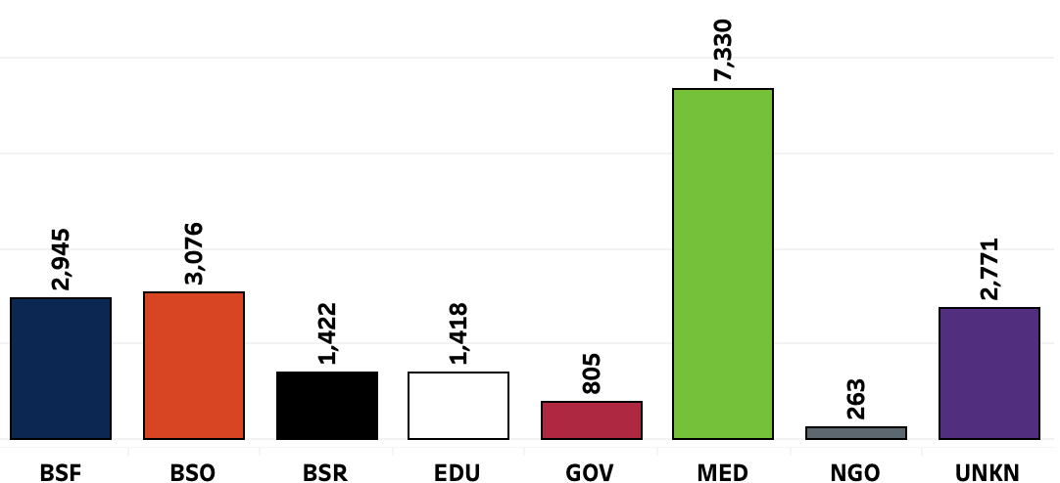
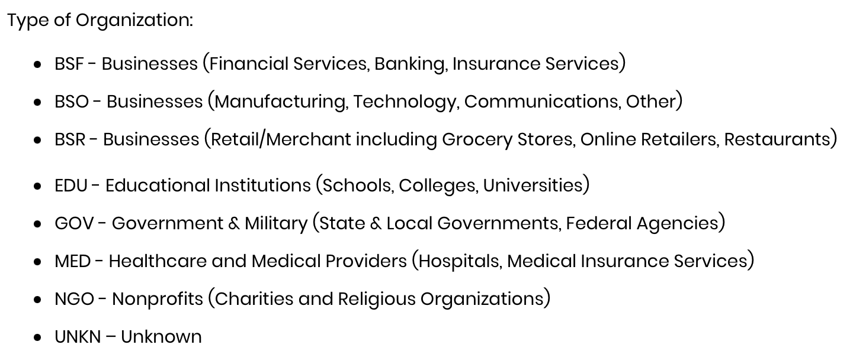
Background – Privacy breach
Privacyrights clearinghouse:
Notes:
Safe Web Act
Payment Ca
rd Industry Data Security Standard (PCI DSS)
confidentiality, integrity, and availability

Slide 9
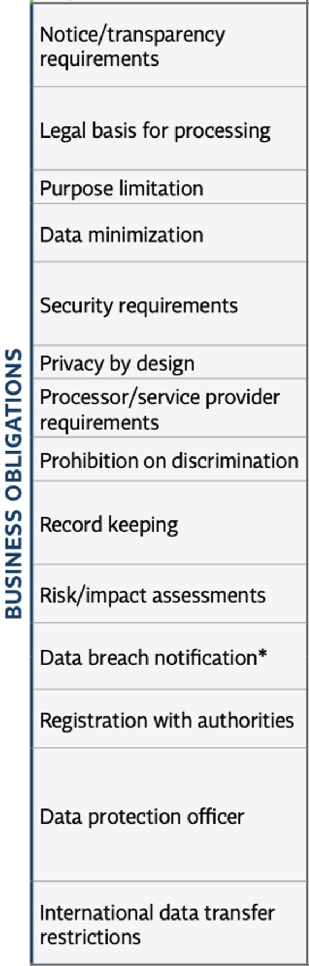
Background - Consumer privacy
There is growing tension between ethical issues and a firm’s economic interest raised by big data analytics and behavioral analysis that violates public norms for acceptable data use
Consumer privacy protection regulations are essential to the change in privacy management practice
EU General Data Protection Regulation (GDPR)
  Proposed - 2012, agreed upon - December 2016, in effect - May 25, 2018
  The scope, timing, means of enforcement, and business obligations
What’s new
  On 04th January 2023, Ireland's Data Protection Commission fined Meta 390 million euros for breaches of the GDPR relating to its social media service
  The platforms’ basis for seeking user permission to collect data for personalized advertising is invalid
Notes:
EU Parliament and Council
Safe Web Act
Payment Ca
rd Industry Data Security Standard (PCI DSS)
confidentiality, integrity, and availability

Slide 10
Background – Tracking technology
It is a script or code on a website or mobile app used to gather information about users as they interact with the website or mobile app
User information is then analyzed by owners of the website or mobile app or third parties to profile users (e.g., IP address) and create insights about users’ online activities
  Pro: improve user experience
  Con: user profile and continuous tracking by third parties without patients’ knowledge or consent
The Meta Pixel collects sensitive health information and shares it with Facebook
Notes:
Safe Web Act
Payment Ca
rd Industry Data Security Standard (PCI DSS)
confidentiality, integrity, and availability

Slide 11
Background - Consumer privacy
U.S. federal consumer privacy law - Health Insurance Portability and Accountability Act (HIPAA) of 1996
  Objective: Designed to protect patients’ personal health information
  Requirements: Obtaining authorization before use or disclosing, implement safeguards to protect the security health information
  Components: Privacy rule, security rule, breach notification rule, and enforcement rule
  Subject: entities(Healthcare providers, health plans, and healthcare clearinghouses) and business associates
U.S. Department of Health & Human Services
  The HIPAA Rules apply when the information that regulated entities collect through tracking technologies or disclose to tracking technology vendors includes protected health information (PHI).
  Regulated entities are not permitted to use tracking technologies in a manner that would result in impermissible disclosures of PHI to tracking technology vendors or any other violations of the HIPAA Rules.
Notes:
Safe Web Act
Payment Ca
rd Industry Data Security Standard (PCI DSS)
confidentiality, integrity, and availability

Slide 12
Research question
Q: Does impermissible data sharing increase information security vulnerability?
How do the HIPAA Rules apply to regulated entities’ use of tracking technologies?
  Tracking on user-authenticated webpages
  Tracking on unauthenticated webpages
  Tracking within mobile apps
HIPAA compliance obligations for regulated entities when using tracking technologies
  Regulated entities are required to comply with the HIPAA Rules when using tracking technologies.
Online tracking technology - poor information security awareness and possible poor practice by the hospital management
  The markup article of 2022 “Facebook Is Receiving Sensitive Medical Information from Hospital Websites” shows many hospital management are not aware of the code insertion.
  Even if there is a vetting process of the code, there is no disclosure on the rigor of the process
Notes:
EU Parliament and Council
Safe Web Act
Payment Ca
rd Industry Data Security Standard (PCI DSS)
confidentiality, integrity, and availability

Slide 13

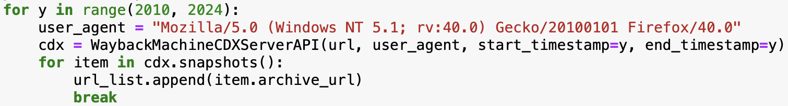
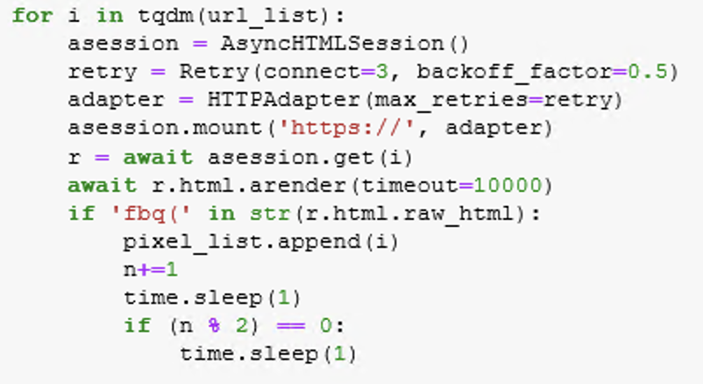
Data collection
Hospital pixel tracking history
  US News hospital list and website URLs
  Internet Archive Wayback Machine: retrieve historical website HTML and java script
  Inspect retrieved code and script for “fbq() ” scripts
  Final: 2010-2023 Hospital-year observation of pixel tracking usage
Notes:
EU Parliament and Council
Safe Web Act
Payment Ca
rd Industry Data Security Standard (PCI DSS)
confidentiality, integrity, and availability

Slide 14
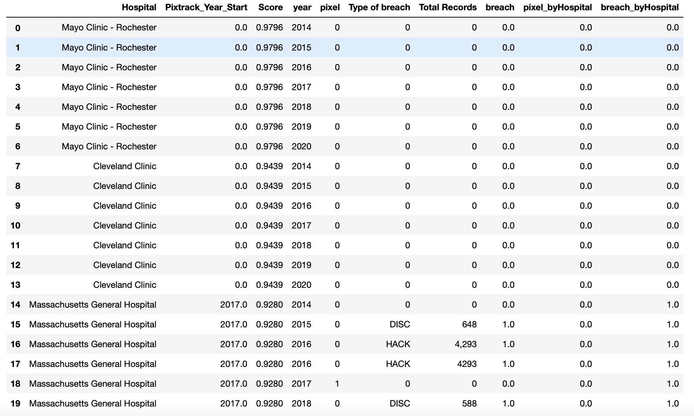
Data collection
Privacy breach
  Privacyrights clearinghouse: breach chronology dataset, selecting “MED” organizations
    Company name, Year of breach, Type of breach, Total Records, Date Made Public and description
  Fuzzy matching of company name to merge the privacy breach dataset with the pixel tracking usage dataset
  Final: 2010-2023 Hospital-year observation of pixel tracking usage indicator and breach incident indicator
Notes:
EU Parliament and Council
Safe Web Act
Payment Ca
rd Industry Data Security Standard (PCI DSS)
confidentiality, integrity, and availability

Slide 15
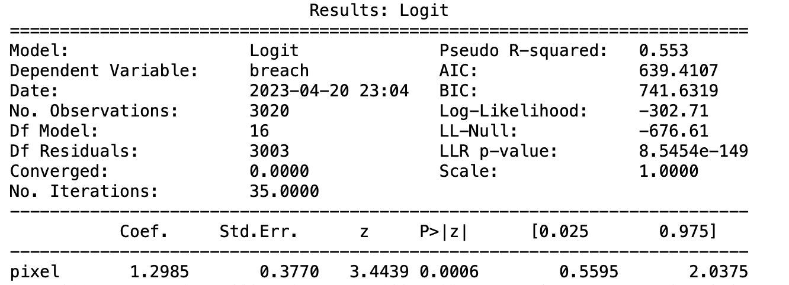
Results
  Logit regression of pixel tracking usage indicator against privacy breach incident
  Hospital and year fixed effects

Slide 16
Future plan of research
Explore the outcome of pixel tracking usage
  Social welfare
    Con: discrimination
    Pro: community quality of life
Explore the determinants of pixel tracking usage
  Centers for Medicare & Medicaid Services Data (CMS) dataset
    Hospital profile (size, ownership, social responsibility, etc)
    Cost report (Financial distress)
  Market competition

Slide 17
The Benefits of Big Data: The Case of Wind Data to Detect Greenwashing
Yu Gu
Summer Project

Slide 18
What and Why
Research Question:
  Can wind data contain incremental information about the electricity generated by wind power from corresponding energy companies?
Motivations:
  Greenwashing is pervasive in the energy sector (RepRisk 2022)
  Wind power is currently the second-largest renewable energy source globally for electricity generation (C2ES 2022)
  The use of big data in accounting has gained attention, with researchers exploring diverse sources like scanner and satellite image data (Qian and Dichev, 2022; Gu, Dia, and Vasarhelyi, 2023)

Slide 19
How
The quantity of electricity produced is a function of wind speed for a particular turbine (Lu and McElroy 2017)
Wind data could provide evidence for
  the quantity of electricity generated
  the revenue produced
  the environmental impact
Further, detect the greenwashing practices, e.g., exaggerating the quantity of electricity produced by wind power on their ESG reports
More importantly, investors could assess the company’s performance in real-time and make informed decisions.

Slide 20
In Progress
Collect data
  Amazon Web Services (AWS)
  The National Renewable Energy Laboratory (NREL) Wind Integration National Dataset
Contact the NREL for collaboration

Slide 21
Partner-client Social Ties and Audit Quality
Lanxin Jiang
Advised by Miklos Vasarhelyi
June 27, 2023
Notes:
In this research I use innovative datasets AuditorSearch dataset available since 2017 and Linkedin
To explore the role of AP–client relationship on AQ

Slide 22
Motivation
  Tension
    Embeddedness theory (Granovetter 1985) suggests that social networks can facilitate information transfer and alleviate management pressure to waive correction of detected misstatements.
    However, social ties can also weaken monitoring mechanisms in governance (Guan, Su, Wu, and Yang 2016) and undermine auditors' monitoring of the financial reporting process (He, Pittman, Rui, and Wu 2017)
  Gap
    Archival audit partner research largely uses non-US settings because the individual partner information was not available in the U.S. until 2017. Institutional differences can impede previous research findings from extending to the U.S. setting (Lennox and Wu 2018).

Slide 23
Objective and Contribution
  This research will explore different social ties between audit partners and client executives.
  This research will contribute to the auditing literature at the partner level in the U.S. setting, and literature using social media in the auditing setting.
  This research will add to the auditor social connection literature by examining different social ties and their impact on audit outcomes.

Slide 24

Progress
  Literature review
  Data collection
    Audit partner names from PCAOB AuditorSearch Form AP database since 2017
    Audit partner personal information from LinkedIn
    Executive information from BoardEx
    Audit outcomes (restatement, going concern opinions, discretional accruals) from Compustat and Audit Analytics
  Construct social tie measures
    employment affiliation connections (He et al. 2017)
    school ties (Guan et al. 2016)
    other social tie measures, e.g., membership, GNN centrality, link strength, neighborhood overlaps
  Examine their impact on audit outcomes and relative importance
  Additional analysis
    Examine the interaction between partner’s innate characteristics (e.g., gender, conservatism) with the social ties

Slide 25
Governance and Donations:
Evidence from Small Nonprofit Organizations
Katerina Liu, Rutgers University
GeDong, City University of New York
Chengzhang Wu, Marist College

Slide 26
Contribution
It is the first empirical study that examines the relation between governance and donations for Form 990-EZ filers.
The development of the governance construct and the multiple conceptual layers of governance dimensions contributes to the agency theory approach in nonprofit literature.
The operationalization of governance as a second-order construct makes it possible to measure the effect of governance on donations for Form 990-EZ filers.
It sheds some light on regulatory oversight in the nonprofit sector for relevant stakeholders (Watchdog agencies and the general public).

Slide 27
Research Question and Key Findings
Research Question: we study the governance and donations of Form 990-EZ filers.
Key Findings
Among four governance constructs, three constructs (management, public access, and board) are positively associated with donations and one policy construct is negatively linked with donations.
Our results support the assertion that good governance disclosed by Form 990-EZ is value-added to donations that small charities receive, independent of other variables such as age, asset, wealth, program ratio, and fundraising expenditures.
Notes:
Charitable organizations solicit donations from the general public or governmental agencies which use Form 990s as the primary information source. Governance effectiveness could encourage outsiders to contribute resources to the NPOs.

Slide 28
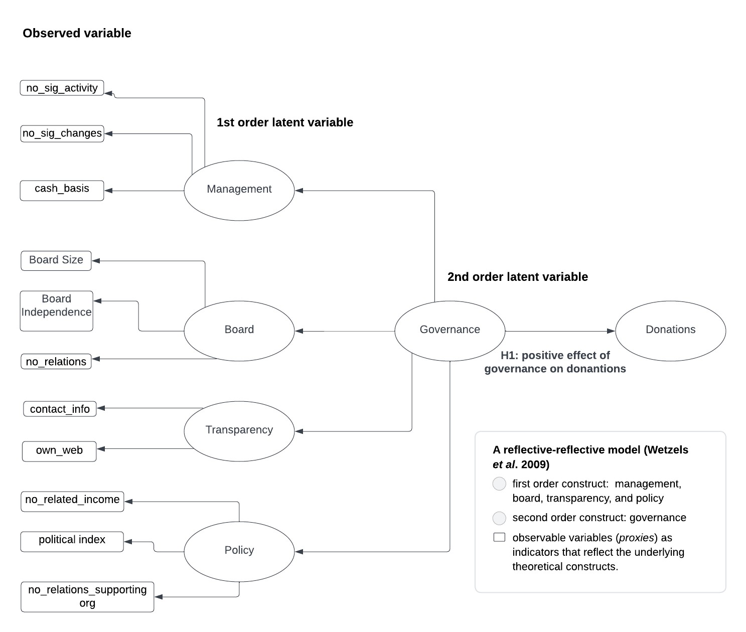
Theoretical Model
A reflective-reflective model (Wetzels et al. 2009)

Slide 29

Tiny Totos – A case for proper ESG reporting
2023
Jonas Sveistrup Søgaard, Ph.D.

Slide 30
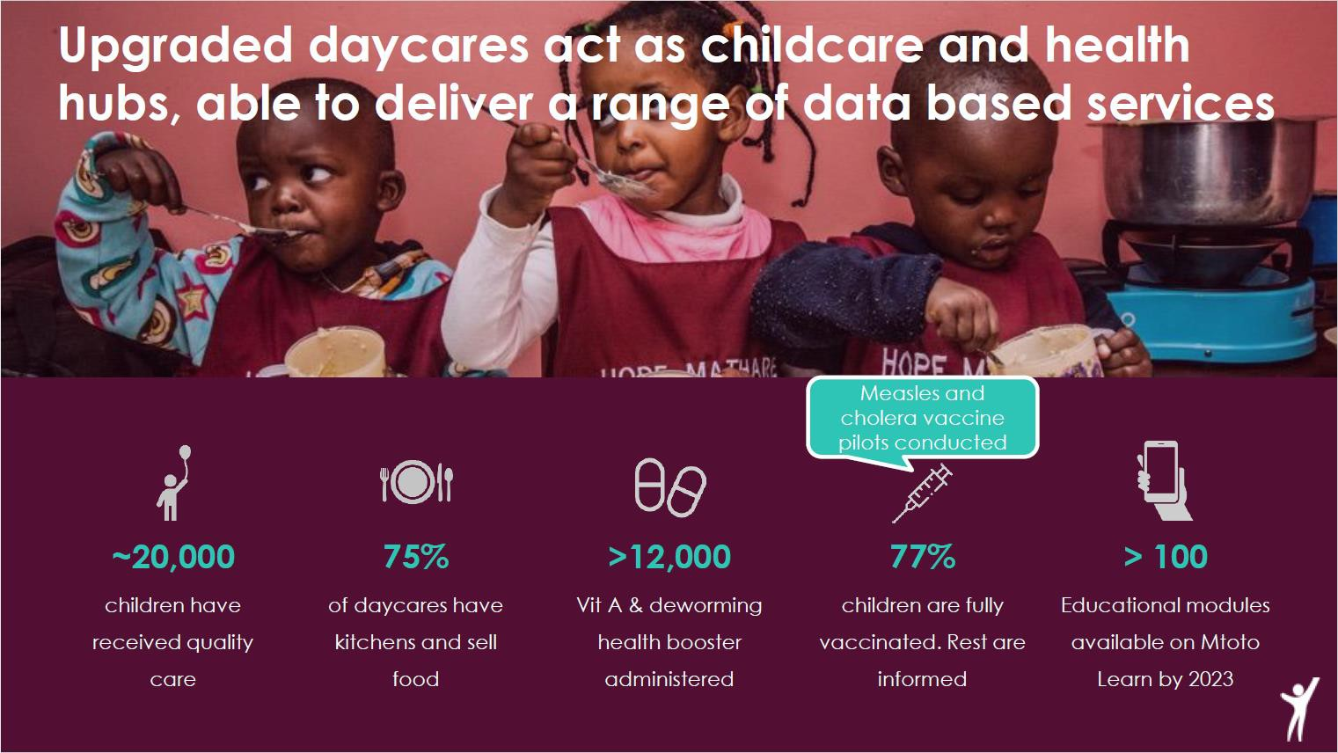
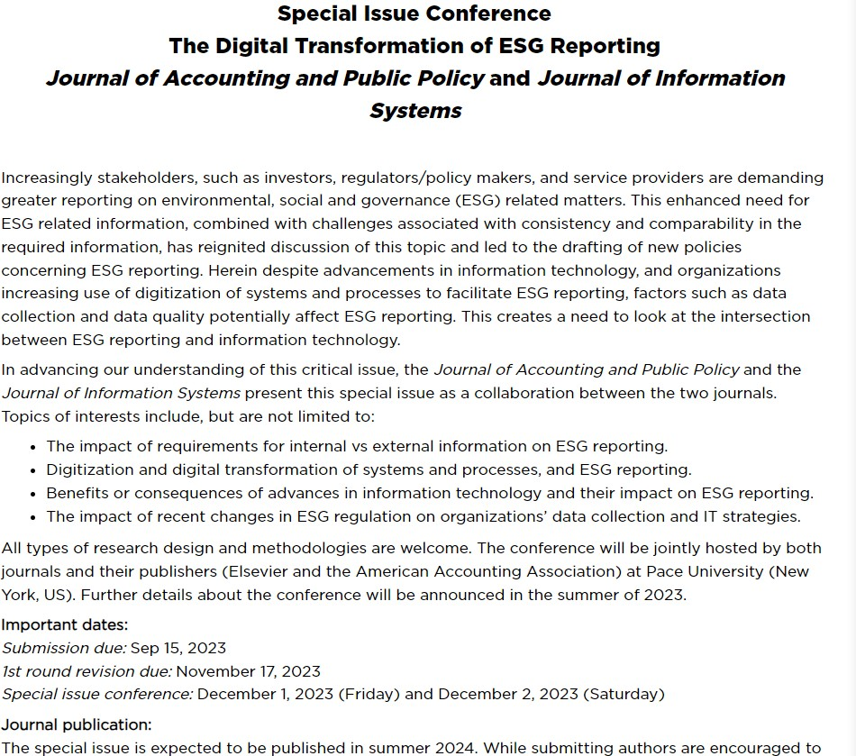
I seek co-author(s) for a case study for the social aspect of ESG reporting
I have access to data…
… I need co-author(s) who wants to develop the paper with me
I’m aiming for Special Issue Conference; Deadline 15th september
… however, not limited to that
2

Slide 31


Slide 32






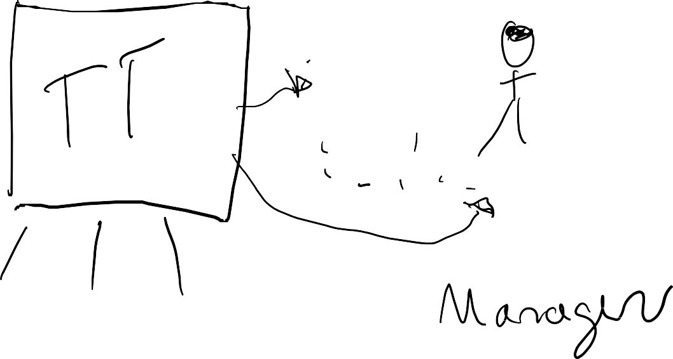












Tiny Totos connects daycare managers with parents
4

Slide 33
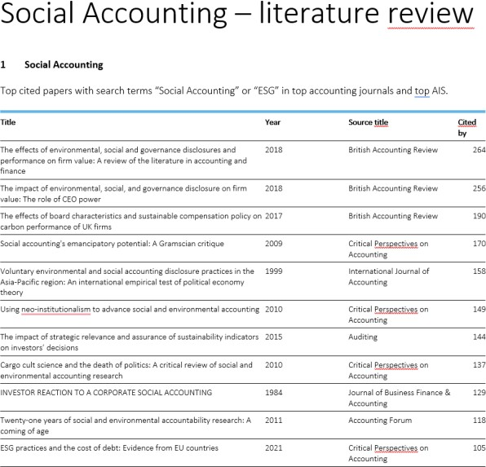
The structure of the paper
1. Literature review in progress
2. Theory development not started
3. Data collection started
A couple of ideas
Two interviews have been conducted already. More are possible if needed, and access to their production data.
Extend recent paper from Gu,
Dia and Vasarhelyi (2023)
ESG regulations to be used as the backbone (US and EU)
Propose a design for ensuring data on using blockchain as a trust infrastructure to ensure investor
Your input ☺
5

Slide 34

So; anyone up for a fun project to push the frontier of ESG reporting and help Tiny Totos ensure more funding by investors to help even more children in Africa?
Contact: jsveistrup@deloitte.dk or jss.acc@cbs.dk
6

Slide 35
The Increased Role of Advanced Technology and Automation in Audit: A Delphi Study

Slide 36
Research Focus
What?
This study seeks to gain expert predictions on the future directions of advanced technology and automation supporting auditors.
Why?
Covid-19: remote audit accelerate the use of advanced technology
Technological innovations change the role of the accounting firm, staff, CPA
How?
Delphi Study (brainstorming session Delphi )
19 experts
Notes:
While academic literature, in part, predicted such trends (Castka and Searcy 2023), what do auditor
professionals themselves predict the future holds?
Brainstorming session -> technology, regulation, skill sets, due care
Delphi method is appropriate “for obtaining the opinion of a panel of independent experts concerning a specific subject”

Slide 37
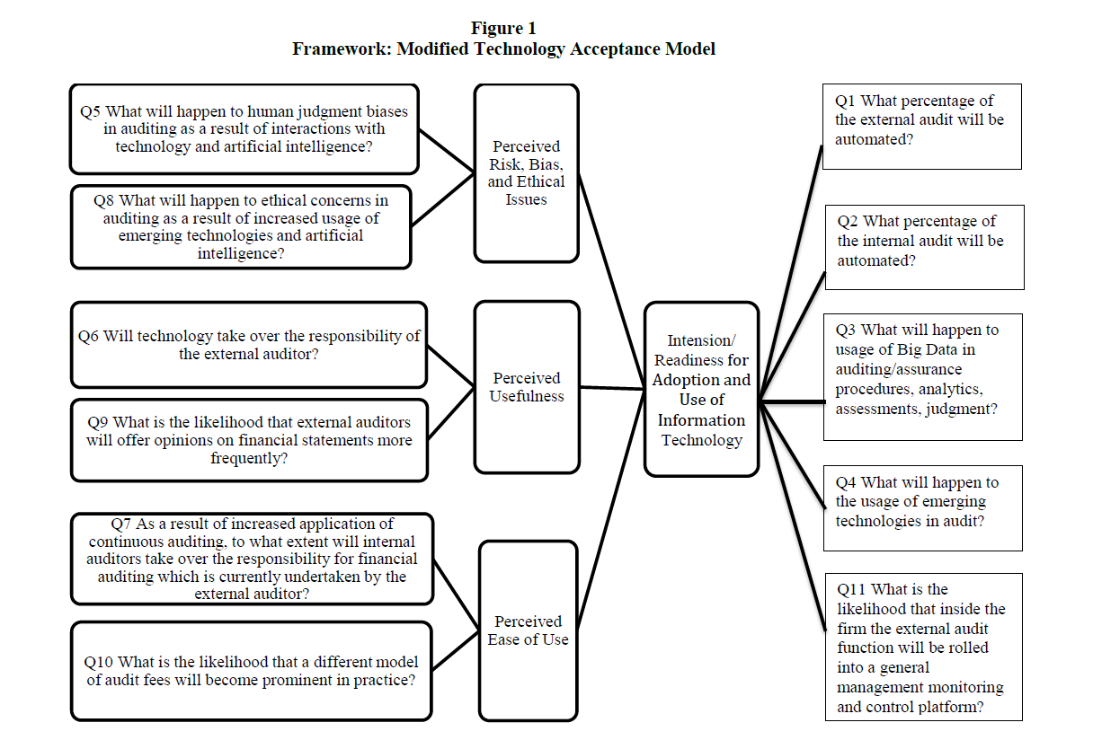
Research Method
Notes:
We used a modified version of TAM (see Figure 1) to develop and analyze questions in the three areas: (1) perceived risk, bias, and ethical issues; (2) perceived usefulness; and (3) perceived ease of use; and linked the three areas to auditor intention or readiness for adoption and use of information technology. Drawn from
information systems literature and applied extensively in many fields, TAM describes factors that
explain user acceptance and use of technology.

Slide 38
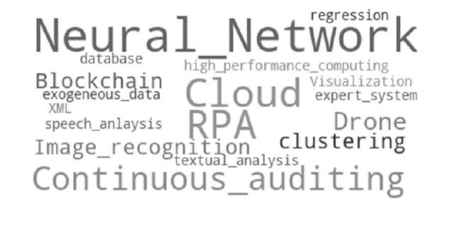
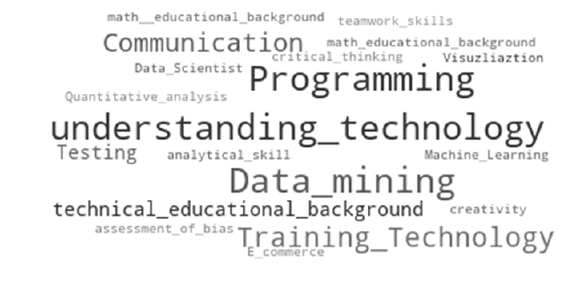
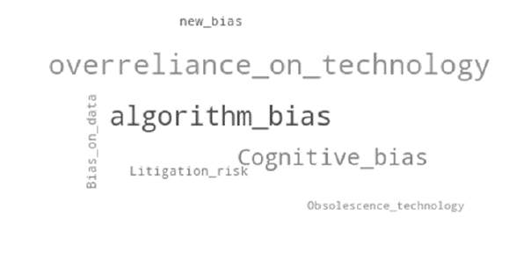
Finding
Brainstorming session
Notes:
Technology, such as AI and automation of routine tasks, is expected to enhance audit
competencies.
technological skill sets are needed for auditors. Specifically,
understanding technology, programming, and data mining are the most desired skill sets. Concerns
were expressed about the use of technology including overreliance, algorithm bias, and cognitive
bias.

Slide 39
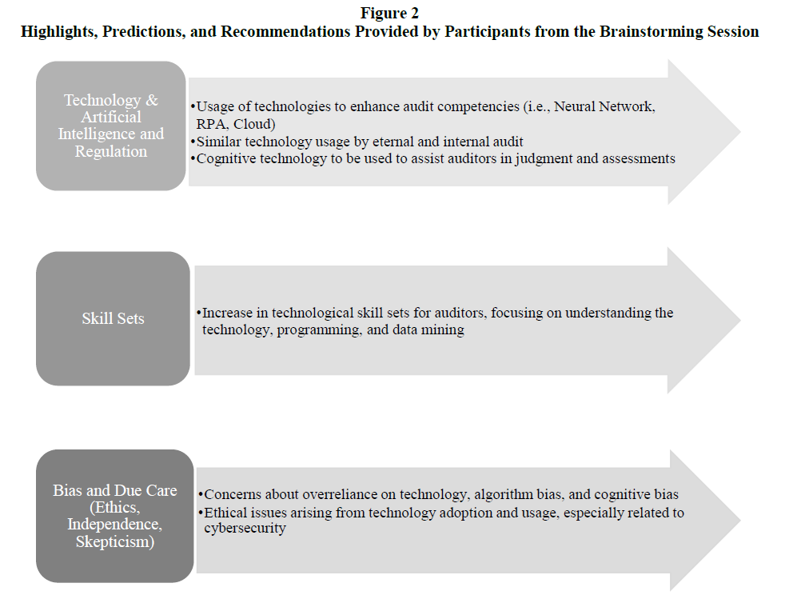
Finding

Slide 40
Finding
Internal and external audits will be highly automated, with an increase in the usage of technology generally
Technological skill sets of auditors are expected to greatly increase.
There is concern about the ethical implications of using technology and the need for compliance and regulatory frameworks.

Slide 41
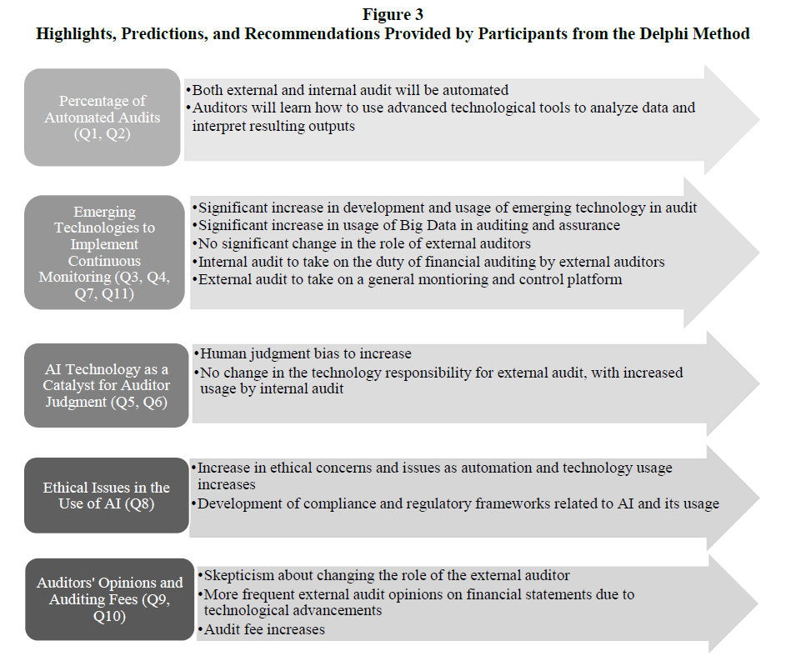
Finding
Notes:
Our experts have similar feedback and envision automation
further enhancing audits with proper training, guidance, and regulation.

Slide 42
Whether Firms’ Risk Disclosures are Informative? Using a Novel Tool to Quantify Textual Data
Qingman Wu
Won Gyun No

Slide 43
Background
Risk disclosures in corporate annual reporting are a very important information source for external information users to get more knowledge about the risks that firms face.
Using number of keywords
Campbell et al. (2014) find that firms are intend to provide firm-specific and informative risk disclosures.
Campbell et al. (2019) find that risk factor disclosures provide information about the level of a firm’s future cash flows and investors incorporate this information into current stock prices.
Chiu et al.(2019) find that risk factor disclosures provided by firms in their annual reports contain useful information that could potentially help their suppliers achieve better investment efficiency.
Beatty et al. (2019) examine the change of information content of firms’ risk disclosures before and after the financial crisis by separating risk into repeated risk, discontinued risk, new risk. They find firms’ risk disclosures were informative before crisis and less informative after the crisis.
Using number of sentence related to firms’ risks
Kravet and Muslu (2013) examine the association between firms’ risk disclosures and investors risk perception and find that firm-level risk disclosures are more likely to be boilerplate.
Yang et al. (2018) examine the association between four risk measures derived from the risk factor section in 10-K filings and audit fees and find that firms’ textual risk disclosures are informative.
Other methods
Bao and Datta (2014) proposed a sent-LDA model (with 30 topics) to simultaneously discover and quantify risk types from textual risk disclosures. They find that some types of risks are informative and some are not.

Slide 44
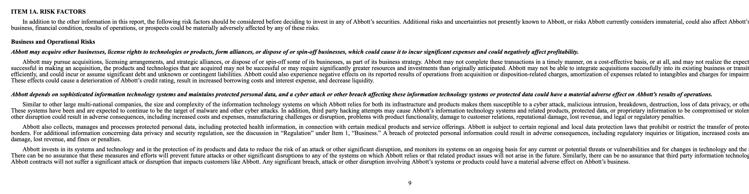
Method
Download 10-Ks from EDGAR
  10-Ks from 2005 to 2022 (tentative)
Data preprocess
  Parse out Item 1A from 10-K
  Extract risk factors by section
  Data cleaning
Classify risk factors using ChatGPT API
Risk types aggregation

Slide 45
The Watchdog Effect of Granular Transparency Regulation: Evidence from Firms’ Responses to the Greenhouse Gas Reporting Program
Dong Gil Kim¹
¹Rutgers Business School
CARLAB meeting, 2023 June

Slide 46
Greenhouse Gas Reporting Program (GHGRP)
The EPA implemented the Greenhouse Gas Reporting Program (GHGRP) in 2010, mandating facilities emitting over 25,000 metric tons of carbon dioxide equivalent per year to disclose their GHG emissions at the facility-level.
Starting in 2012, the EPA began publicly releasing facility-level GHG emissions information through its website.
Publicly traded companies owning regulated facilities are affected by the program’s annual reporting requirements, as it offers granular transparency without imposing compulsory reduction measures.
This unique regulatory context creates an opportunity to examine the influence of granular transparency regulation on firm-level behavior.

Slide 47















Relationship between firm and facilities
Ownership structure Firm-level = Aggregated-level
Two disclosure-levels of transparency regulation
Horizontal policy effect
1. Transparency regulation at aggregated-level
Ex) UK’s firm-level GHG disclosure mandate
The downstream effect of aggregated-level policy on disaggregated-level
A facility can be owned by multiple firms
A firm can own multiple facilities
The upstream effect of disaggregated-level policy on aggregated-level
2. Transparency regulation at disaggregated-level
Facility-level = Disaggregated-level
Horizontal policy effect
Ex) GHGRP, AB32, RGGI in the US
EU ETS in the European Union
Figure: Firms, facilities and two disclosure-levels of transparency regulations

Slide 48
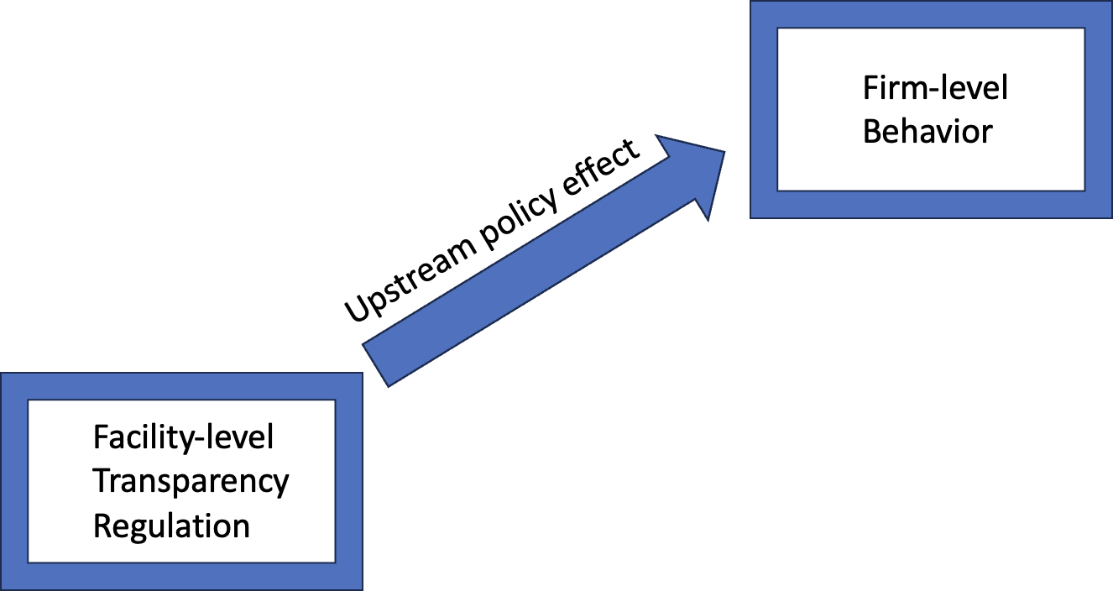
Research questions
The key question is whether requiring facility-level GHG emissions disclosure has an influence on overall firm-level behavior.
Specifically, does the mandate to disclose GHG emissions at the facility level prompt firms to voluntarily reduce their aggregate-level GHG emissions, and if so, what mechanisms are responsible for driving this effect?

Slide 49
Why do accounting students procrastinate? A qualitative analysis using chatgpt
ACCOUNTING EDUCATION RESEARCH GROUP
Eva Blondeel – Carlab Meeting 27-06-2023

Slide 50
Introduction
Active learning interventions: effective to combat procrastination
(Blondeel et al., 2021; Blondeel et al., 2023a; Blondeel et al., 2023b)
However, despite all efforts to actively engage students, the majority of the students still procrastinate
Source: Blondeel, Everaert & Opdecam (2023). Working paper.

Slide 51
Introduction
Active learning interventions: effective to combat procrastination
(Blondeel et al., 2021; Blondeel et al., 2023a; Blondeel et al., 2023b)
However, despite all efforts to actively engage students, the majority of the students still procrastinate
General RQ: Why do first-year accounting students procrastinate?
Source: Blondeel, Everaert & Opdecam (2023). Working paper.

Slide 52
literature
Previous findings
Self-regulation, self-discipline, impulsiveness (Steel & Klingsieck, 2016)
Antecedents of procrastination (Klingsieck et al., 2013)
  Personal antecedents: motivational, emotional etc.
  Situational antecedents: social, external structure etc.
Quantitative (Steel & Klingsieck, 2016) and qualitative (Klingsieck et al., 2013; Lao et al., 2023)
However … there are differences in procrastination between courses (Kljajic et al., 2022)
  Accounting is perceived as a difficult course (Carnegie, 2021)
  Procrastination fluctuates throughout the semester of an accounting course (Blondeel et al., 2023 WP)

Slide 53
contribution
This study
Antecedents for procrastination in the accounting course
Evolution of the antecedents throughout the semester
RQ1: Why are first-year accounting students procrastinating?
RQ2: How do these reason differ throughout the semester?

Slide 54
methodology
In-dept one-on-one interviews with first-year undergraduate accounting students in Business Economics at Ghent University
Qualitative data collection
3 Rounds of interviews
12 Different students each round
Procrastination
Procrastination
Interview
Interview
Interview
T0
T1
T2
W1
W2
W3
W4
W5
W6
W7
W8
W9
W10
W11
W12

Slide 55
Methodology: sample
Stratified sample: Procrastination T0, Gender, and Ability
Round 1 | Round 1
 | Procrastination | Gender | Ability (/20)
S1 | Medium | Male | 11
S2 | High | Female | 6
S3 | High | Female | 12
S4 | Low | Female | 15
S5 | Medium | Female | 14
S6 | Medium | Male | 13
S7 | High | Female | 9
S8 | Medium | Female | 7
S9 | High | Male | 16
S10 | Low | Male | 12
S11 | Low | Female | 16
S12 | High | Female | 6
Round 2 | Round 2
 | Procrastination | Gender | Ability (/20)
S13 | High | Female | 8
S14 | High | Male | 16
S15 | Medium | Female | 12
S16 | Medium | Male | 16
S17 | High | Female | 15
S18 | Medium | Female | 16
S19 | High | Female | 14
S20 | Low | Female | 18
S21 | High | Male | 18
S22 | Medium | Female | 6
S23 | Medium | Male | 15
S24 | High | Female | 15
Round 3 | Round 3
 | Procrastination | Gender | Ability (/20)
S25 | Low | Male | 18
S26 | High | Male | 14
S27 | High | Female | 9
S28 | Medium | Female | 10
S29 | Medium | Male | 19
S30 | Medium | Female | bisser
S31 | Medium | Male | 13
S32 | Medium | Male | 18
S33 | High | Female | 9
S34 | Low | Male | 14
S35 | Medium | Female | 8
S36 | Medium | Female | 13

Slide 56
Methodology: approach
Qualitative interview data: two-step procedure
Transcribing the interviews
Dutch transcripts
Manual selection of sentences referring to procrastination

Slide 57


Methodology: approach
Qualitative interview data: two-step procedure
Manual coding
Develop coding scheme
Manual coding
ChatGPT coding
Provide coding scheme (or not ?)
Prompt Engineering (Gu et al., 2023)

Slide 58





Eva Blondeel
Doctoral Researcher and Teaching Assistant
Research group Accounting Education, Ghent University
Eva.Blondeel@UGent.Be linkedin.com/in/eva-blondeel
Let’s stay connected!
www.accountingeducation.ugent.be

Slide 59
Artificial Intelligence Co-Piloted Auditing
Hanchi Gu, Marco Schreyer, Kevin Moffitt, and Miklos A. Vasarhelyi
Present by: Hanchi Gu

Slide 60

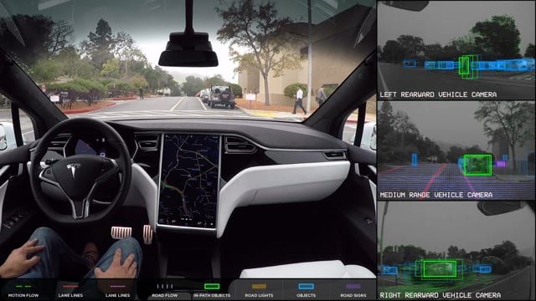
The Concept of Co-pilot
E.g., Tesla’s Autopilot, Ford’s BlueCruise,
and Mercedes’s Drive Pilot
Notes:
The concept of a co-pilot, traditionally associated with aviation, denotes a professional whose responsibility is to assist the pilot in navigating the aircraft.
THE goal of distributing workload, enhanc- ing safety, and increasing operational efficiency.
This concept, however, has found relevance beyond aviation and serves as a concept for technological systems designed to operate synergistically with humans, augmenting human capabilities, enhancing efficiency, and mitigating workload. Nowadays, the concept of co-piloting has been effectively embodied in advanced driver-assistance systems.
FOR Tesla’s Autopilot, Ford’s BlueCruise, and Mercedes’s Drive Pilot

Slide 61









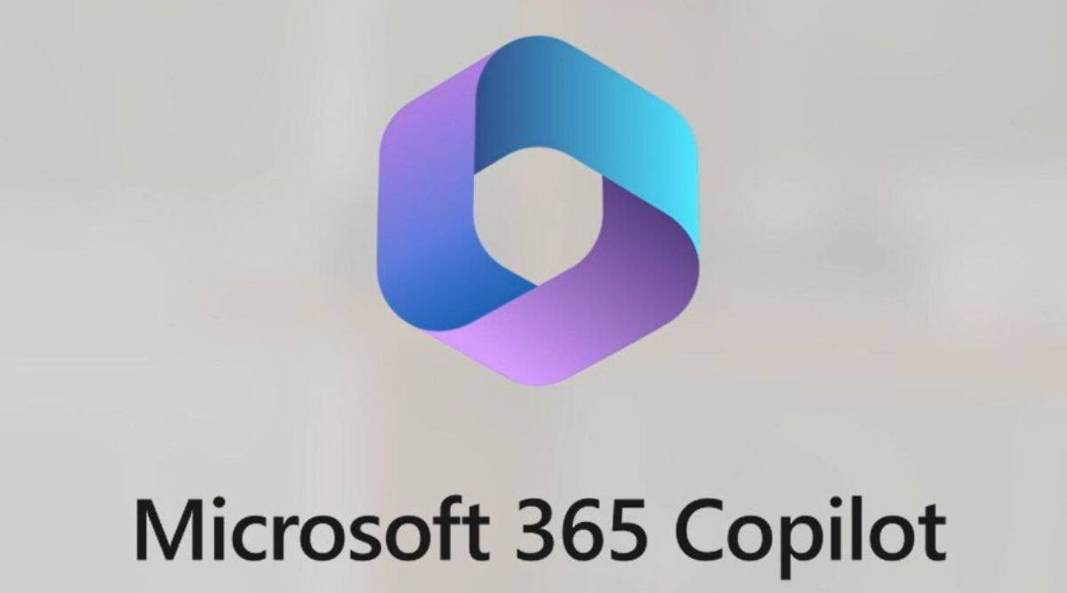
The Development of Co-pilot
Software Development
(e.g., Visual Studio Code, GitHub Copilot),
Customer Support
(e.g., Zendesk, Intercom)
Healthcare
(e.g., BuoyHealth, Ada Health)
Smart Home Assistants
(e.g., Amazon Alexa, Apple Siri, Google Assistant),
General Productivity Assistant
(Microsoft 365 Copilot)
Auditing?

Slide 62
Summary
Our study offers the following contributions:
We introduce the concept of co-piloted auditing, a highly collaborative partnership between human auditors and AI models that capitalizes on each other’s capabilities to enhance auditing.
We present a comprehensive overview of foundation models, with a focus on pre-training and fine-tuning techniques specifically tailored to the domain of financial auditing.
We demonstrate the effectiveness of employing chain-of-thought prompting to guide LLMs in addressing specific audit tasks, highlighting the model’s versatility and reasoning capabilities.
We assess the effectiveness of our prompting protocols by employing ChatGPT, analyzing both the application of the protocols and the quality of the generated responses.

Slide 63
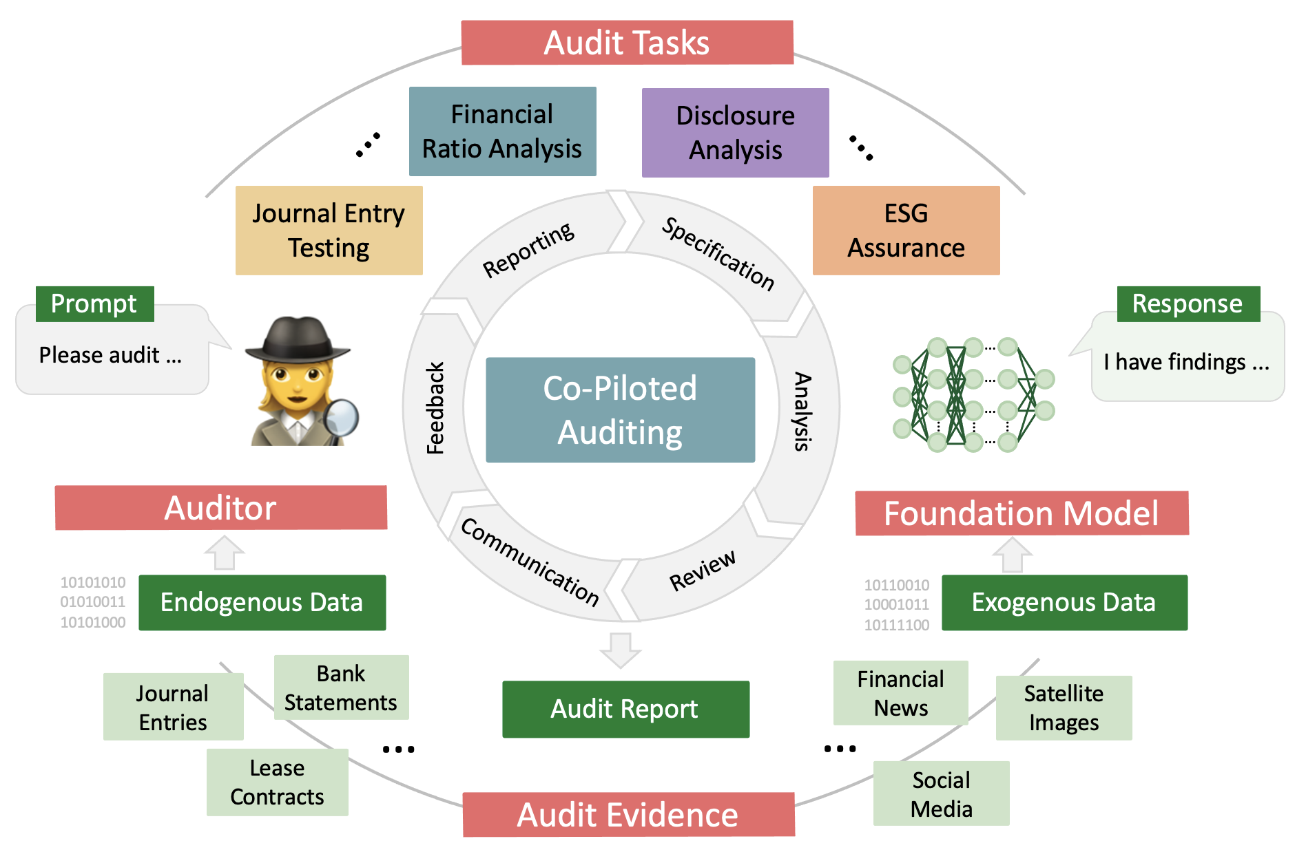
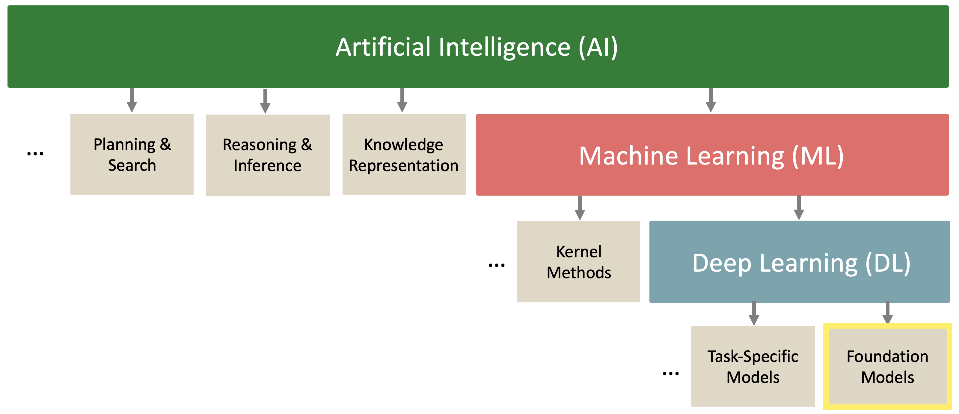
Foundation-Model-Empowered AI Co-piloted Auditing
Co-piloted Auditing Concept Framework
Co-piloted Auditing Process
Notes:
Co-piloted auditing, wherein human auditors collaborate with foundation AI models to accomplish audit tasks. In such a setting, human auditors and models form a highly collaborative partnership, capitalizing on each other’s strengths to deliver comprehensive and accurate audits.
In recent years, the field of deep learning has experienced a paradigm shift from task-specific models toward foundation models.
In the pre-training phase, a foundation model is trained on a vast amount of unlabeled data, typically employing self-supervised learning techniques. In this phase, the model learns from a variety of data sources and data modalities

Slide 64
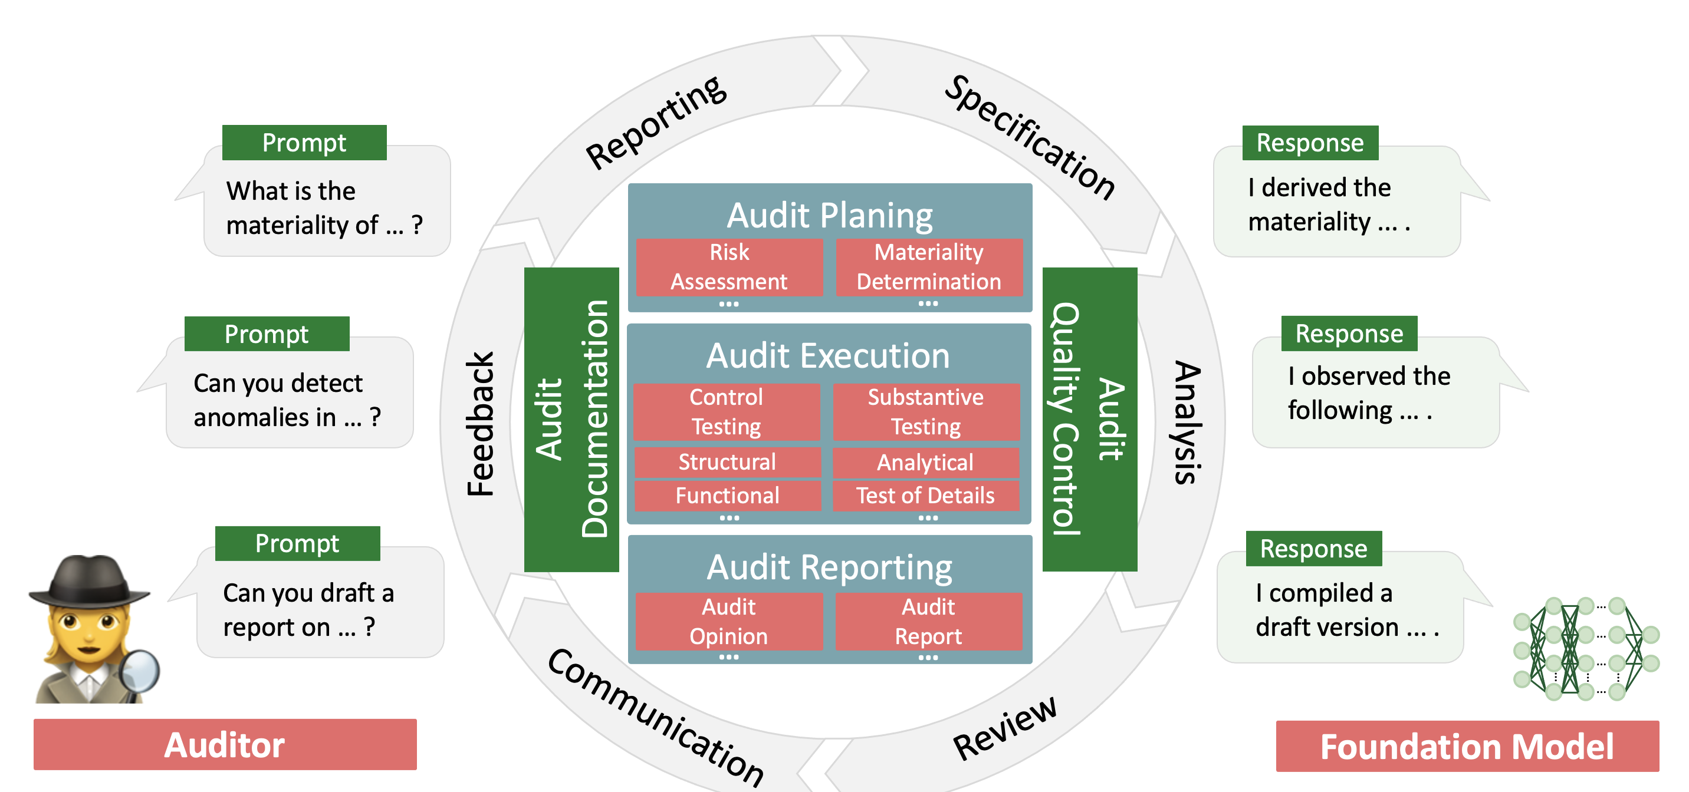
The Process of AI Co-piloted Auditing
Co-piloted Auditing Concept Framework
Co-piloted Auditing Process
Notes:
In this work, we propose the concept of co-piloted auditing, a highly collabora- tive partnership between human auditors and foundation models that capitalizes on each other’s strengths to deliver comprehensive and accurate audits. In particular, we explore the fine-tuning of LLMs using their single or few-shot learning capabilities (Zhao, Wallace, Feng, Klein, & Singh, 2021) to accomplish complex downstream audit tasks (Sanh et al., 2021).
The Co-piloted auditing process, where human auditors and foundational AI models collaborate seamlessly to conduct an audit. This synergistic partnership capitalizes on the unique strengths of each participant across the distinct phases of the audit: Audit Planning, Audit Execution, and Audit Reporting. Additionally, the AI model assists the human auditor in maintaining robust Audit Documentation and enforcing Audit Quality Control.

Slide 65
Experiments of Audit Task
Experiment A: Audit Task - Financial Ratio Analysis
Experiment A: Audit Task - Financial Ratio Analysis
[Model]: Audit initiated. I am now calculating the three financial ratios
based on the provided income statement data (Input 1).
Gross profit margin = Gross profit / Total revenue
Operating profit margin = EBIT / Total revenue
Net profit margin = Net income / Total revenue
Here are the calculated ratios:
Gross profit margin = 1.70782e+11 / 3.94328e+11 = 0.4330258827965754
Operating profit margin = 1.19437e+11 / 3.94328e+11 = 0.3029328940914151
Net profit margin = 9.9803e+10 / 3.94328e+11 = 0.25315486389767526
So, the results are as follows:
Calculation Completed!
Gross profit margin = 0.4330258827965754
Operating profit margin = 0.3029328940914151
Net profit margin = 0.25315486389767526
Experiment B: Audit Task - Post-Implementation Review
Experiment C: Audit Task - Journal Entry Testing
……
Notes:
The proposed CoT prompting strategy offers a systematic and efficient approach to fine-tuning foundation models for complex audit tasks, ultimately enhancing their adaptability and reasoning capabilities in the auditing domain. By demonstrating the versatility and adaptability of the fine-tuning methodology across various audit tasks, the potential of the CoT prompting strategy as a valuable instrument for future AI co-piloted auditing is emphasized. In the subsequent sections, the application of the CoT prompting strategy will be explored through three distinct experiments, each centered on a specific audit task.

Slide 66
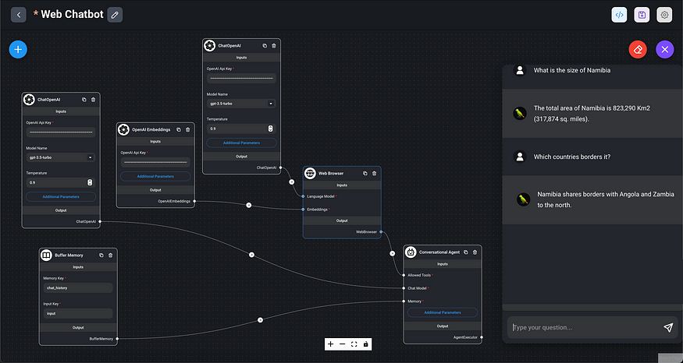
More Development

Slide 67
Manual Journal Entry Testing
--Using Natural Language Processing and Deep Learning
Qing Huang, Huijue Kelly Duan, Marco Schreyer, Miklos Vasarhelyi

Slide 68
Motivation
Information flows within the organization automatically and seamlessly under ERP era.
Flexibility to record complex transaction ➔ Manual Journal Entries
Current audit approach:
  mainly relies on manual testing
  randomly selecting, significant general ledger accounts, material dollar amounts
Considering the volume of the MJEs that an organization needs to process, current sampling testing cannot facilitate an efficient and effective monitoring process.
A better approach to comprehensively and systematically evaluate these MJEs are needed
Notes:
Manual journal entries is a common practice in an organization.
MJEs are considered to have a higher risk compared with automated journal entries.

Slide 69
Methodology
This study aims to find an innovative approach to evaluate MJEs and help the company’s management to improve their control procedures over MJEs and detect anomalous or fraudulent MJEs.
The study constructs three types of key risk indicators(KRI), including textual data and rare clusters, to identify potential fraudulent entries.
Latent space embedding of KRI results are further clustered for downstream audit tasks
The MJEs from a subsidiary of one multinational company are used to conduct this study. Three types of KRIs are constructed.

Slide 70
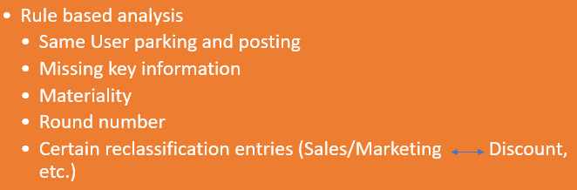
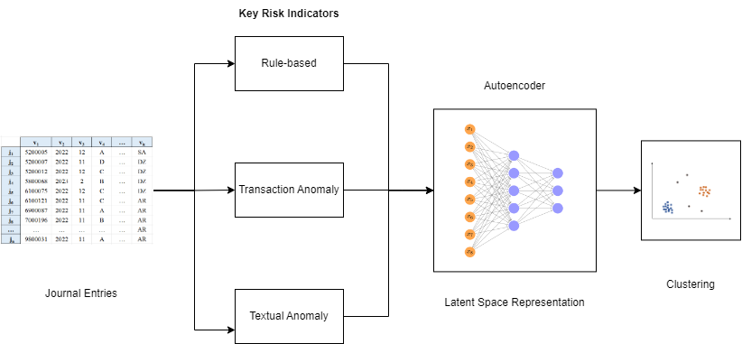


Slide 71
Contribution
Presents an innovative way to comprehensively and systematically evaluate JEs, and assist the company’s management in improving its control procedures over JEs.
Enhances the company’s control and monitoring procedures over MJEs.
Textual analysis in this study can provide management more intuitive information regarding the transaction essences.
Latent space representation of KRI yield interpretable anomaly transaction identification
Notes:
First, It significantly improves the company’s current internal audit practice. Rather than relying on manual random selection, the company can apply the proposed approach, using machine learning and natural language processing comprehensively evaluate MJEs.
Second, It can help the management to better monitor the process of JEs booking, identify those anomalous or fraudulent transactions, and ensure the financial statement are fairly presented.

Slide 72
Collaborate Verbal, Voice, and Visual Evidence in Detecting Managerial Uncertainty and Financial Outcomes
Yue Liu
Second Year Summer Research

Slide 73
Research Question:
Whether the uncertainty evidence in the interviews of CEO about earnings can be used to predict financial outcomes?
Contribution:
Unstructured evidence
Generalize laboratory conclusions to real business situations
Behavior experiment in accounting(Cade et al., 2020):
Investors react more negatively to a video disclosure when the CEO displays nonverbal cues of uncertainty.

Slide 74
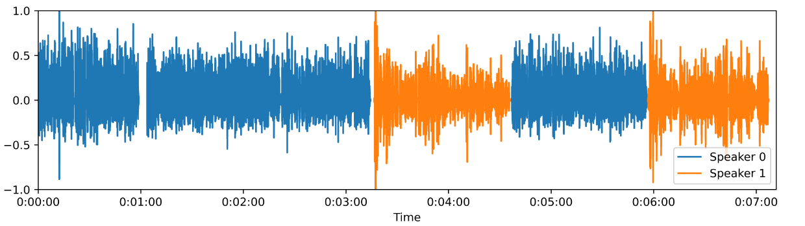
Sample Selection:
2018.01.01 —— 2023.05.31
545 videos
Keywords searching and manual processing
Speaker Diarization:
Extract Frames From Video:
Frames per second

Slide 75
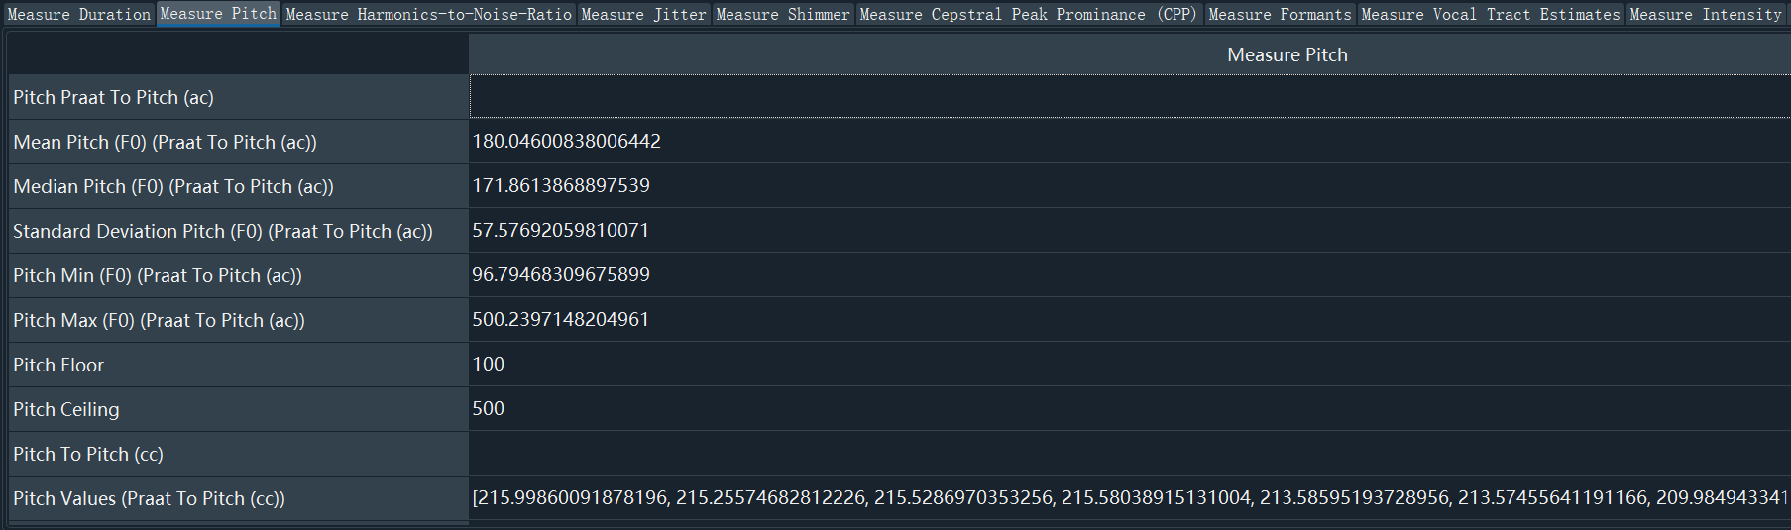
Voice Evidence:
Pitch
Harmonics-to-Noise Ratio
Jitter and Shimmer
…

Slide 76
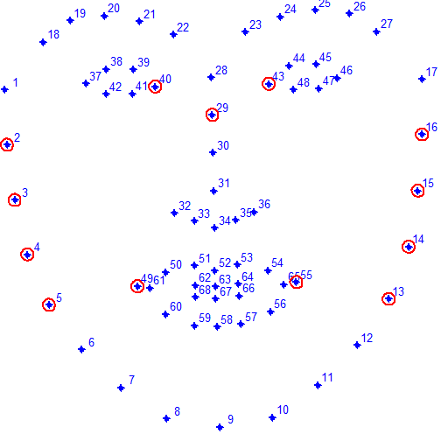
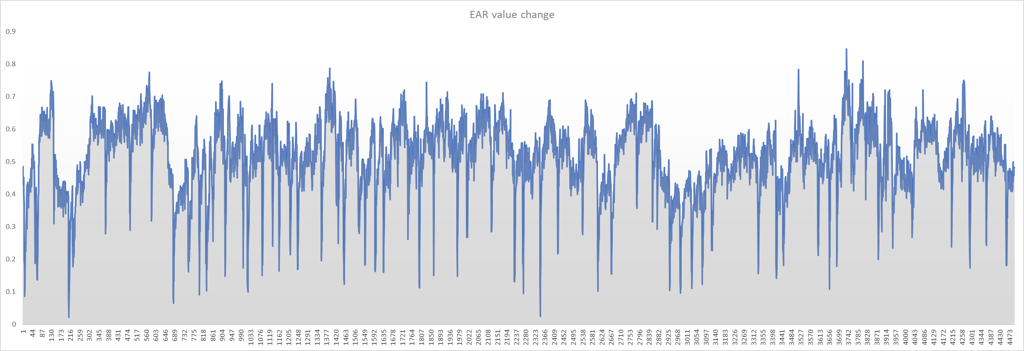
Facial Evidence:
Expression
Eye movement
Frowning
Eyebrows Raising
Head Side Turn
…

Slide 77
Can External Auditors Utilize ChatGPT to Assure ESG Reports? - Starting from Environmental Section Test
Presenter: Irina (Jie Bao)
Coauthored with Benita Gullkvist
6.27.2023

Slide 78
Research goals:
Explores the potential and limitations of ChatGPT in reviewing ESG reports.
Design a Framework:
  to show how we could utilize ChatGPT to extract information and further help assure ESG reports (an example of environmental section tests)
Empirically Test:
  Whether ChatGPT’s outputs agree with the manual check results?

Slide 79
Background
  ESG/ sustainability reports and its assurance
  AI implementation in the Audit process
  Emergence of OpenAI and GPT Architecture
    Strengths of ChatGPT
    Opportunities & Benefit v.s. Challenges & limitations

Slide 80
Assurance Process
Review and understand the company's ESG reporting framework:
    Global Reporting Initiative (GRI)
    Sustainability Accounting Standards Board (SASB)
    Task Force on Climate-related Financial Disclosures (TCFD)
Assess the company's data collection and reporting processes
Verify the accuracy of reported emissions data: Assess the company's emissions reduction targets and performance:
Review disclosures and reporting
Provide assurance opinion

Slide 81
Assurance Process
Review and understand the company's ESG reporting framework:
    Global Reporting Initiative (GRI) -GRI 305: Emissions
    Sustainability Accounting Standards Board (SASB)
    Task Force on Climate-related Financial Disclosures (TCFD)
Assess the company's data collection and reporting processes
Verify the accuracy of reported emissions data: Assess the company's emissions reduction targets and performance:
Review disclosures and reporting
Provide assurance opinion

Slide 82
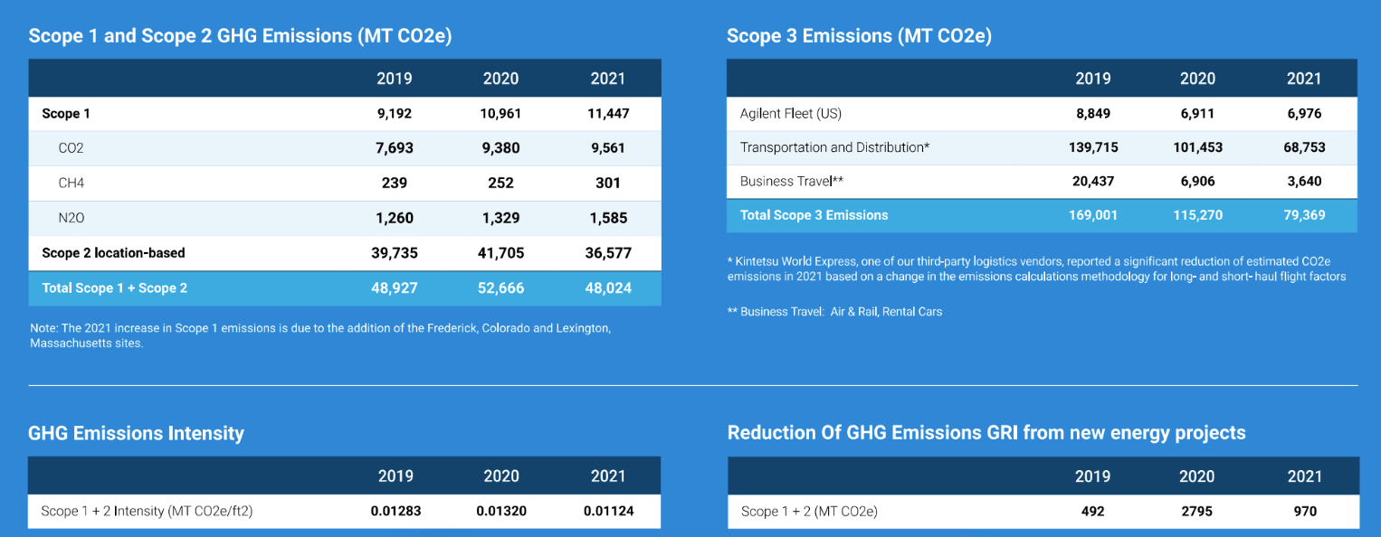
ESG Reporting sample (partial):
Agilent_2021

Slide 83
GRI 305: Emissions
Topic disclosures:
Disclosure 305-1 Direct (Scope 1) GHG emissions
Disclosure 305-2 Energy indirect (Scope 2) GHG emissions
Disclosure 305-3 Other indirect (Scope 3) GHG emissions
Disclosure 305-4 GHG emissions intensity
Disclosure 305-5 Reduction of GHG emissions
Disclosure 305-6 Emissions of ozone-depleting substances (ODS)
Disclosure 305-7 Nitrogen oxides (NOx), sulfur oxides (SOx), and other significant air emissions

Slide 84
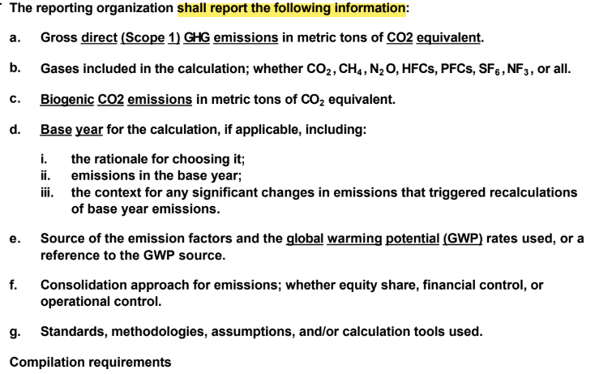

Slide 85
Questions to test:
Q1: “How much are scope 1 GHG emissions in metric tons of CO2e?"
Q2: “How much are scope 2 GHG emissions in metric tons of CO2e using the location-based calculation methodology?"
Q3: “How much are scope 2 GHG emissions in metric tons of CO2e using the market-based calculation methodology?"
Q4: “How much are scope 3 GHG emissions in metric tons of CO2e?"
Q5: “How much are the biogenic CO2 emissions in metric tons of CO2 equivalent?"
Q6: “What gases (CO2 /CO2 , CH4 /CH4 , N2O, HFCs, PFCs, SF6 , NF3) are included in the GHG emission calculation?"
Q7: “What is the base year (baseline) for the emission calculation disclosed?"
Q8: “What is the rationale for choosing the base year (baseline)?"
Q9: “How much are scope 1 GHG emissions in metric tons of CO2e in the base year (baseline)?"

Slide 86
Questions to test:
Q10: “What significant changes in emissions triggered recalculations of base year emissions?“
Q11: “What are the sources of the emission factors?“
Q12: “What are the global warming potential (GWP) rates?“
Q13: “What reference is used for the GWP source?"
Q14: “What is consolidation approach for GHG emissions?; Is it equity share, financial control, or operational control?"
Q15: “What are the standards, methodologies, assumptions, or calculation tools used in the GHG emissions calculation?"
Q16: “Does the calculation of gross direct (Scope 1) GHG emissions exclude any GHG trades?"
Q17: What reporting standard/protocol/framework did the file use?” Is it GRI, SASB, TCFD, ISO, CDP, WRI?"

Slide 87



Method
  Feed the 17 questions to ChatGPT and record the outputs
  Methods tried:
    Plug-in
    API

Slide 88
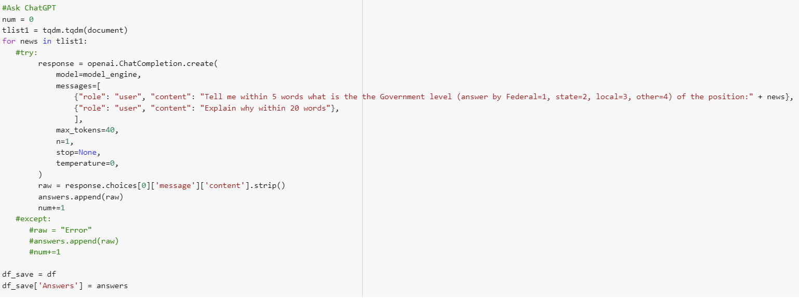
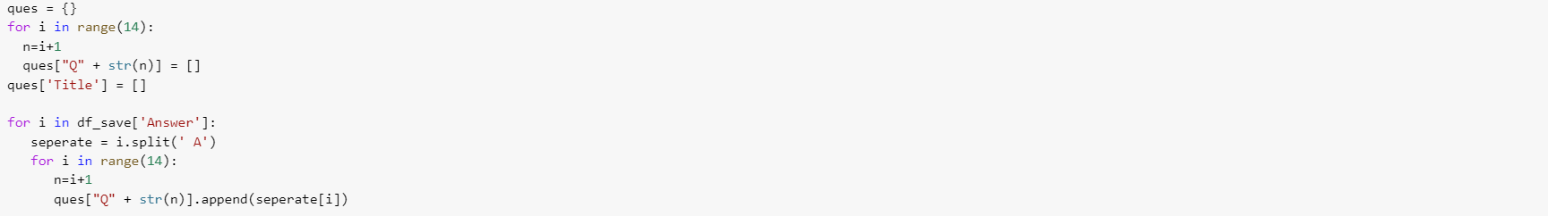
Sample code to use ChatGPT API

Slide 89
Method
    Sample:
    use the year 2021’ ESG reports
    S&P 500 companies without financials (SIC6) = 400 companies
    about 260-280 use GRI standards
    Further check the ones with separate Auditor’s assurance reports
Current sample: 54 (recorded all manual checked answers to 17 questions)
Whether ChatGPT’s outputs agree with the manual check results

Slide 90
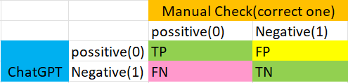
Method
    Code the answers as 1 if it has found the answer, and 0 if it's N/A
    Check Type1 and Type2 errors
    Could further infer the Reporting Quality via the number of questions answered (i.e. contents disclosed)

Slide 91
Sentimental Analysis as a measure for determining the Informativeness of Cybersecurity Disclosures
Presented by: Hongmin William Du

Slide 92
Introduction
Importance of Cybersecurity Disclosures
  Definition of cybersecurity disclosures
  Significance of accurate and informative disclosures for stakeholders, investors, customers, and employees
  Impact of cybersecurity disclosures on decision-making, risk assessment, and overall trust in organizations
  Challenges in evaluating the informativeness of cybersecurity disclosures using traditional measures
Application of Sentimental Analysis on Cybersecurity Disclosures
  Definition of sentimental analysis
  Advantages of sentimental analysis compared to traditional methods

Slide 93
Research Question and Hypothesis
Research Question: Can sentimental analysis be a better measure in determining the informativeness of cybersecurity disclosure?
Hypothesis: Traditional measures of cybersecurity risk, without consideration of sentiment, can be misleading, as firms with more detailed cybersecurity disclosures may actually have lower actual cybersecurity risk.

Slide 94
Data and Methodology
Five main sets of data
  Firm Cybersecurity Disclosures (10-K)
  Unique dataset of software's used by firms (Stackshare)
  Software vulnerabilities (NIST Vulnerability Database)
  Standard firm control variables (Compustat)
  Cybersecurity Breach Dataset (PRC)
Main unique dependent variable: Firm average software vulnerability score
Sub- dependent variable (traditional): Firm data breach (0 if no breach, 1 if breach)
Independent variable: Firm cybersecurity disclosure sentiment score

Slide 95
Sample Distribution
Final Sample: 464 unique firms
Spans a variety of industries
Manufacturing Sales Healthcare
Finance
Other Tech
Transportation IT Companies Admin/Support/Waste Other Services

Slide 96
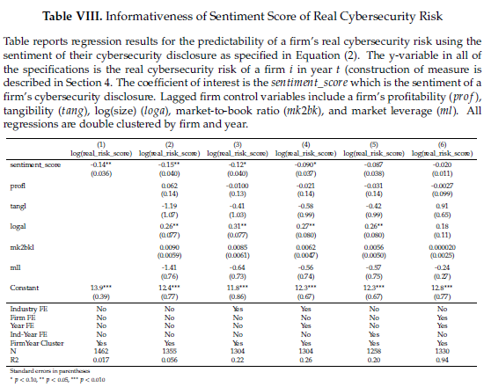
Regression and Results

Slide 97
Conclusion
Sentiment Analysis shows promise as a valuable tool in evaluating the informativeness of cybersecurity disclosures
Sentiment Analysis allows for a more comprehensive understanding by capturing subjective information
Improved decision making: By considering sentiment analysis, organization can make more informed decisions, respond to stakeholders’ concerns, and proactively address cybersecurity risks
Continued research is necessary to refine sentiment analysis methodologies, and establish best practices for its implementation

Slide 98
Analyzing Analyst Question Patterns in Earnings Calls: Leveraging NLP Models for Sentiment and Forward-Looking Analysis
Summer Research Progress Presentation
Haoyun (Harry) Gao
06.27.2023

Slide 99
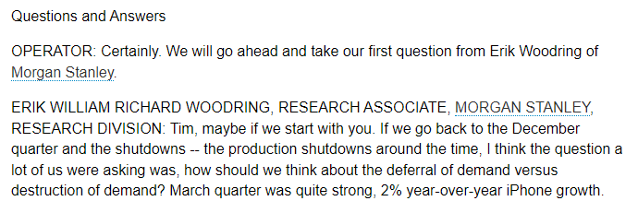
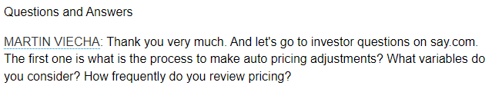
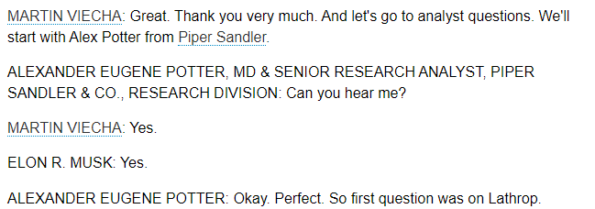
Analysts in conference call Q&A sections
seems random

Slide 100
In a Nutshell
Objectives:
  to investigate the hidden patterns exhibited by analysts’ questions during earnings calls; to measure sentiment and level of forward-looking content in the questions posed by analysts
Potential contributions:
  inform regulators on fairness and transparency in the earnings call Q&A section
  contribute to the literature in the fields of analysts' behavior and NLP research

Slide 101
Hypotheses
H1: There exists bias in the choice of analysts during earnings calls, influenced by factors such as shareholding and brokerage size.
H2: The questions selected earlier during the call tend to be more positive tone in comparison to subsequent questions.
H3: The questions selected earlier during the call tend to have a higher degree of forward-looking content compared to subsequent questions.
Notes:
need a theoretical background

Slide 102
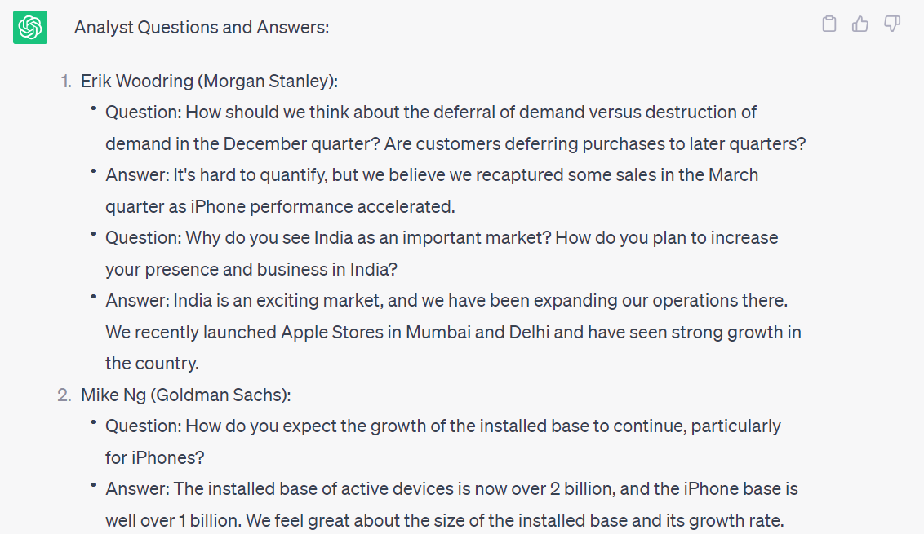
Data and Methodology
Conference call Q&A transcripts
  FactSet
  Seeking Alpha
  Motley Fool
  Factiva
ChatGPT
FinBERT
Notes:
we are gauging the quality of the data

Slide 103
Next steps
develop a stronger theoretical background for each hypothesis
examine the available datasets and start data collection

Slide 104

Questions and comments

Slide 105
Do employees know what would happen? Signals for the firm performance derived from the bottom tone
Hanxin Hu, Rutgers
Kelly Duan, Sacred Heart University
Ting Sun, The College of New Jersey

Slide 106


Motivations and Research Questions
Motivations
Research Questions
Inside Employee perceptions are indicative of the firm’s prospective financial and non-financial performance.
  Anecdotal evidence (e.g., Wells Fargo fraudulent account scandal in 2016).
  Empirical evidence (e.g., Hales et al., 2018; Campbell and Shang, 2021; and Briscoe-Tran, 2022), where inside views are extracted from a company-reviewing social media platform Glassdoor.
Limitations
  Mostly relying on the homogenous scaled ratings; or using dictionary-based approach to extract textual information.
  Using the single aggregated-level index to proxy for employee perception
  The role of “top tone” is often ignored.
How to construct semantically reliable topic features to predict the firm future performance?
Which aspects of information extracted from Glassdoor reviews are more important?
Compared to top management tones in the mandatory disclosure, do inside views carry unique and significant information regarding the firm outlook?
Glassdoor textual reviews
Firm financial and non-financial outcome
Notes:
Based on millions of anonymous employee reviews posted on Glassdoor, this research investigates whether the tone from the bottom can predict a company’s financial and ESG performance

Slide 107
Research Design
Step 1: construct topic features
An unsupervised neural network-based topic model (i.e., Contextualized Topic Model from Federico et al, 2021) is developed to classify over 3,200,000 employee review contents into various categories, including career growth opportunities, work-life balance, workplace atmosphere, and compensation benefits.
Step 2: rolling-window forecast
Step 3: Top tones versus bottom tones
We examine whether employee perspectives can complement the forward-looking tones of top management in the MD&A section to augment the accuracy of performance forecasts.
Using a rolling-window approach for the sample period 2010 to 2021, ridge regression models are used to evaluate if employee perceptions contribute incrementally to forecasting firm profitability, net cash flow activities, and non-financial performance. Furthermore, the attribute importance analysis is conducted to determine which topics are strongly linked to firm-level performance

Slide 108
Thanks!
Any comments or suggestions are welcomed and appreciated ☺
hh497@scarletmail.rutgers.edu

Slide 109
ESG Report Data Extraction:
Generalized Text-Mining Framework
Presented by Steven Katz

Slide 110
Introduction
ESG reports are long, unstructured, and difficult to interpret/compare
Considerable array of options for extracting meta-information
  Sentiment, similarity, part-of-speech prevalence, etc.
Extracting specific information more difficult
  Stated goals, reporting framework(s) used, assuring party

Slide 111
Introduction
Used text mining to answer six questions
  Want to use experience to generate a widely applicable process
  Lots of other questions unasked
Design science project
  Given a corpus of ESG reports, how to extract information?
  Deliverable should be a framework that generalizes ESG report text mining
Target is “researchers who want to use ESG reports but can’t”
  We don’t claim to propose the only right way
  Just a sufficiently right way

Slide 112
Goals of ESG Report Text Mining Framework
What steps must precede analysis?
What technical pitfalls should be avoided?
What about ESG reports presents a unique challenge?

Slide 113
What steps must precede analysis?
Collection/Curation
  Where to gather data
  Linked documents
  Scanning to remove erroneous downloads
Cleaning/Trimming
  Strategies and rationale
  Identifying and removing extraneous pages

Slide 114
What technical pitfalls should be avoided?
Formatting irregularities
  Tables
  Columns
  Images
  Encryption
OCR vs Extraction
  Pros and cons of each

Slide 115
What about ESG reports presents a unique challenge?
Lack of standardized terminology
  Iterative process for building custom bag of words
  Fuzzy searches
  Context-sensitive searches
Limitations of presence/absence as signifier
  “Absence of evidence is not evidence of absence”
  Negative language
  Filer’s incentive to obfuscate

Slide 116
Tentative Framework
Collection/Cleaning
Choosing a search method
Customizing search tools
Testing/Refinement
Verification

Slide 117
AIS Literature Review Generation
Keywords: Artificial Intelligence; Deep Learning; Accounting; Automation; Language Model
Maksym Lazirko
Hanchi Gu

Slide 118
Goals:
Establish & Utilize Carlab LLM
Automate the Literature Review Process
Continuous Auditing Research

Slide 119
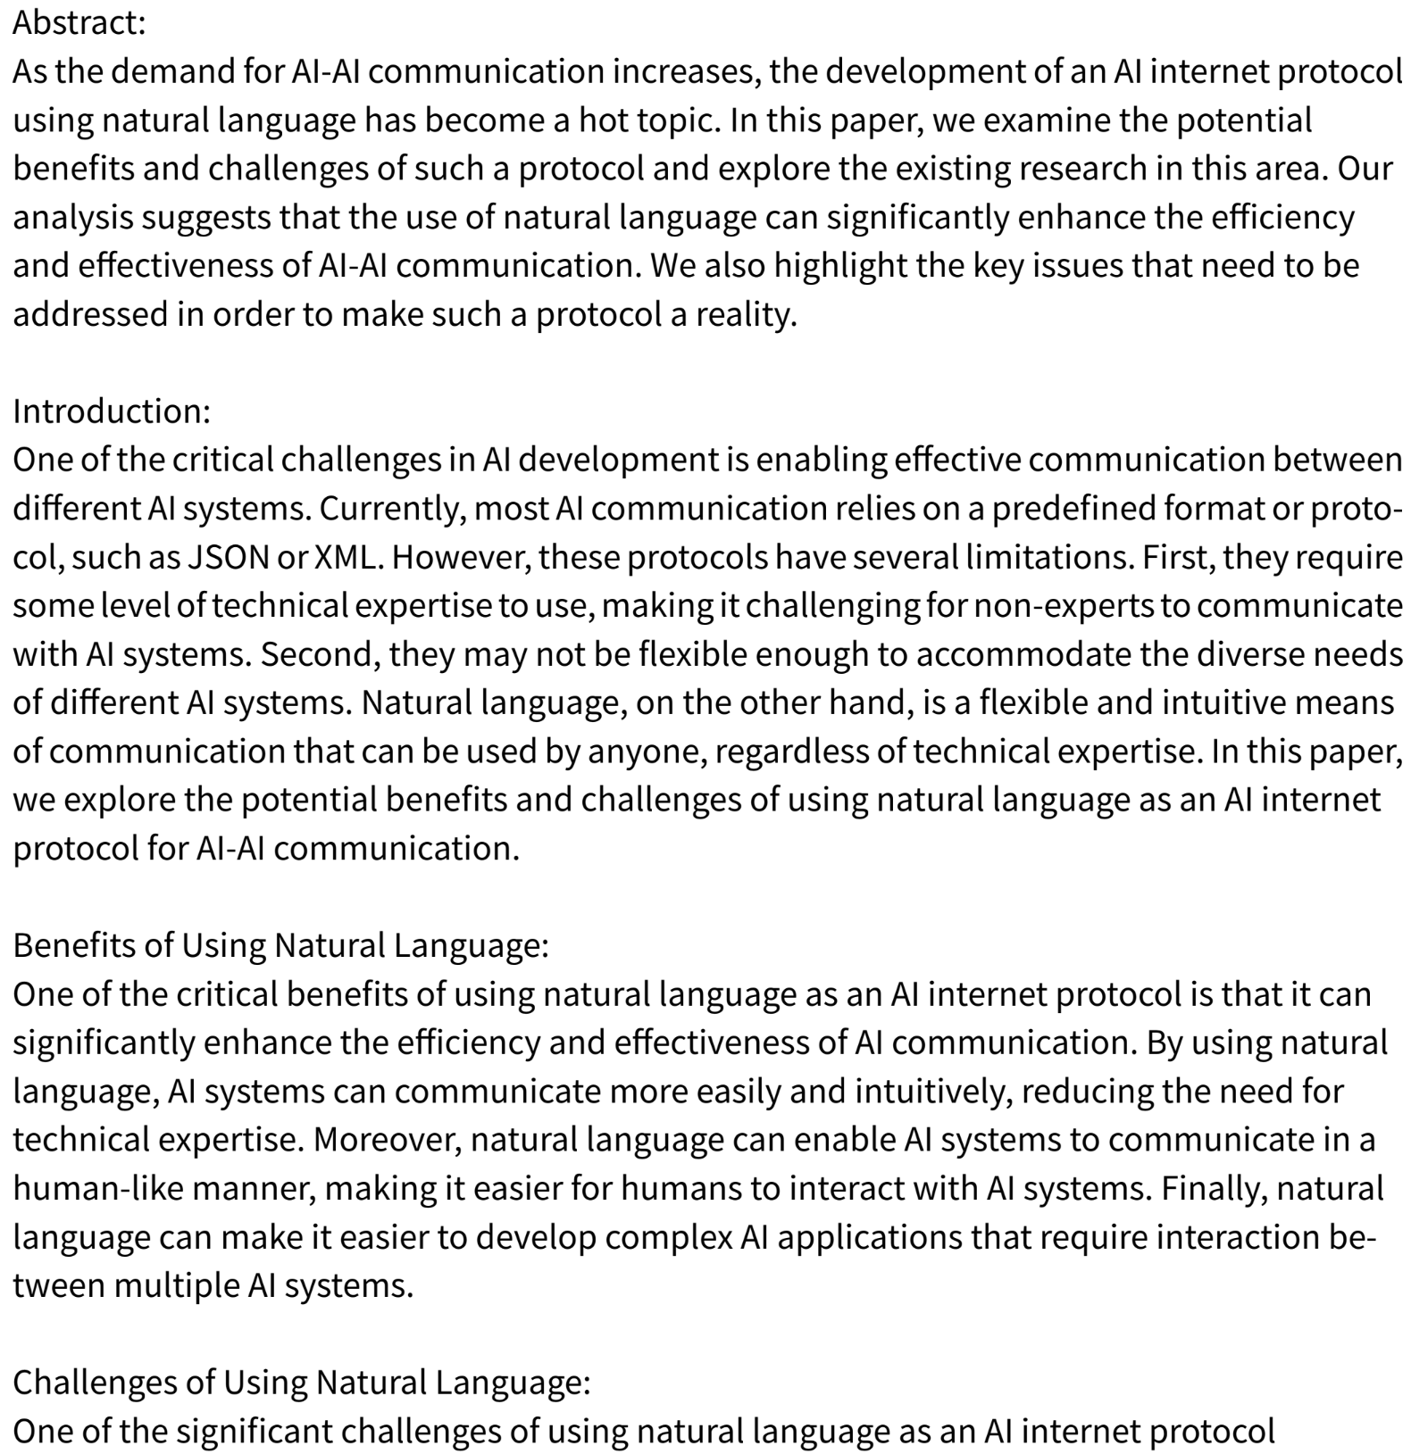
Phase I. Experiment
Involves tinkering with various algorithms/tools
Needs to allow for (AIS) field specification
Paper Must have legitimate Citations

Slide 120
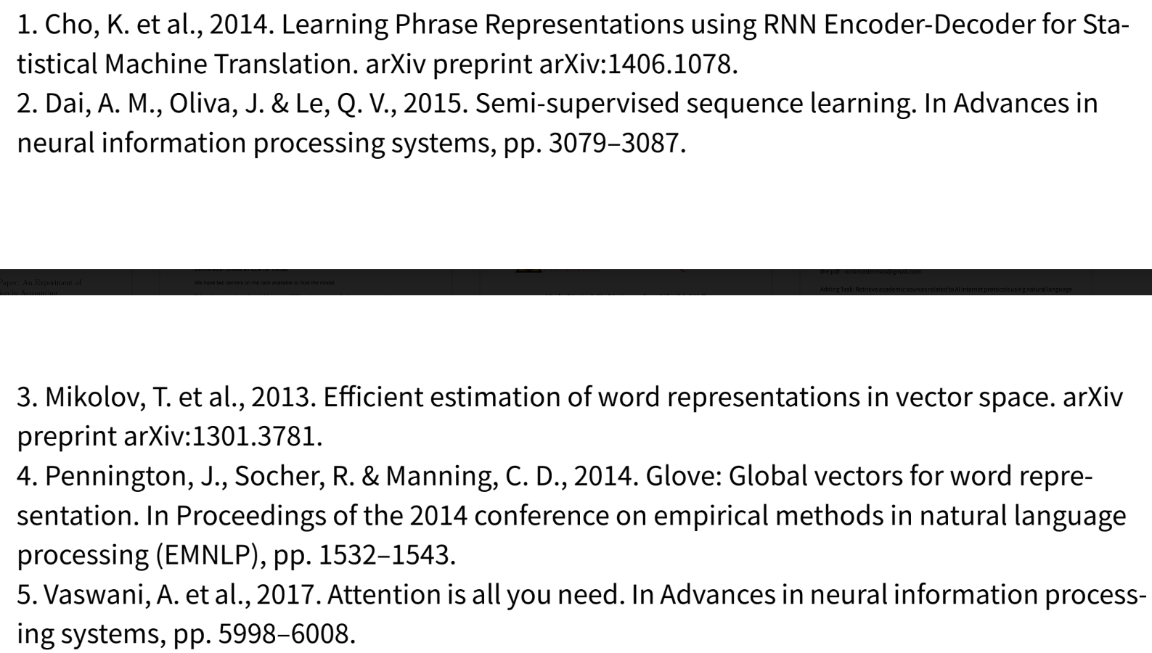
Phase II. Survey
Recreate sample paper that is outside of training data
Compare sample paper and its generated mirror
AIS experts rate quality of generated paper

Slide 121
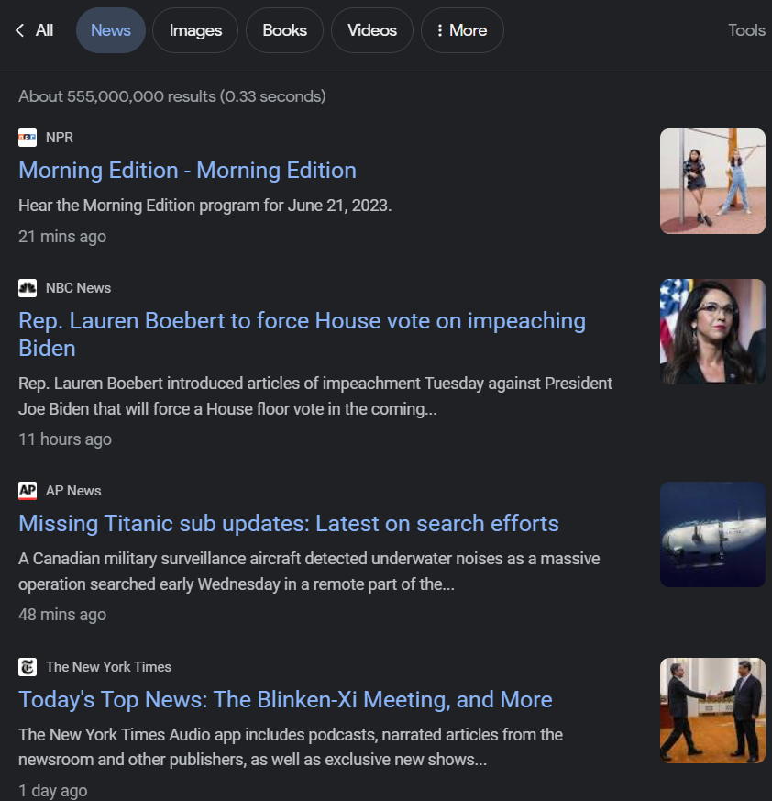
Phase III.
Adjustments & Future Research
Evaluate survey and address possible fixes/limitations
Web Scraping news to determine relevant research topics
Use current events as a seed for algorithm

Slide 122


Slide 123
CONTINUOUS MONITORING SYSTEM WITH INTERACTIVE VISUALIZATION: CASE STUDY ON GOVERNMENT PAYROLL DATABASE
Heejae (Erica) Lee
Ph.D. Candidate

Slide 124
Introduction
Several studies showed that visual analytics can facilitate decision-making by improving cognitive effort productivity.
Integrating interactive data visualization into the CM system can improve decision-making by allowing users to communicate more efficiently with the reported results.
Examine the role of visualization in interactions between human cognitive and continuous monitoring systems.

Slide 125
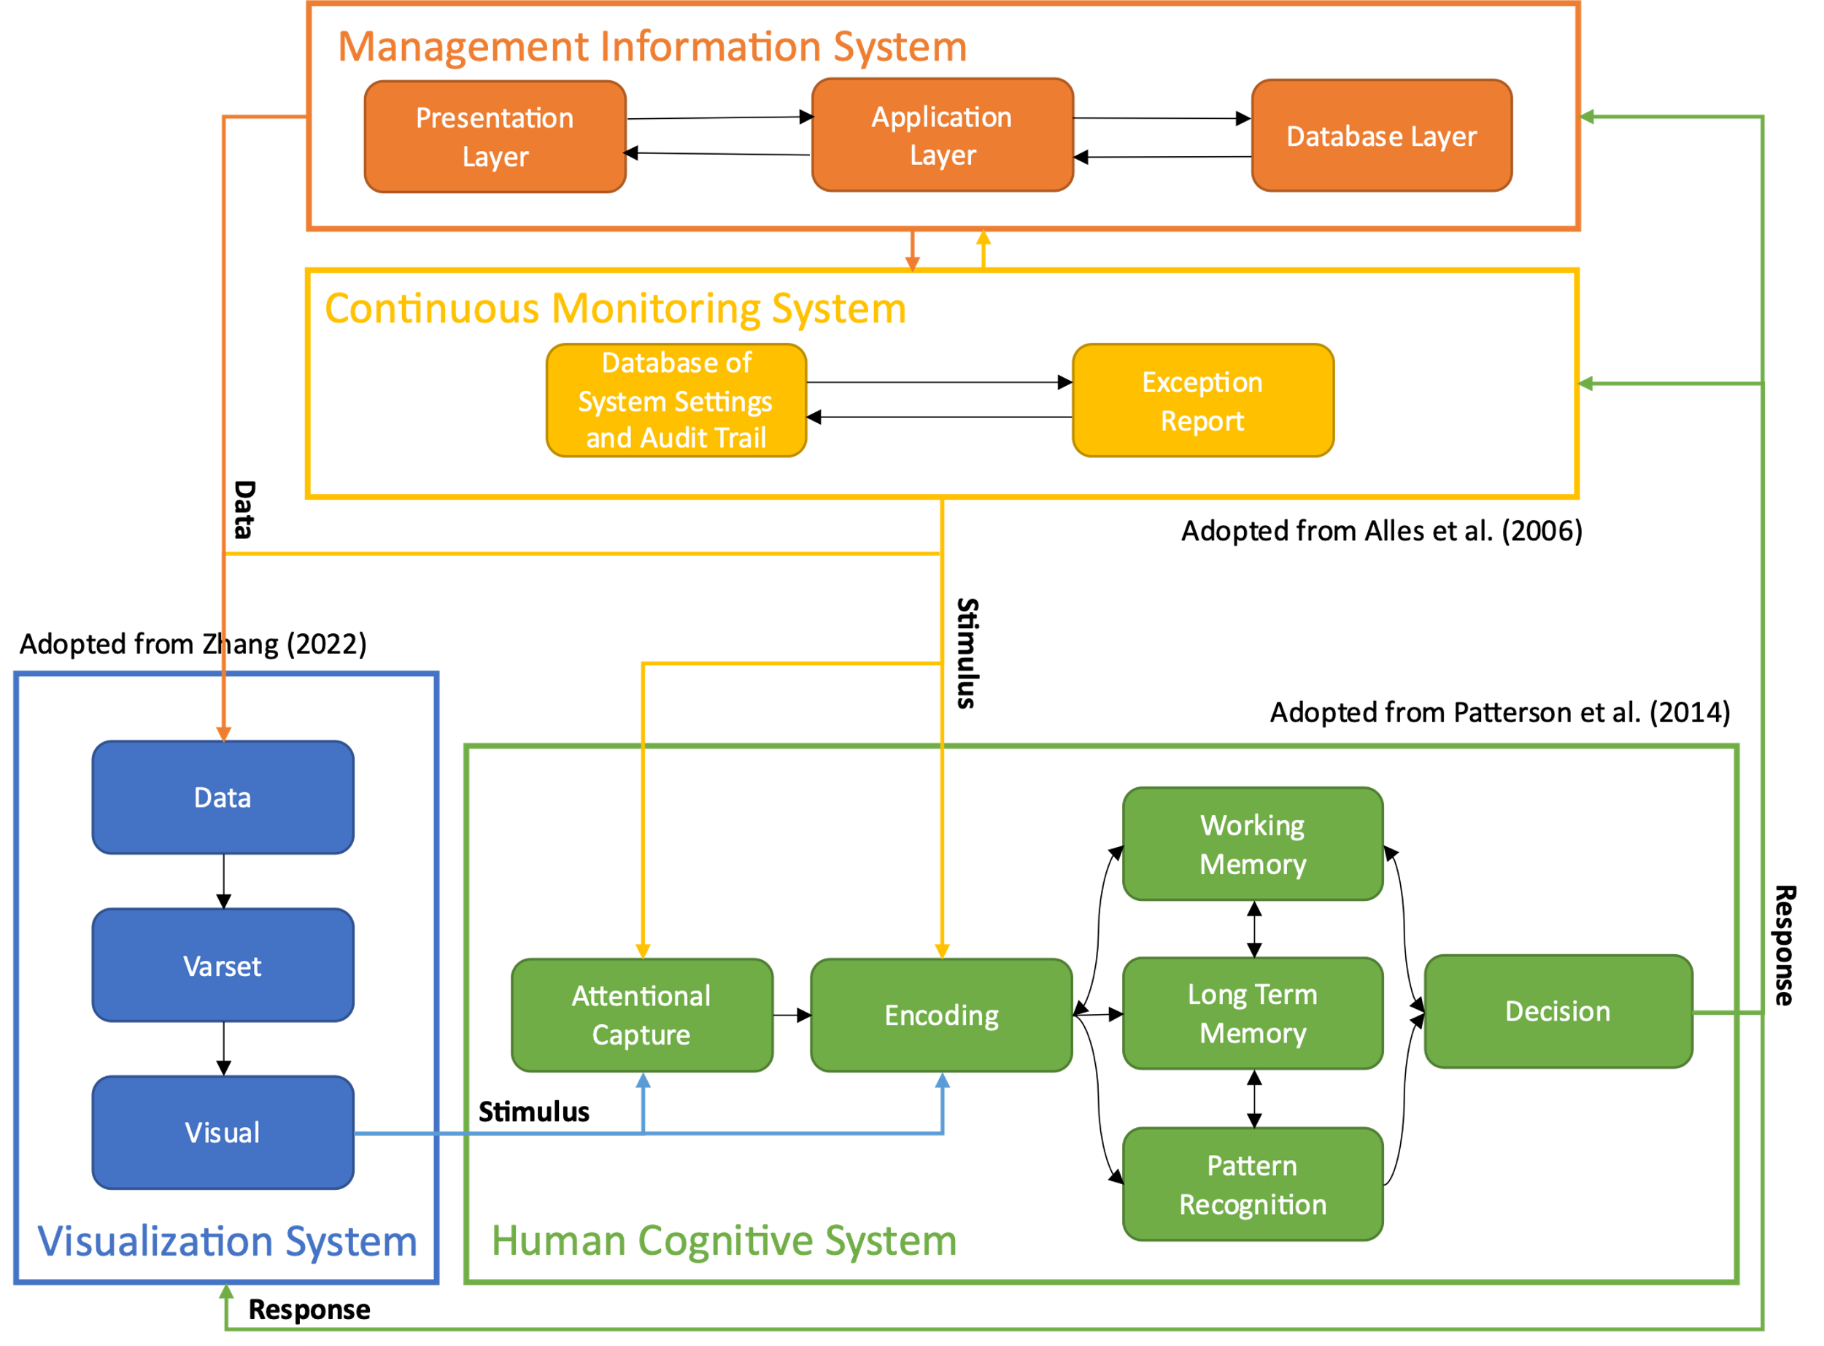
Model
Management Information System & Continuous Monitoring System (Adopted from Alles et al. 2006)
Visualization System (Adopted from Zhang 2022)
Human Cognitive System (Adopted from Patterson et al. 2014)

Slide 126
Case Study
Work with internal audit team to develop visual analytic dashboard
Data were extracted from the payroll database of the state government of Santa Caterina in Brazil.
Payroll data reported in 2021 were used to develop a prototype of the continuous monitoring dashboard.
Data includes 26,107,538 records of 169,082 current and retired employees from 46 departments under the state government.

Slide 127
Current CA system
The CA system creates reports for payment where the change is greater than cutoff every month.
Have two business days before the payment is processed.
The initial cutoff was set to monthly change greater than 3,000 Brazilian Real ($625)
The cutoff was updated to 30,000 Brazilian Real ($6,250) due to volume of exceptions

Slide 128
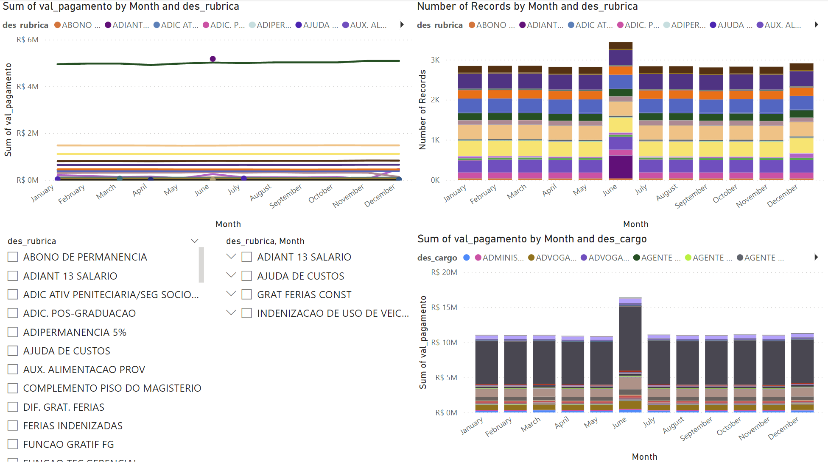
Design of Visual Analytics Dashboard
If the monthly Change of a certain payment type is greater than 3,000 Brazilian Real, it will be listed in the slicer.

Slide 129
Future Plan
Complete prototype and share it with internal audit team
Receive feedback from internal audit team and revise the dashboard

Slide 130
Enhancing Payroll Fraud Detection for Governments: Continuous Auditing with Deep Learning based Outlier Detection
Huaxia Li
Summer Research 2023

Slide 131

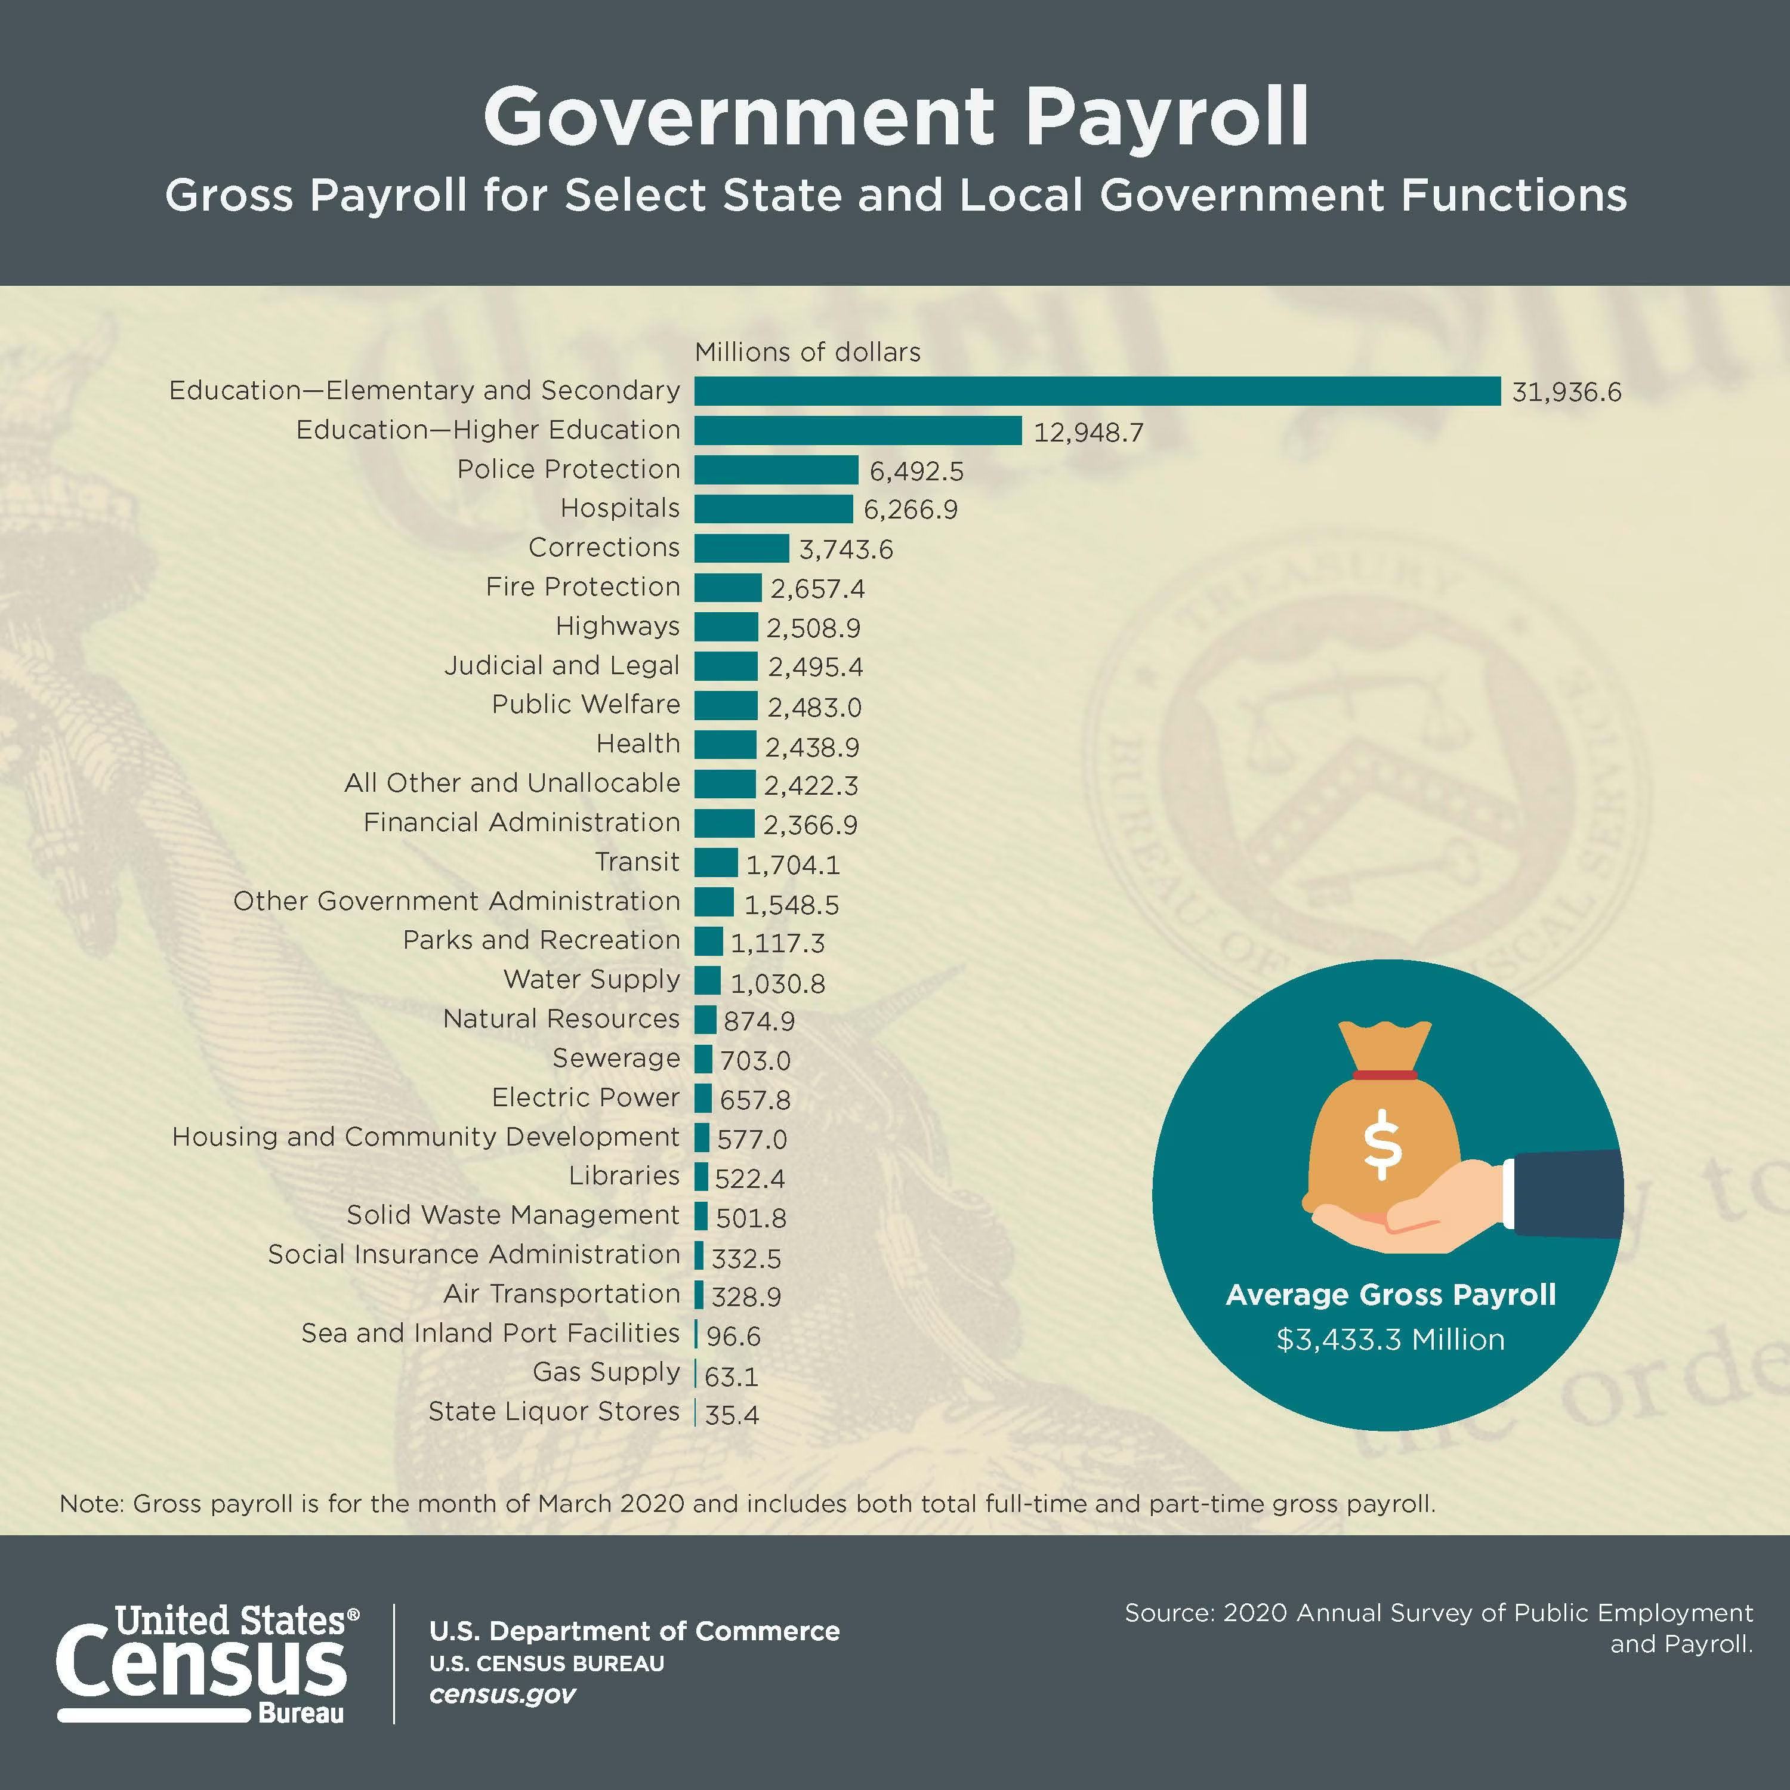
Motivation
Government programs are financed by payments from taxpayers, and as a result, it is essential to ensure that their funds are expended appropriately (Mead, 2008, Rozario and Issa, 2020)
89 billion for March 2020
Source:
Government Payroll (https://www.census.gov/library/visualizations/2021/econ/government-payroll.html)
Mead, D. M. (2008). SEA performance reporting. The CPA Journal, 78(1), 6.
Rozario, A. M., & Issa, H. (2020). Risk-based data analytics in the government sector: A case study for a US county. Government Information Quarterly, 37(2), 101457.
Notes:
Total: 89 billion

Slide 132

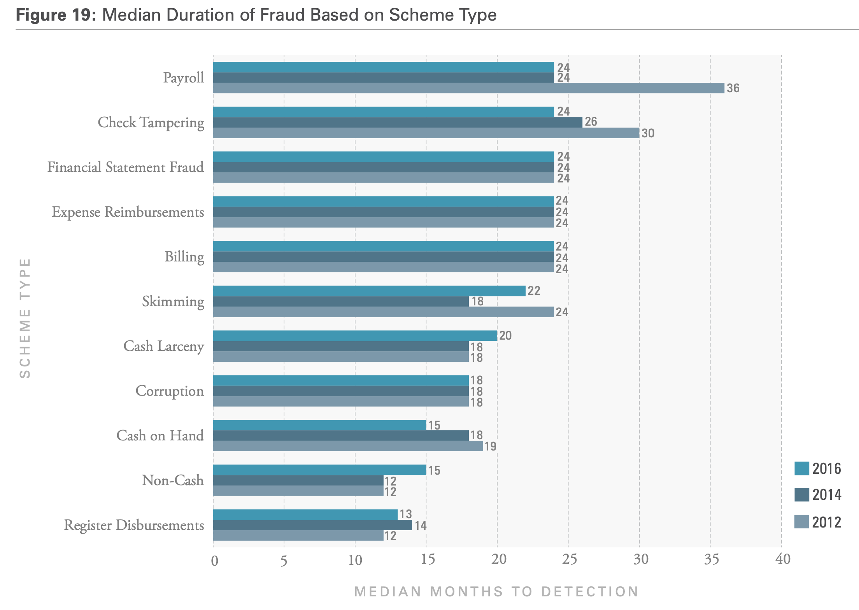
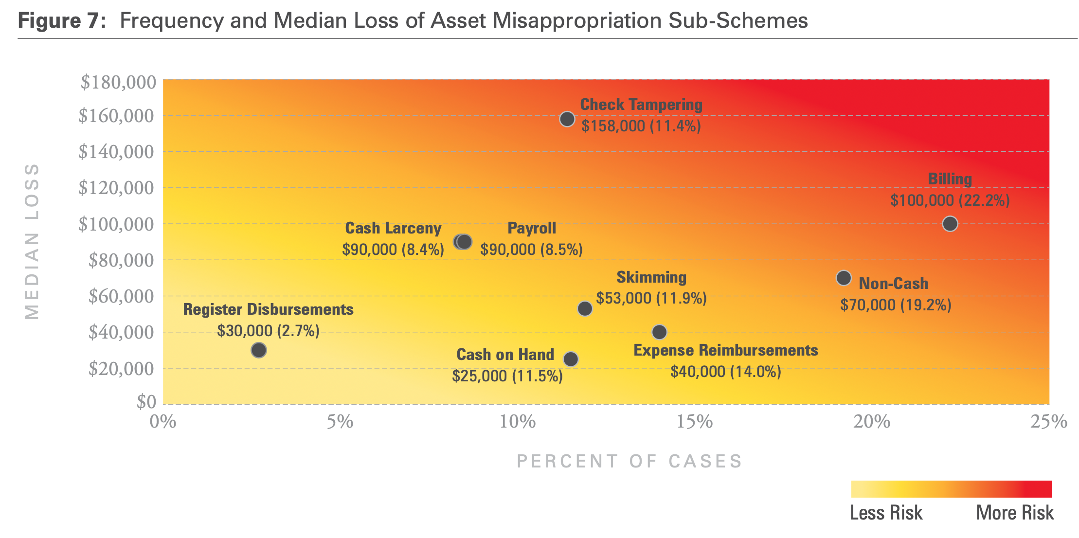
Motivation
Payroll fraud is prevalent in the non-profit sector (Wells, 2005) and is among the top five major types of fraudulent disbursements (Greenlee et al. 2007).
Payroll fraud is hard to detect, and the loss is high
Source: ACFE Report to the Nations on Occupational Fraud, 2016
Source: ACFE Report to the Nations on Occupational Fraud, 2016
Source:
Wells, J.T. (2005), Principles of Fraud Examination, John Wiley, New York, NY, N.Y.
Greenlee, J., Fischer, M., Gordon, T. and Keating, E. (2007), “An investigation of fraud in nonprofit organizations: occurrences and deterrents”, Nonprofit and Voluntary Sector Quarterly, Vol. 36 No. 4, pp. 676-694.
REPORT TO THE NATIONS ON OCCUPATIONAL FRAUD AND ABUSE 2016 GLOBAL FRAUD STUDY (https://www.acfe.com/-/media/files/acfe/pdfs/2016-report-to-the-nations.ashx)

Slide 133


Motivation
Source: ACFE Report to the Nations on Occupational Fraud, 2016

Slide 134
Introduction
Internal auditors are facing the challenges of working with large, instantly accessible data generated continuously and automatically within the government’s payroll systems¹.
In Brazil, governmental organizations can exchange information with other governmental organizations and use these as external databases².
In Brazil, public servants are usually stable in their jobs².
  For instance, after three years in the job, it is very difficult for a public servant to be fired, with very few exceptions (involvement in corruption, for example).
Continuous audit (CA) with advanced technologies is suitable for identifying hidden fraud in these large, complex, and continuous payroll systems such as the Brazilian government sector.
Source:
1. Eulerich, M., & Kalinichenko, A. (2018). The current state and future directions of continuous auditing research: An analysis of the existing literature. Journal of Information Systems, 32(3), 31-51.
2. de Freitas, M. M., Codesso, M., & Augusto, A. L. R. (2020). Implementation of continuous audit on the Brazilian navy payroll. Journal of Emerging Technologies in Accounting, 17(2), 157-171.

Slide 135
Introduction
Outlier detection (OD) methods are promising in detecting anomalies from individual transactions or transaction sequences (Zhang et al., 2022).
OD techniques, such as cluster analysis, can be integrated into a schema of continuous auditing and continuous monitoring benefit from their unsupervised features (Thiprungsri and Vasarhelyi, 2011).
This study will investigate how to enhance payroll fraud detection in government sectors through continuous auditing with OD techniques. Especially, how the advanced method outperforms traditional methods.
Source:
Zhang, G., Atasoy, H., & Vasarhelyi, M. A. (2022). Continuous monitoring with machine learning and interactive data visualization: An application to a healthcare payroll process. International Journal of Accounting Information Systems, 46, 100570.
Thiprungsri, S., & Vasarhelyi, M. A. (2011). Cluster Analysis for Anomaly Detection in Accounting Data: An Audit Approach. International Journal of Digital Accounting Research, 11.

Slide 136
Data
Payroll data from one of the states in Brazil
  State Population: 7,338,473¹ (11th of the 26 states²)
  Jan. 2021 – Nov. 2021
  5,863,855 payment records
  76 features (individual level, job level, payment level)
  140,880 servants
  43 branches
  406 positions
  …
Source:
1. http://www.citypopulation.de/en/brazil/cities/santacatarina/
2. https://en.wikipedia.org/wiki/Santa_Catarina_(state)#:~:text=Santa%20Catarina%20(Portuguese%20pronunciation%3A%20%5B,and%20the%2011th%20most%20populous.

Slide 137
Research questions
1) What are the characteristics of fraudulent activities in governmental payroll systems?
2) How can OD be applied to identify potential fraud in governmental payroll systems?
3) Whether the advanced OD methods (e.g., deep learning) could outperform traditional methods?
4) What are the benefits and challenges of applying CA and OD to governmental payroll systems?

Slide 138
Research design
Data preprocessing
Feature engineering
Model selection and fitting
Model comparison
Model results comparison and analysis
Application
in CA
Data cleaning
Feature selection
Statistical and machine learning methods
Neural network methods
Seeking internal auditor feedback
Ease of use and interpretability
CA process integration
Feature importance
Risk prioritization

Slide 139
Next steps
Model selection and fitting
  Select models from different categories
  Fitting the data with the models, summarize and visualize the results.
Model comparison
  Comparing the results from advanced model result with the those from the benchmark model
  Analyzing the ease of use and cost through consulting the state internal auditors
Application in CA
  Risk prioritization
  Benefits and limitations analysis

Slide 140
Thank you

Slide 141
ESG violation and insider trading
Nichole Li
Rutgers , The State University of New Jersey
Meehyun Kim
Rutgers, The State University of New Jersey
Min Cao
University of Northern Colorado
Miklos Varsarhelyi
Rutgers , The State University of New Jersey

Slide 142
Motivation
The general public and investment community rely heavily on ESG scores/ratings provided by third-party commercial data vendors to identify ESG-friendly firms
Growing evidence suggests that due to information asymmetry and the lack of assurance, having a decent ESG reputation does not translate into socially responsible practices.
Notes:
The complexity and variety of ESG practices make it nearly impossible for an outsider to fully grasp how a firm integrates ESG
A firm may appear ESG-friendly but takes actions otherwise. Consistent with this view some researchers find so-called ESG funds select stocks that are associated with more frequent and more severe labor and environmental violations. Thomas et al. (2022) document that firms in the U.S. cut pollution abatement costs when under earnings pressure to meet or beat earnings benchmarks, and, astoundingly, the phenomenon manifests in firms with higher E ratings.
These studies raise the concern that earning a good ESG image is nothing but a path for firms to the potential benefits without actually improving society and the environment.

Slide 143
Motivation
  Stock market participants want to know if insider trading is widespread because it affects investors' willingness to trade, and consequently affects the liquidity of the stock.
  Policy makers and regulators concerned about the effectiveness of existing insider trading regulations.
Notes:
Provide evidence on whether insider trading before ESG violation is the norm or the exception

Slide 144
Research questions
1. Whether a firm’s own social and environmental violations lead to lower ESG ratings.
2. Whether insiders sell ESG violation firms’ shares before the news of the violation is announced to the general public.
Notes:
Given their possession of private information, insiders have incentives to avoid losses in their investment, we expect them to

Slide 145
Data
Violation tracker
CRSP
Refinitiv

Slide 146
Data
2020/01/01-2022/03/22
Number of records in total | 512,627
Number of records have ticker | 67,633
Number of records have ticker and Total asset | 62,824
Number of records after aggregation | 46,363

Slide 147
Event study
Penalty amount scaled by the total assets
10 percentile

Slide 148



Slide 149


Slide 150


Slide 151
Summer Project Progress
Shaoyu Liu

Slide 152
Municipality Government Reporting Automation
Government Finance Officers Association (GFOA)
  A nonprofit organization that represents public finance officials throughout the United States and Canada
  20,000 members of federal, state/provincial, and local finance officials
  involved in planning, financing, and implementing thousands of governmental operations
Robotic Process Automation (RPA) and Public Reporting
  Standardized and repetitive tasks
  Cannot deal with uncommon and unique cases

Slide 153
Municipality Government Reporting Automation
Objectives
  Looking for commonalities among different reporting schemes
  Create an RPA routine library
    Indicate what public reporting tasks are feasible for automation
  Create a protocol
    Help and instruct users to figure out what tasks and how to automate

Slide 154
Municipality Government Reporting Automation
Current Stage
  Very early initiate stage
  Exploring the feasibility and scope of this project
Define criteria for automation tasks
  Repetitive
  Resource intensive (High potential saving)
  Substantial stakes (Enough stake for people to be interested in)
  Definable (Documents the steps)
  Rule-based
  Machine-readable inputs

Slide 155

Payroll / Time & Attendance
Revenue System
Banking & Treasury
Transparency Portal
ERP / Microsoft D365
City of Columbus:
Digital Transformation
Source: GFOA_AI and the Future of Government

Slide 156
Municipality Government Reporting Automation
Columbus, OH – early mover
  Routine tasks (e.g. preparing and sending letters)​
  Organizing information (e.g. PPP loan distribution) ​
  24/7 assistance to customers (e.g. chatbots, AI-helpers)​
  Algorithmic processes (e.g. audit determination) ​
  Trend analyses (e.g. revenue projections) ​
  Operations (e.g. smart safes, tax form uses) ​
CTO: “I think of it as like having another person on the team”​
Source: GFOA_AI and the Future of Government

Slide 157
Municipality Government Reporting Automation
Future Plan
  Contact Columbus Automation Team to have a show & tell
    Understand what they have done and what we can learn
    Whether their experience is replicable
    Figure out what we can build up on their work
  Subject of automation
    Not only financial reporting, expanding to operation and auditing
  Scope of automation
    Baseline consistency of tasks for different municipalities also using Microsoft Dynamic 365
    Extended to other ERP systems like Oracle and SAP
Notes:
The ultimate goal will be to create an RPA routine library consider different ERP systems, organizations, and reporting functions. Municipalities can pick up to use

Slide 158
Predicting revenues using customer reviews
Presenter: Talha

Slide 159
Source of reviews: Amazon
Data elements: Product id, review id, parent category, review title, review
Data made available by: Stanford University

Slide 160
Plan
Model topics using LDA.
Assign sentiments to review by using star ratings as a guide
Less than or equal to 2 stars = negative review
Greater than or equal to 3 stars = positive review
Correlate topics and sentiments with sales revenue

Slide 161
Plan
Sales revenue will be proxied using Amazon sales rank.
Higher sales rank = higher sales
Prior study shows strong correlation between sales rank and sales revenue.
Other studies have used similar proxies for sales revenue. For example, one study uses the number of customer reviews to proxy for sales revenue.

Slide 162
Plan
I am trying to do a large scale study with as many categories and reviews as I can.
Possibly over a million textual reviews.
Current studies:
E-Word of mouth & Box office revenue
Volume of reviews & sales on Amazon (Cui et al 2012)
Average rating and sales on Amazon (Cui et al 2012)
Some studies just look at certain categories

Slide 163
Software end
Loading csv files line by line into python memory
  Processing each line before moving on to the next
Threading in python – for parallel computing:
  I will create multiple instances of the code to run simultaneously
I will use SQL database for storing work in progress directly to hard disk.
  Work in progress includes processed text.
Small chunksize for LDA training will help keep memory usage down.

Slide 164
Methodology
Studies have used time series analysis.
I will use a fixed effect analysis as I am looking for long term effects.
Control variables (borrowed from previous studies):
Price of product
Product type
Product subcategory

Slide 165
Thankyou

Slide 166
Continuous Auditing in the Age of AI: An Exploration of OpenAI's GPT Model Applications
Jiaqi Sun Kevin Moffitt

Slide 167
Introduction
To develop a conceptual framework for continuous auditing using OpenAI's GPT model,
To understand the potential of AI for real-time risk analysis and anomaly detection in transactional data,
To examine the challenges and solutions in implementing AI in an auditing context.

Slide 168
Research Overview
Data Collection and Preparation: Gathering relevant transactional data and preprocessing it to suit our model's needs.
Fine-tuning the GPT model: Adapting the model to understand and analyze our auditing data effectively.
Evaluating Model Performance: Rigorously testing our model's accuracy and reliability in risk prediction.
Implementation: Developing a system that integrates this model into existing auditing systems, and can provide real-time feedback to auditors.

Slide 169
Progress Made
Week 1 & 2:
Studied fundamentals of continuous auditing and AI.
Explored the specifics of OpenAI's GPT model.
Week 3 & 4:
Identified challenges in traditional auditing.
Explored the potential role of AI in mitigating these challenges.
Week 5:
Started investigating types of auditing data required.
Developed data collection methods.
Began working on data preprocessing techniques.

Slide 170
Findings & Insights
Identified growing interest in AI's potential in auditing
GPT model seems well-suited for auditing tasks due to its language processing capabilities.
GPT model could potentially understand transactional data, assess risk levels, and generate real-time reports.
Major challenges include ensuring interpretability of the GPT model's outputs and the quality of training data.

Slide 171
Challenges & Next Steps
Challenge 1: Complexity of understanding and applying the GPT model in auditing.
Solution: Thorough study of the model and consultation with experts.
Challenge 2: Identifying and acquiring suitable datasets for the study.
Solution: Reached out to various organizations for data and simulated our own data where necessary.
Next Steps
Deep dive into risk assessment and explore how AI can facilitate it.
Fine-tune the GPT model specifically for auditing tasks.
Evaluate the performance of the AI model in auditing, developing appropriate metrics and benchmarks.

Slide 172
The Relationship Between the Proportion of Real Outliers and the Average Attenuation Rate of Outlier Scores: An Approach of Algorithm Selection in Unsupervised Outlier Detection without Ground Truth
Kathy Wei
Alexander Kogan

Slide 173

Introduction
Unsupervised outlier detection
  The essence of unsupervised outlier detection is a process of normality construction and deviation computation achieved without training.
  The normality of a dataset can vary when constructed by different detection methods, which explains why different observations are flagged as outliers.
Fitness of a method to a dataset is difficult to evaluate
  Since the ground truth is not known, it is not possible to evaluate how close the constructed normality is to the real one.
The only output: outlier scores
  As the only output, outlier scores indicate the relative probability of an observation being outliers.
  Usually, the distribution of outlier scores is skewed because outliers are the minority.
Distribution of Outlier Scores
Outlier Score
Observation

Slide 174

Inliers
Dataset 1
Outliers
The proportion of outliers for the 5 datasets is 15%.
Decision boundaries between inliers and outliers are displayed in black except for Local Outlier Factor (LOF) as it has no predict method to be applied on new data when it is used for outlier detection.
Dataset 2
Dataset 3
Dataset 4
Dataset 5
Image Source: https://scikit-learn.org/stable/auto_examples/miscellaneous/plot_anomaly_comparison.html#sphx-glr-auto-examples-miscellaneous-plot-anomaly-comparison-py
Notes:
Decision boundaries between inliers and outliers are displayed in black except for Local Outlier Factor (LOF) as it has no predict method to be applied on new data when it is used for outlier detection.

Slide 175

Hypothesis Development
Outlier or inlier: an unobservable score cutoff $x_{c}$
Assuming an unobservable score cutoff $x_{c}$ exists:
  A score smaller than $x_{c}$ indicates an observation is an inlier.
  More observations that have a score higher than $x_{c}$ mean more outliers.
To better illustrate the concept, the outlier scores are normalized to range from 0 to 1 and the unobservable score cutoff after normalization is $x_{c}^{′}$.
  The decrease of outlier scores from 1 to 0 is called attenuation.
  The decrease rate of outlier scores from 1 to $x_{c}^{′}$is called the average attenuation rate of outlier scores.
Average attenuation rate of outlier scores vs. Proportion of real outliers
Hypothesis: The algorithm that has the most observations (and the lowest average attenuation rate) before $x_{c}^{′}$ fits the dataset best.
However,$x_{c}^{′}$ is not known. Hence, the hypothesis is manipulated to make it testable:
Assume the average attenuation rate of a sample with no outliers is $x_{0}$. As the proportion of outliers in the sample increases, the average attenuation rate will first increase and then decrease.

Slide 176



Hypothesis Development
Score Change – MCD (Top 200)
The average attenuation rate of the sample is equal to the maximum score in the sample minus the minimum score, divided by the sample size.
According to the manipulated hypothesis, the relationship between the average attenuation rate of the sample and the proportion of outliers in the sample can be presented as an inverted U-shape curve.
Score Change – LOF (Top 200)
Average Attenuation Rate
Proportion of Outliers

Slide 177
Hypothesis Testing
The manipulated hypothesis is used to develop an algorithm selection tool.
The tool is applied to select the best algorithm for various datasets.
If the tool can select the algorithm that identifies the most (or close to to the most) outliers, then the hypothesis is true.

Slide 178
Thank You!

Slide 179
Role-play game (RPG) with an integrated story for accounting education
Fangbing Xiong
Eva Blondeel

Slide 180
Overview
Game-based learning (GBL)
Previous literature has shown that game-based learning (GBL) in accounting education would improve students’:
Increases their motivation and attitude and perceived learning (Silva & Rodrigues et al., 2021).
Provides the students with immediate feedback (Kapp, 2012a, 2012b),
Problem-solving skill improvement (San Cristóbal, 2015; Sung et al., 2015)
Communication skill improvement (Reinders & Wattana, 2014).
Helps the students to be the "real agents" of their learning process. (Landers & Armstrong, 2017)
Role-play game (RPG)
Role-play game (RPG) is an application of GBL. RPGs can create stories for students to participate in and allow students to access knowledge in an integrated way. (Grande-de-Prado et al., 2020)

Slide 181
Overview
Role-play game (RPG) (Continued)
Meanwhile, entry-level accounting education also emphasizes an integrated story, as we teach the journal entry recording in accounting cycles (e.g., revenue cycle, payable cycle)
And require students to make a summary and adjustments of the journal entry (e.g. prepare a cash flow sheet/ balance sheet at the end of years)
.RPG can be a good way for accounting education, as well as in the subjects it has been proven beneficial (e.g., Language, history), incorporating with RPGs education tools e.g., Classcraft. (Garcia & Ramon et al., 2010; Lu & Chang, 2016)

Slide 182
Contribution
The previous common accounting gamifications are Monopoly, Jeopardy, Bingo, Puzzles, Twenty-questions, and some simulations. (Moncada & Moncada, 2014)
There are few accountings gamification is using integrated stories as RPG.
As introduction level of financial accounting emphasizes the education target of learning accounting cycle, the research will test whether the student would benefit from learning accounting in a digital integrated story by interacting with an education game.

Slide 183
Design
Game Design
In this study, the authors first built a 20- 30min RPG for "introduction to financial accounting."
After the development of the game, the authors will introduce the game to accounting classes and test the impact of the RPG in accounting gamification on students’ motivation and flow. Inspired by Sanchez et al, (2017), we also add “ludicization” elements in the game to increase the
playfulness.
Game background
The authors designed the game by using RPG Maker MV. The background of the story is a Rutgers student who comes to a mysterious town. In the town, the student meets Prof. Xiong, who says he/her gets a bakery as a lottery reward. The bakery needs help with bookkeeping.

Slide 184

Design
Game Demo

Slide 185
Design
Hypotheses Design
Based on Zhang’s et al. (2021) literature review on RPG education, we found RPG would most impact students’ achievement and motivation. In this study, we’d like to focus on motivation.
H1: RPG with an integrated case study has a positive impact on motivation.
H2: RPG with an integrated case study has a positive impact on flow.
H3: RPG with an integrated case study has a positive impact on attitude.
Questions Remains
Should we also test performance?
Is there a way to emphasize “integrated” story more in the experimental design?
Although no such RPG research appears in accounting, many other subjects have proven the above hypotheses. How can the article be more distinguished?
How about test the “ludicization” surprises in the game?
Survey and experiment Design
The survey and experiment are under design.

Slide 186
Comments?

Slide 187
The Usefulness of Large Language Models in External Audits
Norah Xu
Kevin Moffitt

Slide 188
Objectives
The primary objective of this research is to investigate the potential applications of LLMs in external audits and to evaluate their usefulness in enhancing the audit process.
This research will evaluate LLMs in the context of the stages of the audit and the typical tasks conducted in each stage.

Slide 189
The stages of audit | How LLMs conducted | How to evaluate
Planning | Comprehend and summarize relevant documents such as financial reports, prior audit reports, and industry news. Draft the audit plan | Compare the LLM's summaries and draft plans with those made by human auditors
Risk Assessment | Analyze text from various sources to identify potential risks. | Compare the LLM’s identified risks with those identified by human auditors
Internal Controls Testing | understand and explain control processes based on descriptions in the auditee's documentation. | Compare the LLM's understanding with that of a human auditor
Substantive Testing | Not be directly involved
Reporting | Draft the report | Evaluated based on the clarity, accuracy, and completeness of the LLM’s draft compared to a human-generated report.
Follow-up | Review updated documents and comparing them with previous versions. | The LLM's ability to identify changes.

Slide 190
Research progress
Literature review
  Research LLMs and their current applications;
  Research current AI Applications in Auditing;
  Research potential applications of LLMs in Auditing;
  Research metrics for evaluating LLM applications in auditing.
Methodology
  Develop a framework for identifying and evaluating LLM applications in the external audit.
  Apply this framework to the Planning stage and its associated tasks for a sample company.
  Solicit feedback from audit professionals—is the framework useful and are the initial results informative?

Slide 191
Research progress (cont.)
Results
  Continue to fine tune the framework and apply it to the remaining stages of the audit.
  Document the results and discuss findings.
Limitations, Conclusion, Introduction, Abstract

Slide 192
Bad Debt In Emergency Department
Yao Yao
Notes:
Further step – cross country evidence

Slide 193
Background
In 2021, the amount spent on health care in the United States increased by 2.7 percent to $4.3 trillion, or $12,914 per person. Health spending accounted for 18.3 percent of the nation’s GDP.¹
One of the significant reasons for the rising cost is unpaid medical bills / medical bad debt (D. Shi, J. Zurada and J. Guan 2015). In addition, hospitals usually end up paying 30%-50% of recovered bad-debt revenue to collection agencies.
Furthermore, uninsured, underinsured and patients with high-deductible plans add further pressure on the bad debt issue.
According to Durand-Zaleski I et.al (1993), the surgical department has the strongest correlation to bad debt. However, the emergency department also plays a significant roles.

Slide 194
Emergency Department
The emergency department is at the center of many significant issues in healthcare today. Previously the emergency department was referred to as a "loss leader" for revenue in many hospitals
One of the major differences between emergency departments and planned services is managing the requirements for EMTALA — the Emergency Medical Treatment and Labor Act. Enacted by the U.S. Congress in 1986, it requires facilities to provide emergency care to all patients, regardless of insurance status or ability to pay.
EMTALA also requires any hospital receiving Medicare payments to:
  Provide incoming patients with a medical screening examination (MSE)
  Stabilize patients who have an emergency medical condition
  Transfer patients or accept them as appropriate to the care their facility can provide
Triage

Slide 195
Motivations
Bad debt prediction is a complex task, and it is extremely difficult in the healthcare context. Unlike financial institution, health providers are unable to obtain any financial information due to legal and moral reasons, which forces hospitals to act as unintentional lenders.
There is very little research exploring machine learning techniques in predicting bad debt in the healthcare industry.
Despite the fact that many studies concentrate on the Emergency Department unit, they are more focused on predictions of either ED overcrowding or Triage outcomes leveraging machine learning.

Slide 196
Literatures | Variables | Models | Data Source
Zollinger et al.(1991) | Total hospital charge; Total hospital revenue; Patient information (insurance, employment, marital, gender, diagnosis, discharge status) | Multiple Regression model | 985 patients from 28 Indiana hospitals
Veletsos (2003) | credit factors, demographic information, and previous organizational payment patterns | IBM Intelligent Miner and DB2 | 2400 patients (inpatients & outpatients) from Florida hospital
Zurada et.al (2005) | Patient Age (PA), Patient Gender (PG), Injury Diagnosis Code (IDC), Dollar Amount of the Claim (DAC). | Neural networks, decision trees, logistic regression, memory-based reasoning, the ensemble model | 6180 cases from a healthcare company
D. Shi et al.(2016) | Days, Debt, Patient information (Gender, Age, Marriage, Occupation, insurance), Ngrade (level of nurse care), Injury diagnosis code (IDC), Total and other subtotal costs, | Bayesian networks, decision trees, KNN, random tree, random forest, radial basis function neural networks, bootstrap aggregating and neural networks | 179 cases from China hospital
Liu N et al. (2022) | ED triage, ED disposition, inpatient discharge, and after inpatient discharge, patient information, ED waiting time, ED boarding time, patient loading time, time | Machine learning based AutoScore (Interpretable SERT); Random forest, Regression model, deep learning | EHR Dataset from Singapore General hospital over 13 years
Literature review

Slide 197
Data Collection and Model Developments (Help Needed)
Variables
Patient Information (Age, Gender, Insurance)
EHR dataset (ED): Triage Information (Triage Class, Disposition, Diagnosis code, Outcomes)
The total amount of claims
Good/Bad/Unknown

Slide 198
The Analysis and Prediction of Fiscal Distress in Local Governments:
Using Logistic Regression and Machine Learning Algorithms
Katerina (Ruanjia) Liu, Rutgers University
Huaxia Li, Rutgers University
Kyunghee Yoon, Clark University

Slide 199
Financial distress of local governments
According to the Census Bureau, local governments are defined as
  General purpose: cities and counties
  Special-purpose: school districts, water authorities and other narrowly-defined municipalities
The stages of municipal difficulty (Urahn et al. 2013)
Consequences of bankruptcy protection
  High cost of professionals
  High property tax bill and low pension benefits for citizens
  Lost population and reputation damage
  Impaired access to the capital markets
Budget gaps widen
It cannot pay bills
service cut
worker layoff
Increasing tax/fee
file for Chapter 9 bankruptcy protection
Notes:
Financial distress: Officials usually respond with some combination of service cuts, worker layoffs, tax and fee increases, reserve spending, and borrowing
Consequences of bankruptcy protection :
High fees for receivers, emergency managers and bankruptcy attorneys
High property tax bill and low pension benefits for citizens
Lost population and reputation damage

Slide 200

U.S. Chapter 9 Filings over Time
2012: the city of Stockton (CA)
the city of San Bernardino (CA)
All Chapter 9 Municipal Bankruptcy between 2000 and 2022
Notes:
Economic Downturn: The aftermath of the 2008 financial crisis and the subsequent economic downturn had lingering effects on local governments. Many municipalities were already struggling with declining property values, reduced tax revenue, and increased pension obligations.
Housing Market Crash: The bursting of the housing bubble in the mid-2000s led to a significant decline in property values, which, in turn, impacted property tax revenues for many municipalities. As housing prices plummeted, property tax revenues, a primary source of funding for local governments, also declined.
Pension and Healthcare Obligations: Many municipalities faced mounting pension and healthcare obligations for public employees. Meeting these obligations became increasingly challenging as pension funds were underfunded, and healthcare costs continued to rise.
Declining State and Federal Aid: In some cases, state and federal assistance to municipalities decreased, leaving local governments with fewer resources to cover budget shortfalls.
Reduced Access to Credit: Following the financial crisis, some municipalities found it difficult to access credit markets, making it challenging to borrow money to cover short-term expenses.
Failed Development Projects: Some municipalities were burdened with debt from failed development projects or investments in municipal bonds that went sour.
Legal and Political Factors: Bankruptcy filings by municipalities are subject to legal and political considerations. In some cases, filing for bankruptcy was seen as a last resort to renegotiate contracts, restructure debt, and address budgetary issues. Filing for Chapter 9 municipal bankruptcy is a complex and legally regulated process, and it requires approval from the court.

Slide 201
Main Findings & Contributions (1/2)
Main Findings
  Net position ratio, non-tax revenue ratio, general fund balance, growth of taxable property value, lower level of governmental activities (negative direction on fiscal distress)
  Municipalities in four divisions have higher possibility of fiscal distress
  Middle Atlantic; East North Central; South Atlantic; West South Central
  XGBClassifier emerges as the optimal classifier, followed by Logistic Regression and C4.5 Decision Tree
Notes:
decrease the likelihood of fiscal distress
Increase total net position,
Downsize the governmental activities & more resources devoted to business-type activities

Slide 202
Main Findings & Contributions (2/2)
Contributions
  Examining Financial indicators & Socio-economical indicators
  Providing useful insights to practitioners who are interested in municipal fiscal distress
  States in Middle Atlantic; East North Central; South Atlantic; West South Central
    NJ, NY, PA
    IL, IN, MI, OH, WI
    DE, FL, GA, MD, NC, SC, VA, WA, WV
    AR, LA, OK, TX
  Offering an effective way to predict fiscal distress in imbalanced datasets
  Tune hyperparameters of classifiers
Notes:
decrease the likelihood of fiscal distress
Increase total net position,
Downsize the governmental activities & more resources devoted to business-type activities
various indicators to understand the level of financial status of municipalities

Slide 203

Literature review (1/2)
10-Point Test (Brown 1993)
  Total revenue per capital, intergovernmental revenue,…
  Strengths: the data is accessible from the Government Finance Officers Association (GFOA)
  Weakness: subjective evaluation score
Modified 10-Point Test (Maher and Nollenberger 2009)
  Cash solvency (the ability to pay obligations in the next 30 to 60 days)
  Budgetary solvency (the ability to generate enough revenues to pay expenses within the budgetary period)
  Long-run solvency (the ability to pay all long-term costs of operations such as pensions)

Slide 204
Literature review (2/2)
Fanning and Cogger (1998) compared logistic regression, linear discriminant analysis, quadratic discriminant analysis, and an ANN model to detect fraudulent financial statements.
Antulov-Fantulin et al. (2021) predict the bankruptcy of Italian municipal entities using machine learning algorithms.
Cohen et al. (2017) applied logistic regression to study municipal financial distress in Italy, with an accuracy rate of 75%.
Capalbo and Grossi (2014) adopted probit regression to assess the impact of socioeconomic factors on Italian municipal financial destabilization.
  regional GDP, density of population, and personal income per capita

Slide 205

Research Design (1/3)
Accounting insolvency, also known as technical insolvency, occurs when an entity’s total liabilities exceed its net assets, and is often used to assess U.S. municipalities' financial condition (Fischer & Prachyl, 2020)
examining relevant determinants of the fiscal status of municipalities (i.e., technical insolvency)
predicting municipalities with fiscal distress in an imbalanced dataset
Notes:
GASB Statement No. 56 requires to evaluate whether there is substantial doubt about their ability to continue as a going concern for 12 months beyond the financial statement date.

Slide 206

Research Design (2/3)
Figure: The Fiscal Status Assessment Framework

Slide 207

Research Design (3/3)

Slide 208

Data Processing

Slide 209

Sample Selection
Notes:
GASB Statement No. 56 requires to evaluate whether there is substantial doubt about their ability to continue as a going concern for 12 months beyond the financial statement date.

Slide 210

Sample Distribution
Notes:
GASB Statement No. 56 requires to evaluate whether there is substantial doubt about their ability to continue as a going concern for 12 months beyond the financial statement date.

Slide 211

Chapter 9 Authorization
Control for state legislation of Chapter 9 on the fiscal status of municipalities
Notes:
GASB Statement No. 56 requires to evaluate whether there is substantial doubt about their ability to continue as a going concern for 12 months beyond the financial statement date.

Slide 212
Prediction Classifiers (1/2)
  Classification Model
  Logistic Regression (baseline model)
  XGBClassifier
  RUSBoost
  C4.5 Decision Tree
  Exactly Balanced Bagging
  Roughly Balanced Bagging
Notes:
Roughly Balanced Bagging

Slide 213

Prediction Classifiers (2/2)
Y= Technical Insolvency
Coded as 1 when the net position of GA is negative, otherwise as 0
80% of the data assigned as training data and the remaining 20% assigned as test data.

Slide 214

Logit Regression Prediction Results

Slide 215
Significant Predictors_Logistic Regression
Unrestricted Net Asset Unrestricted (L1)
Net Position / Total Revenue (primary government)
Revenue Dispersion (B3)
Non-Tax Revenue Sources / Total Revenue
General Fund Balance (B5)
General Fund Balance / General Fund Revenue
Tax Base Growth (S1)
(Taxable Assessed Value of Property in Current Year-Taxable Assessed Value of Property in Prior Year) / Taxable Assessed Value of Property in Prior Year
Government Size (GS)
Scale and scope of government activities : Ln (Revenue of Primary Government)
U.S. Census Bureau region definition: Division 2, 3, 5, 7
Middle Atlantic; East North Central; South Atlantic; West South Central

Slide 216

Model Performance Evaluation (1/2)
Precision = $\frac{TP}{TP + FP}$ where: TP: True positive
  FP: False positive
  TN: True negative
  FN: False negative
Recall = $\frac{TP}{TP + FN}$
F1-score = $2∗\frac{Recall Rate∗Precision Rate}{Recall Rate+Precision Rate}$
Notes:
Explain what means...

Slide 217

Model Performance Evaluation (2/2)
XGBClassifier emerges as the optimal classifier for predicting financial distress in this
imbalanced dataset, followed by Logistic Regression and C4.5 Decision Tree
Notes:
Explain what eans...

Slide 218

LR Model Performance
Notes:
Explain what means...

Slide 219

XGBClassifier Model Performance
Best Parameters: {'learning_rate': 0.1, 'max_depth': 4, 'n_estimators': 50, 'subsample': 1.0}
Notes:
Explain what means...

Slide 220

RUSBoost Model Performance
Best Parameters: {'learning_rate': 0.5, 'n_estimators': 200}

Slide 221

C4.5 Decision Tree Model Performance
Best Parameters: {'max_depth': 10, 'min_samples_leaf': 4, 'min_samples_split': 2}

Slide 222

Exactly Balanced Bagging Model Performance
Best Parameters: {'max_features': 0.5, 'max_samples': 1.0, 'n_estimators': 50}

Slide 223

Roughly Balanced Bagging Model Performance
Best Parameters: {'base_estimator__max_depth': None, 'n_estimators': 50}

Slide 224
Work in Progress
  Adding two more years, 2016 & 2017
  Enhancing model performance in an imbalanced dataset (Class 1 prediction)
  RandomUnderSampler: resamples the majority Class (Class 0) in training data
  Undersampling the Majority
  Tuning Sampling Ratio

Slide 225
Auditing Medical Assessments: Risk Assessment with Machine Learning in Medical Diagnostics
Presented by: William Du

Slide 226
The Necessity of Precision in Medical Diagnostics
Importance of Precision and Promptness in Medical Diagnostics
Objective of the Research: Develop an ML model for predicting psychiatric diagnostic labels from doctors’ notes to improve diagnostic precision and reliability.
  Assist Practioners with a tool to audit their medical assessments
QA Model for Psychiatric Diagnostics: Propose a Question-Answering (QA) model as a novel approach to predict psychiatric labels, aiming to minimize misdiagnoses and enhance patient care.
Notes:
The research question for the paper revolves around how machine learning can be applied to psychiatric diagnostic processes to improve accuracy and reduce the incidence of misdiagnoses. Specifically, it investigates the effectiveness of a Question-Answering model in predicting psychiatric diagnoses from clinical notes and assessing the risk levels associated with these diagnoses.

Slide 227

Psychiatric Diagnostic QA Model
Inputs: Doctor’s Note and Expected Outputs of a variation of diagnosis code’s for the patient
Output: Generated answers of a variation of diagnosis codes for the patient based on the doctor’s note
Notes:
Question-Answering (QA) models are simply information retrieval systems that search for answers to queries posed by humans and automatically communicate results in a natural language.

Slide 228
Model Design
Objective: To create a model proficient in interpreting complex medical texts and providing accurate multi-label diagnoses.
Transformer Models Evaluation: Examined Bidirectional and Auto-Regressive Transformers (BART) for their generative capabilities and pre-training objectives.
Integration of UnifiedQA: Incorporated UnifiedQA architecture, fine-tuned for QA tasks, to handle diverse medical questions.
Model Fine-Tuning: Conducted extensive fine-tuning with BART models on a vast dataset of QA pairs, adapting to psychiatric diagnostic terminologies.

Slide 229

Risk Categorization
Systematic Comparison: Automated process to compare ML model's diagnostic conclusions with those of treating psychiatrists.
Objective of Comparison: Assessing the concordance between ML model predictions and psychiatrist diagnoses.
Risk Level Assignment: Diagnoses categorized into high, medium, or low-risk based on agreement level.

Slide 230

Results
17 % of cases as High Risk
46 % of cases in Medium Risk
37% of cases in Low Risk

Slide 231

Model Performance
Precision Score: Calculated as the ratio of True Positives to the sum of True Positives and False Positives. This score reflects the accuracy of the model in identifying correct diagnostic labels.
Recall Score: Determined by dividing the True Positives by the sum of True Positives and False Negatives. This score assesses the model’s ability to capture all relevant diagnostic labels.
F1 Score: Represents the harmonic balance between precision and recall. This score is crucial in providing a single metric that balances both the precision and thoroughness of the model in identifying diagnostic labels.

Slide 232
Connecting the Dots: Auditing in the Age of Foundation Models and Multi-modal Data
Hanchi Gu, Marco Schreyer, Kevin Moffitt

Slide 233









Motivation
Role of Auditors
  Responsible for maintaining accuracy and transparency in financial records.
  Review a wide range of audit evidence, from internal records to regulatory documents.
Growing Complexity of Audit Data
Audit data now encompasses a broader range of formats
Integration of diverse data types, like textual, numerical, and multimedia, adds to the complexity.
The advent of big data technologies contributes to the complexity
Rapid technological advancements introduce new data sources and types, further complicating audit processes

Slide 234
Motivation
Foundation model
A foundation model primarily refers to a large-scale model that has been pre-trained and serves as the basis for fine-tuning across different tasks and fields
Multi-modal Model Research
Studies the integration of various data modalities like text, visual, tabular, spatial, and audio for meaning-making
  matching textual and visual data, generating text from visuals, and creating complex images from text
Transfer Learning in Multi-modal Models
  Allows the application of knowledge from one domain to improve performance in another, connecting different data modalities
Recent Developments
  GPT-4 Turbo
  more modalities such as audio, video, and 3D data

Slide 235
Summary
Propose a new framework for future accounting information systems
  Integration of audit evidence from diverse data modalities through an automated system
  Incorporation of AI, specifically foundation models to overcome data modality barriers for more efficient operations
  Utilization of a document-oriented architecture accommodating various data types
Thorough evaluation of the system's accuracy, consistency, and transparency
Notes:
In this study, we propose a future version of the AIS system, where all the audit evidence of different data modalities can be automatically connected. Systems features with artificial intelligence can get rid of all the barriers caused by data modalities and contribute to efficient operation. Our approach employs a document-oriented architecture, which accommodates diverse data types. We rigorously assess the framework’s performance in terms of accuracy, consistency, and transparency.

Slide 236

Framework Design

Slide 237






Sandbox Testing
Synthetic Company
Bright Future Tech Solutions
Synthetic Documents
…
Purchasing Invoice
SAP Table (Master Table)
Purchasing Policy
Support Document
Warehouse Image
Audit Tasks
…
One-Time Vendor
Missing Invoice
Unmatched Record
Warehouse Safety Check

Slide 238
Employee Insights, Financial Integrity:
Rethinking Internal Control Effectiveness Measurement
Hanxin Hu, Rutgers Business School
Kelly Duan, Sacred Heart University
Ting Sun, The College of New Jersey

Slide 239
Background and Motivations
  In response to accounting scandals earlier this century, SOX 404 was implemented to provide an early warning signal of impending accounting problems.
  The effectiveness of SOX has faced skeptics
    Common incidence of Type II errors - the underreporting or undetection of adverse ICOs (Plumlee and Yohn 2010; Rice and Weber 2012; Rice et al., 2015);
    Binary nature of audit reports (Christensen et al., 2019)
  Employee perceptions offer implicit insights into organizational culture and operations potentially related to internal control effectiveness (Ji et al. 2017; Campbell and Shang 2022)
  2. Research design and results
  To assess internal control effectiveness where the presence of residual risk remains unknown, we introduce a novel measure of internal control Employee_Insights_index based on crowdsourced employee insights that are gathered from the Glassdoor website.
  Topic modelling and Machine Learning.
  Validation results
    Employee_Insights_index has been validated through the subsequent restatement and abnormal accrual quality.
Notes:
In response to the accounting scandals earlier this century

Slide 240
Thank you
Hanxin Hu
hh497@scarletmail.rutgers.edu

Slide 241
ESG violation and insider trading
Presented by: Nichole Li

Slide 242
Motivation
The general public and investment community rely heavily on ESG scores/ratings provided by third-party commercial data vendors to identify ESG-friendly firms
Growing evidence suggests that due to information asymmetry and the lack of assurance, having a decent ESG reputation does not translate into socially responsible practices.
Notes:
The complexity and variety of ESG reports make it very hard for an outsider to fully grasp how a firm ESG performace really is. So Many investors rely heavily on third paties’ ratings to identify ESG.
A firm may appear ESG-friendly but takes actions otherwise. Growing evidence suggests that due to information asymmetry and the lack of assurance, having a decent ESG reputation does not translate into socially responsible practices. Consistent with this view some researchers find so-called ESG funds select stocks that are associated with more frequent and more severe labor and environmental violations. Thomas et al. (2022) document that firms in the U.S. cut pollution abatement costs when under earnings pressure to meet or beat earnings benchmarks, and, astoundingly, the phenomenon manifests in firms with higher E ratings.
These studies raise the concern that earning a good ESG image is nothing but a path for firms to the potential benefits without actually improving society and the environment.
We want to check if the firm with higher ESG

Slide 243
Motivation
  Stock market participants want to know if insider trading is widespread because it affects investors' willingness to trade, and consequently affects the liquidity of the stock.
  Policy makers and regulators concerned about the effectiveness of existing insider trading regulations.
Notes:
Provide evidence on whether insider trading before ESG violation is the norm or the exception

Slide 244
Research questions
1. Whether a firm’s ESG violations impact its stock prices.
2. Whether insiders sell ESG violation firms’ shares before the news of the violation is announced to the general public.
Notes:
Given their possession of private information, insiders have incentives to avoid losses in their investment, we expect them to
Market enviromenmt of ESG investment

Slide 245
Data
Violation tracker
MSCI KLD
CRSP
Refinitiv

Slide 246
Data
2020/01/01-2022/03/22
Number of records in total | 512,627
Number of records have ticker | 67,633
Number of records have ticker and Total asset | 62,824
Number of records after aggregation | 46,363

Slide 247
Descriptive statistics
offense_group | sum_of_penalty | percentage_of_total_x | count_of_records | percentage_of_total_y
competition-related offenses | 88,209,860,913 | 11.22 | 2,834 | 0.55
consumer-protection-related offenses | 107,995,124,538 | 13.74 | 21,014 | 4.10
employment-related offenses | 31,884,636,060 | 4.06 | 117,128 | 22.85
environment-related offenses | 116,708,463,764 | 14.85 | 76,680 | 14.96
financial offenses | 262,957,251,001 | 33.46 | 9,930 | 1.94
government-contracting-related offenses | 50,474,480,449 | 6.42 | 3,350 | 0.65
healthcare-related offenses | 52,053,242,030 | 6.62 | 1,201 | 0.23
miscellaneous offenses | 1,881,046,442 | 0.24 | 547 | 0.11
safety-related offenses | 73,747,102,043 | 9.38 | 279,943 | 54.61
Notes:
9 categories

Slide 248


Slide 249
Event study
Penalty amount scaled by the total assets
10 profiles
Notes:
divide into ten equal parts by percentage of the total amount
I want to do the event study using the CRSP daily stock file database via python. My research start date is Jan 1st 2000 and my end date is jan 1st 2022. I want to use more specific parameters in the event study. For example, I want to use the fama french plus momentum model to calculate the expected return. I also want to set up the estimation window, event window and the gap days.

Slide 250
Notes:
all

Slide 253


√
Notes:
safety

Slide 254



Slide 255


Slide 256


Notes:
Enviro

Slide 257



Slide 258



