Slide 1
Pricing for wireless network: Review, Classification and Comparison of Relevant Models
Qi Liu, Miklos Vasarhelyi
Rutgers University
19th AAA Annual Meeting
Strategic and Emerging Technologies Research Workshop

Slide 2
Content
Introduction
Motivation
Research Purpose
Overview of mobile wireless network architecture
Classification methods of wireless pricing models
Review of notable pricing schemes
Currently used pricing scheme
Notable pricing scheme in literature
Classification, Comparison and Analyze
Factors inhibiting deployment of proposed pricing models
Conclusion and Future Research
Notes:
We then address and discuss important factors that have inhibited the deployment of those reviewed models and suggest what might be short-term and long-term pricing.

Slide 3
Introduction(1/2)
Motivation
Pricing is significant for the wireless service providers to recovery infrastructure investment cost for quickly developed technology and diversified services and applications.
Network bandwidth is limited, pricing could also be used to control congestion. (E.D. Fitkov-Norris and A. Khanifar, 2000)
Finding a more efficient charging scheme has attracted much research effort over the last decade.
Many pricing models have been proposed, however, few of them are implemented in practice.

Slide 4
Introduction(2/2)
Purpose of this research:
Review, classification and compare currently proposed pricing models for wireless network
Discuss factors that have inhibited the deployment of these models
Give suggestions for the future research

Slide 5
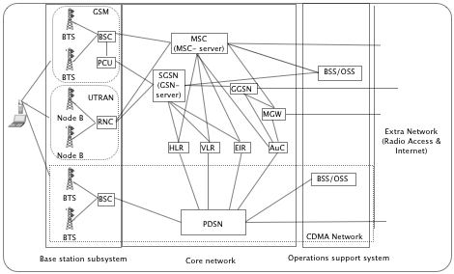
Overview of mobile wireless network architecture
Notes:
General perception of mobile wireless network architecture. This figure shows basic network architecture of currently used three types of mobile wireless network.
In mobile networks, the BSS is in charge of handling traffic and signaling between a mobile device and the core network.
The core network carries out call switching and mobility management and provides transport for Internet Protocol packet services.
While the OSS provides network and business support services.
The network infrastructures that are connected with charging are distributed in the core network and those that are relevant to billing are in the OSS.

Slide 6
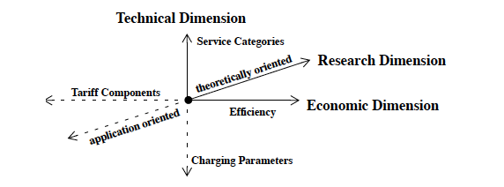
Classification methods of wireless pricing models(1/2)
Three-dimensional classification method (B. Stiller and P. Reichl, 2001)

Slide 7
Classification methods of wireless pricing models(2/2)
Pricing models for Best Effort Services and Pricing models with Quality of Service guaranteed (T.T.T. Nguyen, G. J. Armitage, 2003)
Static and Dynamic pricing models (S. Mandal et al., 2006)
Non-competitive （optimization-based） and Competitive (game theory-based) models (D. Niyato and E. Hossain, 2008)

Slide 8
Currently used pricing strategy in mobile wireless network
Metered Pricing
The model involves charging the users on a monthly basis and the exceed usage on metered usage of the service.
Flat rate Pricing
A fixed fee is charged for a set amount of bandwidth to access the network.
Volume-based pricing
The number of packets transferred in the network are counted as a parameter of pricing.
 | Non-Competitive | Competitive | Static | Dynamic | Best Effort Service | QoS guaranteed
Metered Pricing | X |  | X |  | X
Flat Rate Pricing | X |  | X |  | X
Volume-based Pricing | X |  | X |  | X

Slide 9
Notable pricing models in Literature(1/2)
Priority based pricing (R. Cocchi et al.,1992)
Traffic are flagged with different priority and price by users.
Smart market pricing (MacKie-Mason K. J and Varian R. H,1993)
Users bit for each packet, the packet will be accepted only if the bid exceeds the current marginal cost of transportation in the network.
Shadow Pricing (Kelly, F.P,1995)
Users pay for the amount of congestion that their packets impose on others.
Edge Pricing (S. Shenker et al,1996)
Users are charged only by the first network provider along a data path rather than computed in a distributed fashion along the entire path.

Slide 10
Notable pricing models in Literature (2/2)
Expected Capacity Pricing (D. Clark, 1995)
Users are assigned a service profile of network usage according to service providers’ expectation
Nominal bit rate (K. Kilkki et al, 1998)
Various services are classified into several classes with different service levels and prices.
Paris-metro pricing (A. M. Odlyzko,1999)
The available bandwidth is split into several channels, each with a fixed fraction of the network capacity and price.
Resource Negotiation and Pricing scheme (X. Wang et al,1999)
Users are able to negotiate and contract with the service provider about several QoS parameters.

Slide 11
Classification of reviewed pricing models
 | Edge pricing | Smart market pricing | Shadow pricing | Paris-metro pricing | Priority based pricing | Expected capacity pricing | Nominal bit Rate | Resource Negotiation and Pricing Scheme
Non-competitive | X |  | X | X | X | X | X | X
Competitive |  | X
Static | X |  |  | X | X | X |  | X
Dynamic |  | X | X |  |  |  | X
Best Effort Services | X | X | X | X | X | X | X
Quality of Service guaranteed |  |  |  |  |  |  |  | X
Popular pricing models are focused more on Non-competitive, Static and Best Effort Services. Combination of some or all of these models may form a more efficient new pricing model in the future research.

Slide 12
Comparison– 3-Dimensional Evaluation Model (T.T.T. Nguyen and G.J. Armitage, 2003)
Efficiency of network utilities
Optimization of service provider’s revenue
Implementation cost of a model (the cost of applying new technologies, upgrading equipment, overhead costs of accounting, charging and billing system and labor cost)
Pricing Model | Economy Efficiency | Technology Complexity | Social Impact
Metered Pricing | Medium | Low | Low
Flat Rate Pricing | Medium | Low | Low
Volume based Pricing | Medium | Medium | Low
Edge pricing | Medium | Low | Low
Smart market pricing | High | High | High
Shadow pricing | High | High | High
Paris-metro pricing | Medium | Medium | High
Priority based pricing | Medium | High | High
Expected capacity pricing | Medium | High | Medium
Nominal bit pricing | High | High | Medium
Fairness among network users
(the users with more valuable traffic will be given more network resources and better quality of services if
they have greater willingness to pay than the others)

Slide 13
Factors inhibiting deployment of proposed pricing models
Implementation cost
Pricing strategy adjustment cost
The cost of price adjustment include physical costs, managerial costs and customer costs. (M. J. Zbaracki et al., 2003)
Difficulty to satisfy both customer satisfaction and effectively congestion control
Customers prefer the simple pricing scheme, which could not effectively control network congestion.
Technology limitation
The pricing models based on QoS technologies can not be deployed.

Slide 14
Conclusion and Future Research
Eleven well-discussed pricing schemes of wireless network are classified and compared.
The factors that inhibits the deployment of these pricing scheme are discussed after analyzed by 3-Dimentional evaluation model.
Future Research
Combination of proposed pricing schemes for best effort services could be a most appropriate solution in short-term.
In the long-term, with the development of technology, pricing scheme with guaranteed QoS should be used.

Slide 15
Thanks for your attention!

