Slide 1
Cluster Analysis for Anomaly Detection
Sutapat Thiprungsri
Rutgers Business School
July 31th 2010

Slide 2
Contribution
To demonstrate that cluster analysis can be used to build a model for anomaly detection in auditing.
To provide a guideline/example for using cluster analysis in continuous auditing.
Notes:
2

Slide 3
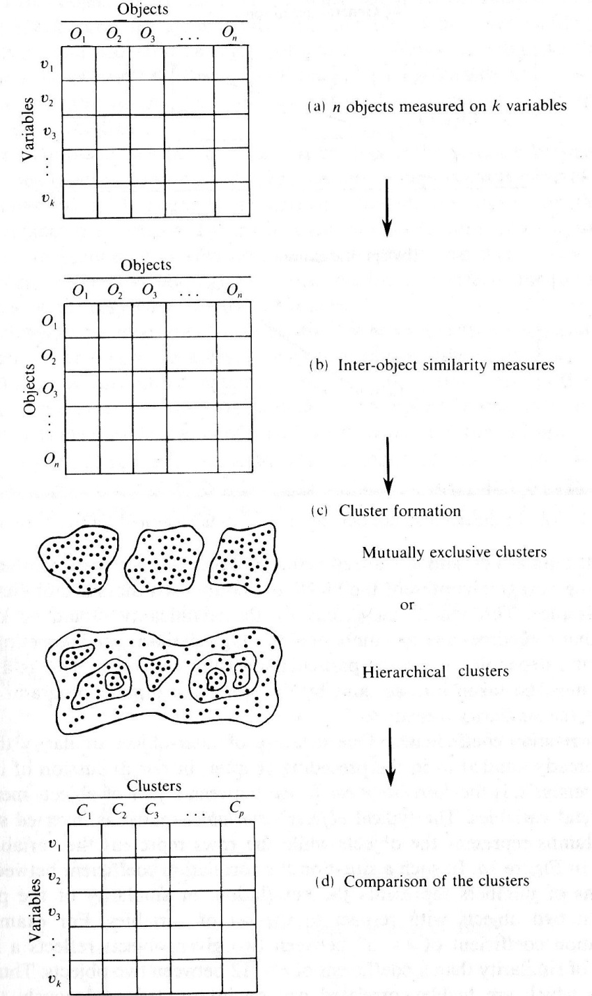
Cluster Analysis
Clustering is an unsupervised learning algorithm.
Clustering is a useful technique for grouping data points such that points within a single group or cluster are similar, while points in different groups are different.
An Outline of Cluster Analysis Procedure. (Kachigan, 1991)

Slide 4
Cluster Analysis: Application
Marketing
Cluster analysis is used as the methodologies for understanding of the market segments and buyer behaviors.
For example, B. Zafer et al. (2006), Ya-Yueh et al. (2003), Vicki et al. (1992) , Rajendra et al. (1981) , Lewis et al. (2006) , Hua-Cheng et al. (2005)
Market segmentations using cluster analysis have been examined in many different industries.
For instance, finance and banking (Anderson et al, 1976, Calantone et al, 1978), automobile (Kiel et al, 1981), education (Moriarty et al, 1978), consumer product (Sexton, 1974, Schaninger et al, 1980) and high technology industry (Green et al, 1968).

Slide 5
Cluster Analysis for Outlier Detection
An Outlier is an observation that deviates so much from other observations as to arouse suspicion that it is generated by a different mechanism (Hawkins, 1980)
Literatures find outliers as a side-product of clustering algorithms (Ester et al, 1996; Zhang et al, 1996; Wang et al. 1997; Agrawal et al. 1998; Hinneburg and Keim 1998; Guha et al, 1998..)
Distance-based outliers (Knorr and Ng, 1998, 1999; Ramaswamy et al., 2000)
Cluster-based outliers (Knorr and Ng 1999; Jiang et al, 2001, He et al, 2003 ;Duan et al, 2009;)
Research Question:
How can we apply clustering models for detection of abnormal (fraudulent/erroneous) transactions in continuous auditing?

Slide 6
The Setting: Group Life Claim
Purpose
To detect potential fraud or errors in the group life claims process by using clustering techniques
Data
Group life claim from a major insurance company from Q1: 2009
Approximately 184,000 claims processed per year (~40,000 claims per quarter)

Slide 7
Group Life Claims Processing System (BIOS)
Group Life Business Units
Claims
Billing
Underwriting
Reject/Deny Claim
Claim receipt & setup
(Note A)
No
Countersignature required for amounts over approving authority
Claim Examiner gathers additional information and approves if within approving authority $ Limits
Data Entry & Automated System Review by Claim Reviewer
No
Assign Unique Claim Numbers
Yes
Yes
Record & Payment Processing (Note B)
No
Claim level details ran against plan business rules, state requirements, plan options
If Clean Form (meets standard requirements) and under $10,000 then auto-adjudicated
Yes
Treasury Workstation (TWS)
Note A: The Key elements of a claim include Employer’s Statement, Beneficiary designation and Enrollment Forms are submitted via the online system . Claimant’s statement and death certificate are submitted via paper. All paper documents supporting the claims are imaged.
Note B: Payments are made to beneficiary(s) in one instance but can be made to multiple beneficiaries.

Slide 8
Clustering Procedure
Clustering Algorithm:
K-mean Clustering
Attributes:
Percentage: Total interest payment / Total beneficiary payment
N_percentage=(percentage-MEAN)/STD
AverageCLM_PMT: Average number of days between the claims received date to payment date (the weighted average is used because a claim could have multiple payment dates)
N_AverageDTH_PMT=(AverageDTH_PMT-MEAN)/STD
DTH_CLM: Number of days between the death dates to claim received date.
N_DTH_CLM=(DTH_CLM-MEAN)/STD
AverageDTH_PMT: Average number of days between the death dates to the payment dates (the weighted average is used because a claim could have multiple payment dates)
N_AverageDTH_PMT=(AverageDTH_PMT-MEAN)/STD
DTH
CLM
PMT

Slide 9
Cluster centroids:
 | Cluster#
Attribute |  | Full Data | 0 | 1 | 2 | 3 | 4 | 5 | 6 | 7
 |  | (40080) | (2523) | (54) | (84) | (222) | (295) | (31) | (768) | (36103)
N_AverageDTH_PMT |  | 0 | 0.6374 | 15.177 | 3.5419 | 6.9858 | 0.8778 | 10.9006 | 2.7806 | -0.1937
N_percentage |  | 0 | 0.2666 | 1.8334 | 9.3405 | 0.5042 | 3.4637 | 26.6913 | 0.3185 | -0.1057
Clustered Instances
0 2523 ( 6%)
1 54 ( 0%)
2 84 ( 0%)
3 222 ( 1%)
4 295 ( 1%)
5 31 ( 0%)
6 768 ( 2%)
7 36103 ( 90%)
Attributes:
N_AverageDTH_PMT: Normalized Average number of days between the death dates to the payment dates (the weighted average is used because a claim could have multiple payment dates)
N_Percentage: Normalized Total interest payment / Total beneficiary payment

Slide 10
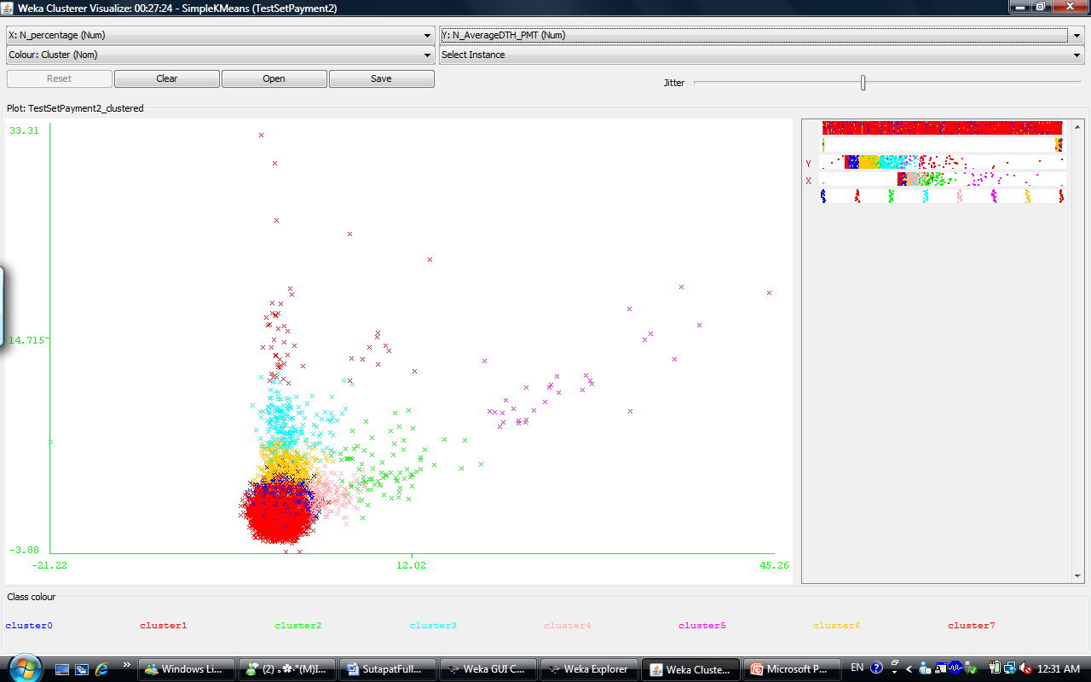
Cluster1: 54 claims
Cluster2: 84 claims
Cluster5: 31 claims

Slide 11
Cluster centroids:
 | Cluster#
Attribute | Full | Full Data | 0 | 1 | 2 | 3 | 4 | 5 | 6 | 7 | 8 | 9 | 10 | 11 | 12
 |  | (40080) | (510) | (343) | (194) | (98) | (3699) | (30) | (1275) | (741) | (32658) | (286) | (39) | (110) | (97)
N_AverageCLM_PMT |  | 0 | 3.33 | 5.85 | 1.12 | 0.93 | 0.27 | 1.08 | 1.44 | -0.02 | -0.26 | 0.33 | 1.28 | 9.81 | 4.04
N_DTH_CLM |  | 0 | 0.05 | 0.29 | 5.63 | 9.27 | -0.10 | 11.51 | -0.11 | 0.83 | -0.13 | 2.89 | 17.31 | 0.40 | 0.49
N_AverageDTH_PMT |  | 0 | 1.24 | 2.37 | 5.64 | 8.93 | 0.01 | 11.06 | 0.40 | 0.78 | -0.21 | 2.79 | 16.50 | 3.80 | 1.90
N_percentage |  | 0 | 0.21 | 0.16 | 1.78 | 0.66 | 0.11 | 26.89 | 0.51 | 0.48 | -0.12 | 1.00 | 2.22 | 0.30 | 7.78
Clustered Instances
0 510 ( 1%)
1 343 ( 1%)
2 194 ( 0%)
3 98 ( 0%)
4 3699 ( 9%)
5 30 ( 0%)
6 1275 ( 3%)
7 741 ( 2%)
8 32658 ( 81%)
9 286 ( 1%)
10 39 ( 0%)
11 110 ( 0%)
12 97 ( 0%)
Attributes:
N_AverageCLM_PMT: Normalized average number of days between the claim received date to the payment dates (the weighted average is used because a claim could have multiple payment dates)
N_DTH_CLM: Normalized number of days between the death date to the claim dates
N_AverageDTH_PMT: Normalized Average number of days between the death dates to the payment dates (the weighted average is used because a claim could have multiple payment dates)
N_Percentage: Normalized Total interest payment / Total beneficiary payment

Slide 12
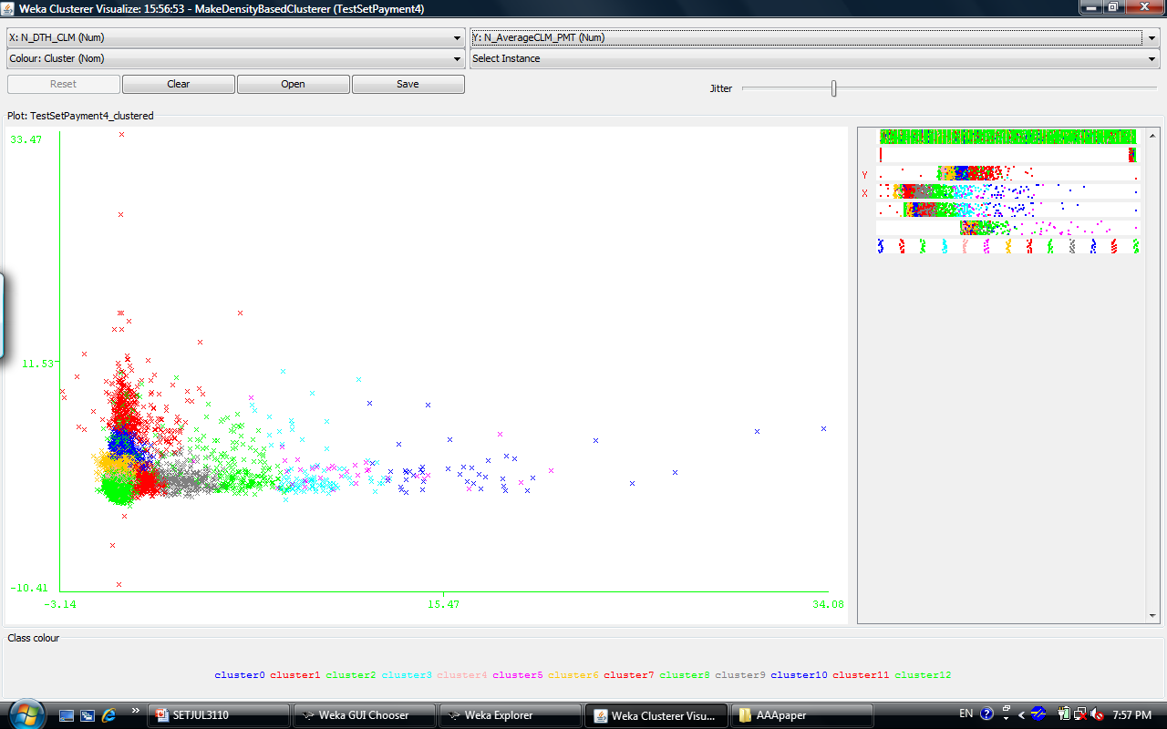
Cluster 2:194 claims
Cluster 3:98 claims
Cluster 5:30 claims
Cluster 10:39 claims
Cluster 11:110 claims
Cluster 12:97 claims

Slide 13
Distance-Based Outliers
A distance-based outlier in a dataset is a data object having a distance far away from the center of the cluster.
Probability distribution over the clusters for each observation is calculated.
The observations which has lower than 0.6 would be identified as possible outliers.
CLM_ID | Cluster0 | Cluster1 | Cluster2 | Cluster3
20808005145 | 0.00021 | 0.806916 | 0.000961 | 0.191913
20808005307 | 0 | 0.114174 | 0.002238 | 0.883588
20808005512 | 0.000075 | 0.973995 | 0.000095 | 0.025835
20808007974 | 0.96161 | 0.036733 | 0.000011 | 0.001646
….. | … | … | … | ..

Slide 14
Distance-Based Outliers
Simple K-mean: 2 attributes
Simple K-mean: 4 attributes
Cluster | Outliers
Cluster 0 | 154
Cluster 1 | 0
Cluster 2 | 6
Cluster 3 | 9
Cluster 4 | 22
Cluster 5 | 2
Cluster 6 | 36
Cluster 7 | 96
Cluster | Outliers
Cluster0 | 31
Cluster1 | 21
Cluster2 | 7
Cluster3 | 2
Cluster4 | 205
Cluster5 | 2
Cluster6 | 49
Cluster7 | 46
Cluster8 | 157
Cluster9 | 11
Cluster10 | 0
Cluster11 | 12
Cluster12 | 4

Slide 15
Results: Distance-based AND Cluster-based outliers
Cluster Analysis | Cluster-Based Outliers | Distance-Based Outliers
Cluster Analysis with 2 Attributes | 169 | 325
Cluster Analysis with 4 Attributes | 568 | 547
Cluster-based outliers can be used to identify clusters with smaller populations as outliers.
Distance-based outliers can be used to identify specific observations from clusters as outliers.

Slide 16
Limitations
Cluster Analysis always generates clusters, regardless of the properties of the data-set. Therefore, the interpretation of the results might not be clear.
Identification of anomalies will have to be verified.
Future Research
More attributes related to other aspect of the claims would be used .
Rule-based selection processes would be incorporated to help in identification of anomalies.
Notes:
16

Slide 17
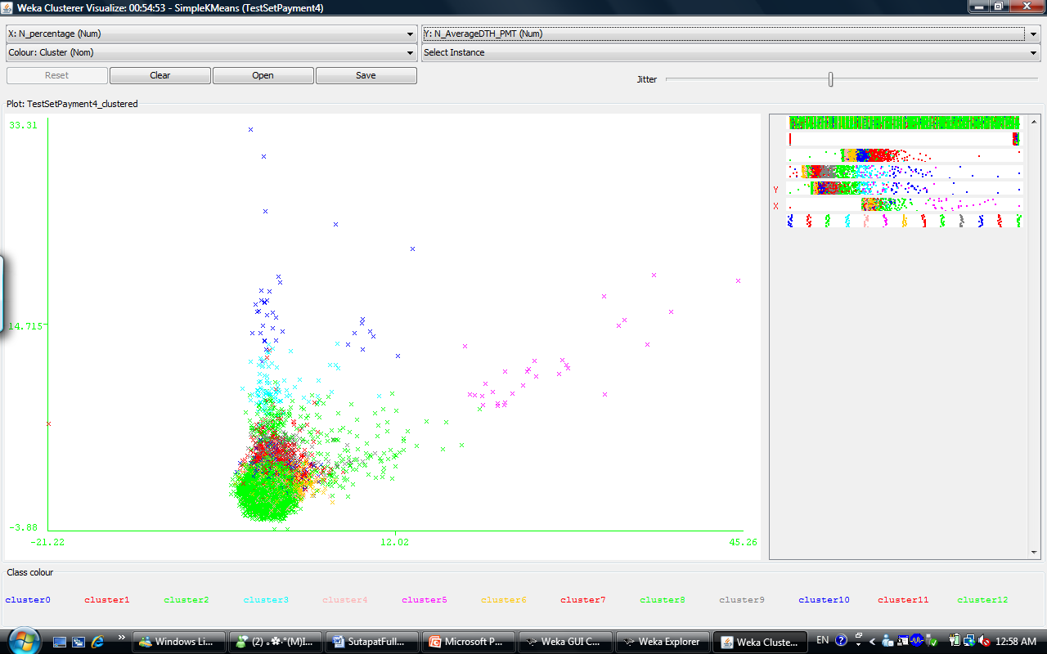
Cluster 2:194 claims
Cluster 3:98 claims
Cluster 5:30 claims
Cluster 10:39 claims
Cluster 11:110 claims
Cluster 12:97 claims

Slide 18
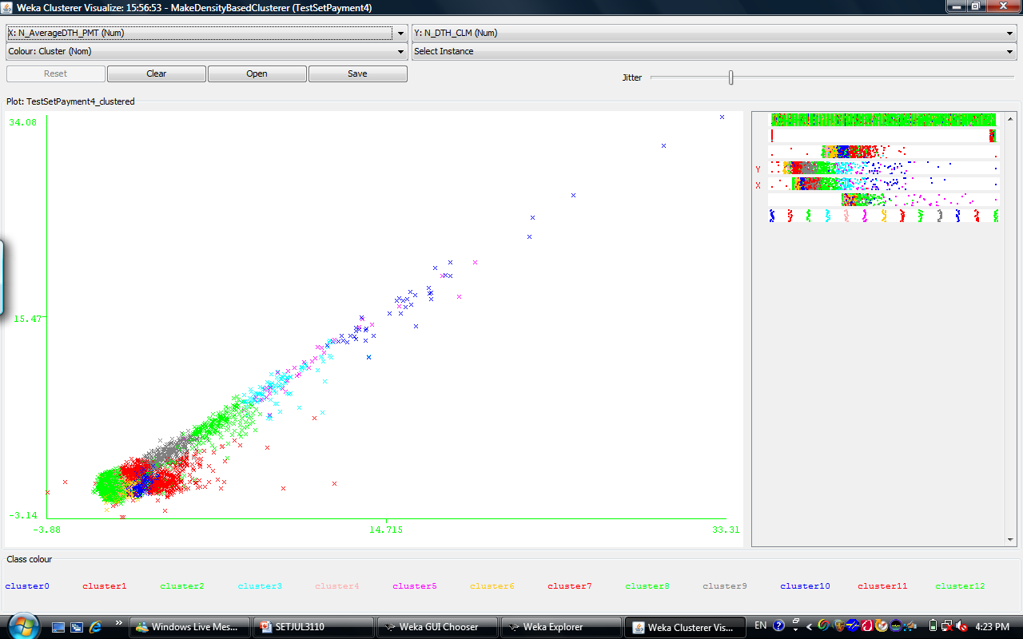
Cluster 2:194 claims
Cluster 3:98 claims
Cluster 5:30 claims
Cluster 10:39 claims
Cluster 11:110 claims
Cluster 12:97 claims

