Slide 1
Auditing, the Technological Revolution, and Public Good
Miklos A. Vasarhelyi
KPMG Distinguished Professor of AIS
Rutgers Business School
June 30, 2017
PIOB, MADRID

Slide 2
THE STORY
The world is rapidly changing, technology enables a 365/24/7 economy
How has the audit profession evolved?
Some major transformations…
Robot arm is developed for assembly lines
First virtual reality glasses and gloves
Deep Blue defeats chess player
Sampling is introduced
IT audit becomes common
Move to Risk-based approach
Smart Phone is developed
Disclose audit fees
Driveless cars
Adopts KAM
Society
1970s 1980s 1990s 2000s 2010s
Audit
Source: PwC 2017 and Matthews 2006

Slide 3
DILEMMAS
Technology is moving much faster than its adoption in the assurance arena
If analytic methodologies find a material error how do you deal with prior periods?
What happens if in full population testing you find many thousands of exceptions?
If you are monitoring transactions and assuring before they go downstream is that substantive testing or control testing?
If analytic methodologies are not covered in the CPA exam how can the students be interested?

Slide 4
Public Good
Adopt the audit data standard to create an easy interconnectivity of audit technology
Create an experimentation period of dual or multiple audit standards
Reengineer and re-imagine the structures of accounting and audit education
Collaborate among the monitoring and standard setters to accelerate and improve accounting and audit standards

Slide 5
Outline
The Continuous Audit and Reporting Lab
Big Data and Analytics
  Analytics – the RADAR Project
  A Cognitive Assistant
  Deep Learning in Assurance
  Smart contracts using blockchain
  Exogenous Process Assurance
Imagineering Audit 4.0
Issues and what can be done now

Slide 6
The CarLab
Continuous Audit and Reporting Laboratory
  Graduate School of Management
  Rutgers University

Slide 7


Slide 8
An evolving continuous audit framework
Continuous
Audit
Continuous Risk
Monitoring and
Assessment
Automation
Sensing
ERP
E-Commerce
Continuous
Audit
Continuous
Control
Monitoring
Data
Notes:
8

Slide 9
CRMA
CDA
CCM
KPMG
Sigma Bank
HP
Itaú-Unibanco
Verizon
GL
KPIs/KRIs
PPP
Credit Card Insurance
A/P
Process Mining
PPP Insurance
IDT
P&G
Itaú- UniBanco
AT&T
Duplicate Payments
Inventory Dashboard
HCA
Duratex
Siemens
Supply Chain
A/P
Met-Life
Continuous Control
Monitoring
P&G
J+J
Talecris / ACL
CA Technologies
Claims Wires
American Water / Caseware
Inventory
FCPA Sales Commission
FCPA
Audit Automation
P&G: Order to Cash
Auditor Judgment
Siemens- AAS Automation
AICPA – ADS / APS
Audit Methodologies
Multidimensional Clustering
Process Mining
Continuity Equations
Predictive Auditing
Visualization
Analytic Playpen
Deep Learning
Blockchain and Smart Contracts
Cognitive decision assistant
Notes:
M

Slide 10
Big data

Slide 11
BIG
DATA
Clickpath
Analysis
Automatic collection
IoT
data
Mobility
data
Multi-URL
Analysis
Web data
Where are / were you?
Hand collection
Scanner
data
Traditional data
What did you buy?
ERP data
Security
videos
legacy data
What Products relate?
Can you predict results?
Buffer
os
Social media
Can you control inventory online?
Newspieces
E-mails
Media recordings
Can you keep real time inventory?
Media programming
videos
Can you audit inventory real time ?
Security recordings
Telephone recordings
3 Vs: Volume, Variety & Velocity

Slide 12
Analytics

Slide 13
Data Analytics
Illustration: Revenue Three-Way Match
Entity ABC has revenue of €125 million generated by 725,000 transactions. The three way match procedure is executed with the following results:
 | Amount (€) | % | Number of Transactions | %
No differences | 119,750,000 | 95.8 | 691,000 | 95.3
Outliers:
Quantity differences | 3,125,000 | 2.5 | 16,700 | 2.3
Pricing differences | 2,125,000 | 1.7 | 17,300 | 2.4
Note: Materiality for the audit of the financial statements as a whole is €1,000,000.

Slide 14
Illustration 2– Predictive Analytic (cont.)
Data and Model Description
Data Analytics
Data Analytics
Objective: Predict revenue at the store level (approximately 2,000 stores) for a publicly held retail company using internal company data and non-traditional data (e.g., weather).
Forecasting daily store level sales (one step ahead forecasting).
Multivariate regression model with / without the peer store indicator and weather indicators.
AR(1)+…+AR(7) with / without the peer store indicator and weather indicators.

Slide 15
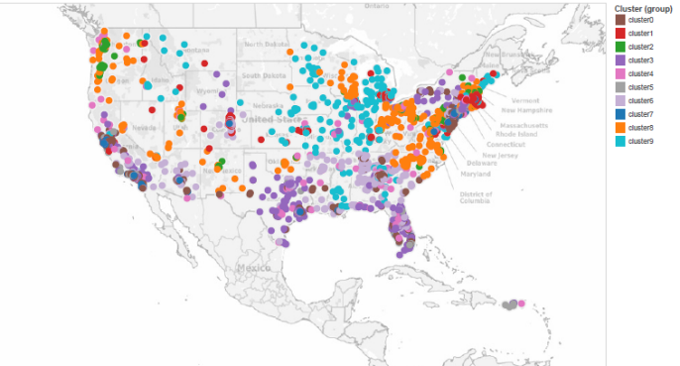
Illustration 2 – Predictive Analytic (cont.)
Clustering Using Store Sales by Peer Group
Data Analytics
Data Analytics

Slide 16
Illustration 3 – Clustering
Data Analytics
Multidimensional clustering is a powerful tool to detect groups of similar events and identify outliers – Audit Sampling (AS 2315)
Can be used in most set of data examination procedures (preferably with a reduced set of data).
Looking for anomalous clusters and outliers from the clusters - Statistically complex.
Multidimensional Clustering for audit fault detection in an insurance and credit card settings and super-app Sutapat Thiprungsri, Miklos A. Vasarhelyi, and Paul Byrnes

Slide 17
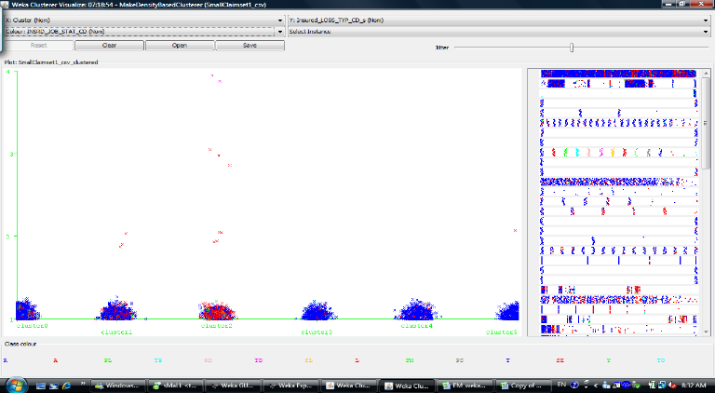
Illustration 3 – Clustering (cont.)
Data Analytics

Slide 18
Data Analytics
Illustration 3 – Clustering (cont.)
Some of the Challenges that Arise
What audit evidence does data analytics create?
Is clustering a risk assessment procedure, substantive procedure, or both?
What follow-up on outliers is necessary? Materiality?
Is it appropriate to reduce other substantive tests with clustering?
Should there be guidance of acceptable level of variance?
If auditors (or others) are developing applications for use in the audit, what quality control should be performed to verify that the application is fit for purpose, technically sound etc.?
Should there be an experimentation period to create guidance for clustering / predictive analytics/ etc?

Slide 19
RADAR
Rutgers AICPA Data Analytics Research Initiative

Slide 20
The RADAR project
Rutgers, AICPA, CPA Canada, and 8 largest firms
Started officially in June 2016
3 projects currently
  Exceptional Exceptions (MADS)
  Process Mining
  Visualization as Audit Evidence

Slide 21









Multidimensional Audit Data Selection (MADS)
Traditional sampling
approach
New approach
MADS
Whole Transaction Data
(Entire Population)
Advance in data processing ability & data analytic techniques allows auditors to evaluate the entire population instead of examining just a chosen sample.
Auditors’ judgment-based filters –
3-way match procedure
Notable Items
BUT, often generate large numbers of outliers.
Impractical for auditors to investigate entire outliers
Outlier Detection Techniques – Additional filters
Exceptions
Crucial to develop a method that can help auditors effectively deal with large amounts of data, but also assist them to efficiently handle a massive number of outliers.
Prioritization
Prioritized
Exceptions

Slide 22
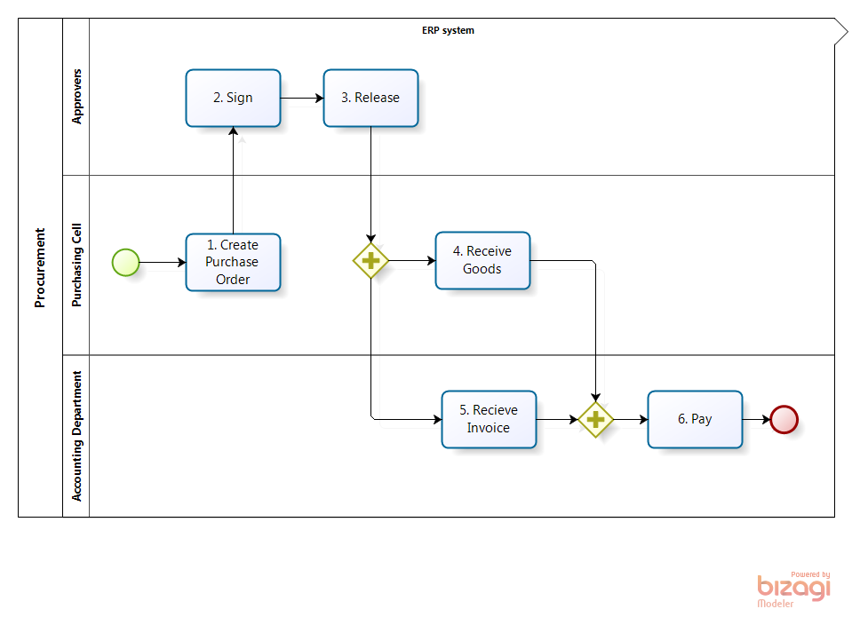
Analytics for Internal Control Evaluation through Process Mining

Slide 23
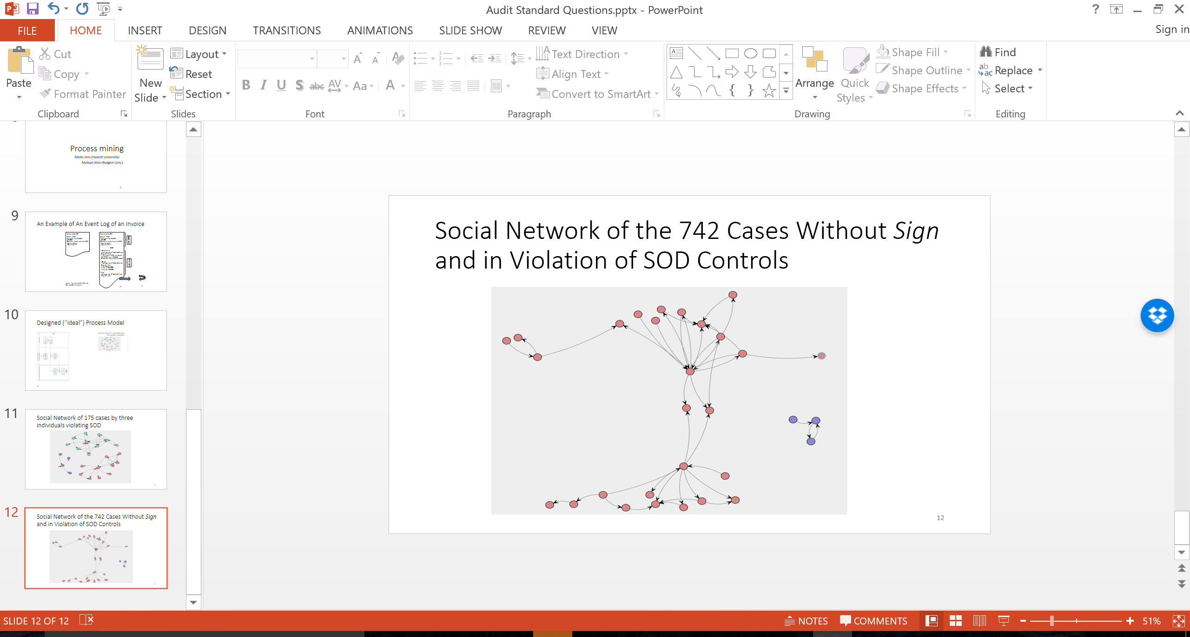
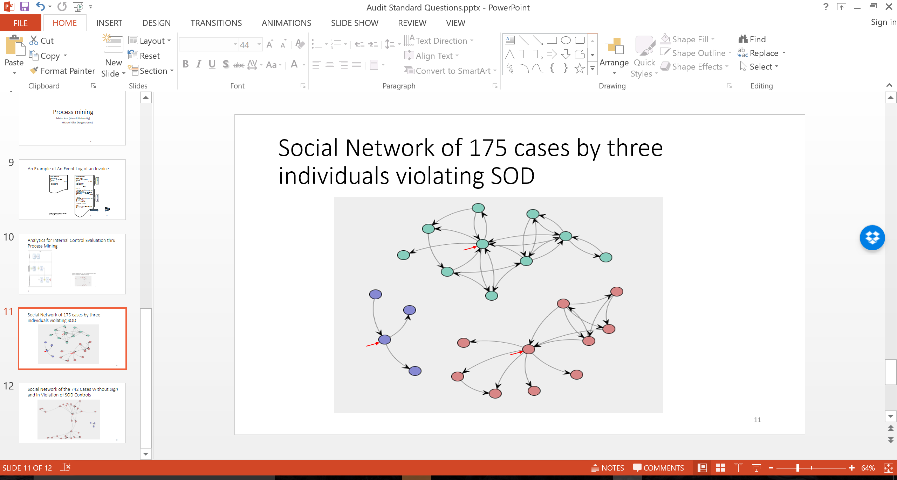
Analytics for Internal Control Evaluation through Process Mining

Slide 24
Visualization in Audit Process
Risk Assess-ment
Develop Audit Plan
Obtain Audit Evidence
Review and Reporting
Understand client’s business and industry
Assess client business risk
Perform preliminary analytical procedures
Understand internal control and assess control risk
Assess fraud risks
Perform Subsequent events review
Issue audit report
Assess engagement quality
Substantive tests of transactions
Perform analytical procedures
Test of details of balances

Slide 25
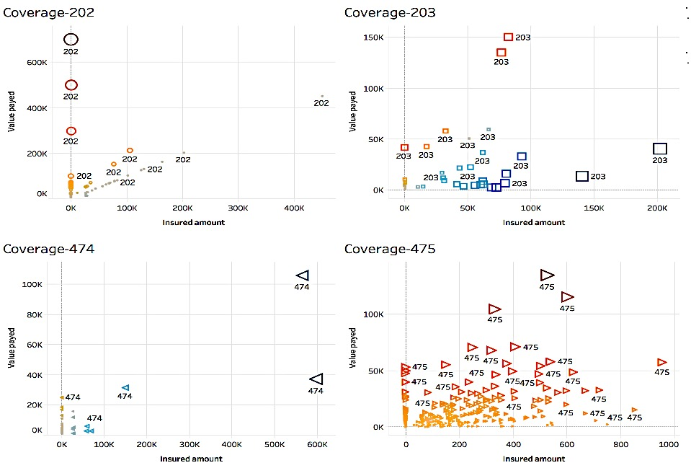
Dashboard: investigate the relationship between insured amount and actual payment amount by different coverage codes for the individual claims

Slide 26
Developing an intelligent cognitive assistant for brainstorming meeting in audit planning and risk assessment
Qiao Li
Miklos Vasarhelyi
2017/5/2

Slide 27
Proposed Framework for the Intelligent System
User Interface
1. Brainstorming Discussion Procedures
Industry – Update understanding -
New events - Significant account - …
Knowledge Base
2. Recommended Topics
E.g., Revenue
Sources, amounts (month, quarter, year), new customer contracts; new suppliers, changes in standards…
Web
Structured data
Text Resources
3. Decision Support Functions (Buttons)
Info retrieval
Query
Help
Comparison
Calculation
Standards
Web search
Skip
Notes:
A system-driven assistant for barnstorming discussion, make the process more standardized, and kpmg can tailor this procedure based on needs
Based on vpa, now we have a pre-determined procedures for the discussion
For each step, we collect from VPA about the knowledge, we capture the topic
How to build our own categories of knowledge
Apple’s Siri is an example of a QA system that exploits the knowledge-based approach. In hybrid QA systems, like IBM’s Watson, while the question is semantically analyzed, candidate answers are generated using the IR methods.

Slide 28
Proposed Framework for the Intelligent System
- A directive system based on VPA analysis
User Interface
Brainstorming Discussion Procedures
Industry
Update understanding
New events/ areas
Significant account
Business Risks
Fraud Risks
Going Concern
Accounting policies
IT controls
Related Parties
Other topics
End &Documenting
Start
Enter
Record
2. General understanding:
Company information
Business strategy
……
Skip
1. …
3. …
4. Financial risk – account level
Revenue
Cash flow
……
5. …
6. …
…
Recommended topics
Revenue
Sources
……
Decision support functions (Buttons)
Info retrieval
Query
Comparison
Calculator
Help
Standards
Skip
Web search
Structured data
Text Resources
Web
Knowledge base
Notes:
A system-driven assistant for barnstorming discussion, make the process more standardized, and kpmg can tailor this procedure based on needs
Level1: Based on vpa, now we have a pre-determined procedures for the discussion
Level2: For each step, we collect from VPA about the knowledge, we capture the topics, they can be richen and extended if we have more vp or we have users to train the prototype
How to build our own categories of knowledge
Apple’s Siri is an example of a QA system that exploits the knowledge-based approach. In hybrid QA systems, like IBM’s Watson, while the question is semantically analyzed, candidate answers are generated using the IR methods.

Slide 29
Important modules in the system
Strategy:
Piggybacking modules from other domain (such as Siri) to support the system
Components of the cognitive system
List of Modules
Natural Language User Interface
1. Procedures learned from VPA
Speech Recognition
2.Recommended topics learned from VPA
Natural Language Processing
QA system
3. Functions developed based on VPA
Personal context awareness
4. Knowledge organization
Service delegation system
Text-to-speech
Notes:
The speech recognition systems makes use of sophisticated Machine Learning techniques like Convolutional Neural Networks and Long short-term memory
predict what you're getting at based on key words that you use, as well as your general habits and language choice. She is designed to adapt to your individual preferences over time and personalise results
Computer monitor what people usually do in one step. E.g., check micro economy, if a person didn’t do it, suggest him (others also check…)

Slide 30
Deep Learning in Auditing
Ting Sun
And
Miklos A. Vasarhelyi

Slide 31

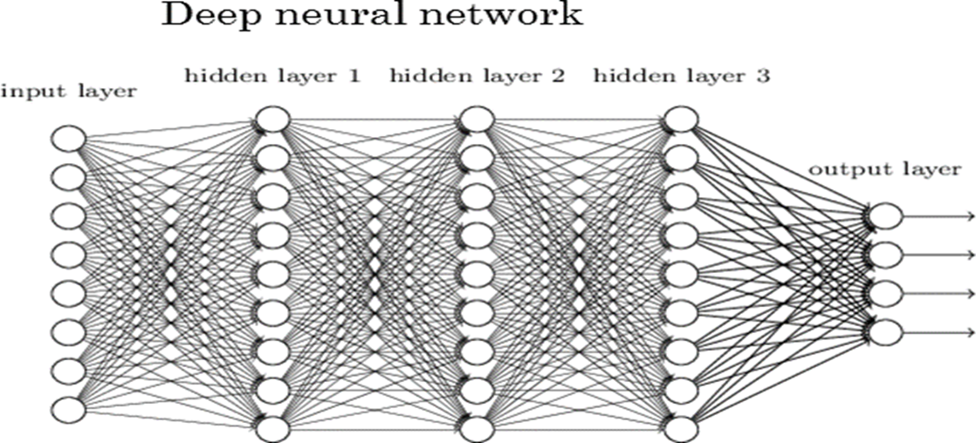


Background:
Deep learning
An example: a face recognition deep neural network
Deep learning employs deep neural networks to simulate how the brain learns.
object models
object parts
(combination
of edges)
edges
pixels

Slide 32
Dissertation Essays
Research 1. The incremental informativeness of management sentiment for internal control material weakness prediction:
An application of deep learning to textual analysis for conference calls
Research 2. The performance of sentiment feature of 10-K MD&As for financial misstatements prediction:
A comparison of deep learning and bag of words approach
Research 3. Do Social Media Messages Provide Clues for Audit Planning?
- An Application of Deep Learning Based Textual Analysis of Tweets to Audit Fee Prediction

Slide 33
Smart contracts using blockchain
Jamie Frieman and Miklos A Vasarhelyi

Slide 34



Proposed Environment
Transaction/event occurs
Received by blockchain system and relevant smart contracts are activated.
Relevant information for analysis located
Relevant requirements are retrieved
Entry Posted(if applicable)
Transaction Rejected
Transaction Accepted
Parties Notified
Parties Notified (if applicable)
Loaded to block

Slide 35





Proposed Environment cont.
Validated transactions/events are compiled to form a block
The new block is time stamped and added to the existing chain
Auditors
Management
Shareholders
Armchair Auditors

Slide 36
Assurance with exogenous (big) data
Can a system (data) be audited without going directly into the client data?

Slide 37
Can there be auditing without getting data directly from the client?
Of course assertions by management are needed (to be verified)
Big data provides a plethora of information progressively more and more relevant
Moon (2016) showed that social media can indicate variances in revenue streams (his CRMA dissertation)
Revenues show high correlation with items such as advertising, social media utterances, supply chain flows, transactions in electronic purchases, IoT measures, etc.
Costs can be associated to online prices, third party orders, process discontinuities, etc.
Most models until more research is performed are ad hoc

Slide 38
Can there be auditing without getting data directly from the client? (cont)
The level of probable error on these measurements is clearly larger but much less susceptible to tampering
Easier (likely) to create a continuous reporting system that can serve for assurance
Standards would have to radically change
IS THIS AUDITING?

Slide 39
Exogenous Evidence Integration
What data will be considered evidence?
Measurements | Measurement variables | Assurance of | Quality compared with traditional
Facebook/twitter/news mentions | Name mentions Positive / negatives Sentiment Text meaning | Risk faced Product popularity Sales level | Different
Calls / mails to customer services | Classification of type and outcome by agent | Reserve for product replacement Bad debt estimates | Different
Internet of Things (IoT) records of equipment usage | Sensor data (e.g. weather data) | External Verification | Better
Face recognition of clients | Metadata of videos and pictures: time, location, identity of the person | Fraud | Less accurate but exogenous so it is not intrusive
Video footage | Number of cars in parking lots | Estimates of sales revenue | Less accurate, but more difficult (costlier) to falsify
Geo-locational data | GPS coordinates Zip codes | Efficiency Fraud (collision) FCPA (kickbacks) | Accurate

Slide 40
Automating the audit

Slide 41
Audit Production Line
Phase | AI-Enabled Automated Audit Process | Traditional Audit Process
Pre-planning | -AI collects and analyzes Big Data (exogenous) -Data related to the client’s organizational structure, operational methods, and accounting and financial systems feed into AI system | -Auditors examines client’s industry -Auditor examines client’s organizational structure, operational methods, and accounting and financial systems
Contracting | -AI uses the estimate of the risk level (from phase 1) and calculates audit fees, number of hours -AI analyzes a database of contracts & prepares contract -Auditor and Client sign contract | -Engagement Letter prepared by the auditor based on the estimated Client risk -Auditor and client sign contract
Understanding Internal Controls and Identifying Risk Factors | -Feed flowcharts, questionnaire answers, narratives, into AI and use image recognition and text mining to analyze them -Use Drones to conduct the walkthrough, then use AI to analyze the generated video -Use visualization and pattern recognition to identify Risk factors -AI aggregates all this data to Identify Fraud and illegal acts risk factors | -Document understanding (flowcharts, questionnaires, narratives, walkthrough) -Auditor aggregates this information and uses their judgment to identify risks factors -Understanding of IC to determine the scope, nature, and timing of substantive tests.
Control Risk Assessment | -Continuous Control Monitoring Systems examine controls continuously -AI runs Process mining to verify proper IC implementation -Logs are automatically generated to ensure their integrity. | -Examination of the client’s IC policies and procedures -Risk assessment for each attribute -Test of controls -Reassess risk -Document testing of controls.

Slide 42
Audit Production Line (Continued)
Phase | AI-Enabled Automated Audit Process | Traditional Audit Process
Substantive tests | -Continuous Data Quality Assurance to ensure quality of data and evidence -AI examines data provenance -Continuous test of details of transactions on 100% of the population -Continuous test of details of balances (at all times) -Continuous pattern recognition, outlier detection, benchmarks, visualization | -Periodical Sampling-based tests, and nature, extent, and timing depend on IC tests -Tests of details of a sample of transactions -Test of details of balances (at a certain point in time) -Analytical procedures
Evaluation of Evidence | -This becomes part of the previous phase | -Auditor must evaluate the sufficiency, clarity, and acceptability of collected evidence. Accordingly, the auditor may either collect more evidence, or withdraw from engagement.
Audit Report | -AI uses a predictive model to estimate the various risks identified -Audit report can be continuous (graded 1-00 for example) rather than categorical (clean, qualified, adverse, etc.) | -Auditor aggregates previous information to issue a report -Report is categorical: Clean, qualified, adverse, etc.

Slide 43
Imagineering the future audit
The Thinking that must go into change

Slide 44
ASSURING INVENTORY and other things
Supliers
Sales
And managing
everything
Tracking merchandise path
Real time recording of sales & cash & receivables
E-commerce ordering
Real time inventory ordering, supplier managed inventory, product mix management
Real time detection of inventory receiving
Real time detection of inventory reduction
Inventory
GPS
RFID
GPS
Year end physical counts
Year end RFID counts
Month end RFID counts
Day end RFID counts
Every second RFID and GPS and e-commerce records

Slide 45
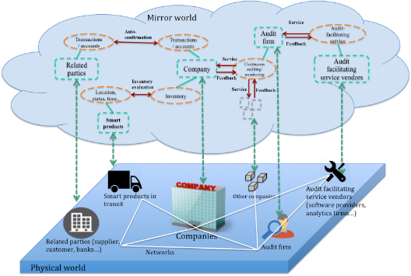
Basic Structure and Functions of Audit 4.0

Slide 46







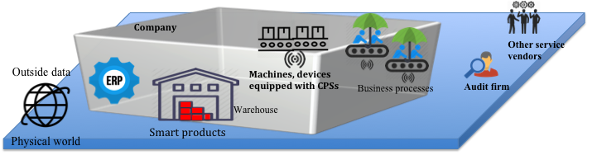
Linking Blockchain to Audit 4.0
Mirror world
Mirror world
Mirror world
Payment layer
Company’s wallet
Audit firms’ wallet
Smart control
layer
Fraud detection
Continuous auditing
Continuous monitoring
Process mining
Outside data
Accounting
data
IoT data
Non-financial information
System log
Blockchain layer
Notes:
Bring in steps
Talk about audit 4.0

Slide 47
Issues and what can be done now

Slide 48
AUDIT DATA standard

Slide 49



Use process mining to generate Audit Data Analytics plans
Use belief network to analyze results and provide further guidance
Audit
Data
Standards
App recommendation
Systems
Corporate data stores
ADA Plans
Assertion1:
Audit Procedure1
Assertion2:
Audit Procedure2
Assertion3:
Audit Procedure3…
Audit apps
Synthesize results and plan for further ADA
Audit
usable data
Final report

Slide 50
An experimentation program

Slide 51
An experimentation program for New GAAS
Objective:
To substantially accelerate the inclusion of modern analytic and monitoring methods and explore new forms of audit evidence.
Execution:
Agreement between the audit client, the audit firm, the standard-setter, and an academic institution (e.g. Rutgers University):
A safe harbor provision indicating the relaxation of existing audit standards (i.e. PCAOB, IAASB) on participating audit engagements.
Agreed upon procedures that will act as substitutes to traditional audit procedures.
The client IT team would provide access to presumably large amounts of system generated data (i.e. more data than in traditional engagements); the client’s IA team would participate in the program.
Specification of the audit area and engagement that will be targeted for examination.
The audit for the selected business process can be examined from its initial (i.e. planning) to concluding audit phase (audit wrap-up).

Slide 52
education

Slide 53
What should auditors know in Analytics
We need our staff to be aware of the tools and techniques that are available to them to address audit risks.
We need our professionals to be able to identify risks (frame out their questions) and to think about what data would be useful in addressing those risks (answer those questions).
Our auditors can leverage the skills of specialists in capturing and transforming that data. Our auditors need to think about how they could analyze that data and to visualize the data in order to provide the information or evidence necessary to reach their conclusion,
We have standard tools and data engineers to help build custom solutions.
Mike Leonardson (EY Leader of Analytics)

Slide 54
conclusions

Slide 55
Key Questions
Where in the audit of historical financial statements are these methods to be used?
How to create an experimentation period where supervised analytics projects are performed in real engagements?
How to deal with the economic limitations of using data analytic methods in audits?
How can human and device competencies be created?
How will data analytics impact regulators’ approaches and auditing standards?

Slide 56
Observation
It should be clear that the art of leveraging technology and data analytics will further enhance the quality of the audit and achieve better protection of the public interest.
Audit regulation has the power to accelerate the rate of adoption of analytics and this is a great opportunity for standard setting.

Slide 57
Public Good – Actions to consider
Adopt the audit data standard to create an easy interconnectivity of audit technology
Create an experimentation period of dual or multiple audit standards
Reengineer and re-imagine the structures of accounting and audit education
Collaborate among the monitoring and standard setters to accelerate and improve accounting and audit standards

Slide 58
Thanks!!
Contact me at
miklosv@rutgers.edu
Visit
http://raw.rutgers.edu

Slide 59
EXTRA slides

Slide 60
Resource:
Audit Data Analytics free on YouTube from the
Rutgers Curriculum
1. Introduction to Audit Analytics:
https://www.youtube.com/playlist?list=PLauepKFT6DK8nsUG3EXi6lYVX0CPHUngj
2. Special Topics in Audit Analytics:
https://www.youtube.com/playlist?list=PLauepKFT6DK-PpuseJtSMlIy-YBhaV4TH
3. Information Risk Management:
https://www.youtube.com/playlist?list=PLauepKFT6DK8uxePhPCoHjDf8_DlhRtGS
4. Tutorials for Risk Management:
https://www.youtube.com/playlist?list=PLauepKFT6DK9Grq8J67NMyGpYh1AsBb--
For more information please visit:
http://raw.rutgers.edu/accounting-courses.html

